Slide 1
The socio-economic gradient in teenagers’ reading skills: how does England compare to other countries?
John Jerrim, Institute of Education

Slide 2
Background
Social mobility has emerged as one of the key academic and political topics in the UK over the past decade
Economics:
- intergenerational income mobility has decreased in the UK
- Stronger association in the UK than elsewhere
Some disagreement by Sociologists about the above (Goldthorpe, Saunders)
Nevertheless, seems to be broad agreement that education is one of the key drivers of intergenerational persistence
Hence intergenerational educational mobility (i.e. link between family background and children’s attainment) a key topic in its own right

Slide 3
A model of intergenerational persistence
STAGE 1 (Early investments)
STAGE 2 (HE investment)
STAGE 3 (Labour market entry)
Heredity
Time inputs
Goods inputs
University graduation
Labour market outcomes
Family background
Child’s teenage skills
University entry
Three key stages:
Development of cognitive (and non-cognitive) skills
Investment in higher education
Labour market entry and outcomes

Slide 4
Focus today……..
STAGE 1 (Early investments)
STAGE 2 (HE investment)
STAGE 3 (Labour market entry)
Heredity
Time inputs
Goods inputs
University graduation
Labour market outcomes
Family background
Child’s teenage skills
University entry
Three key stages:
Development of cognitive skills
Investment in higher education
Labour market entry and outcomes

Slide 5
Aims of this paper
Document the relationship between family background and teenagers’ reading skills
How England currently compares to other countries on average
Is the association between family background and low achievement greater in England than other developed nations……………. ………….or is it that low SES children struggle to obtain the highest level of skill?
Is there evidence England has managed to weaken the association between family background and children’s outcomes over past decade?
Notes:
the OECD recently noted that the socio-economic gradient in England (in terms of children’s reading skills) is steeper than the international average

Slide 6
Benefits of international comparison

Slide 7
Why compare educational mobility cross-nationally
Some part of the association between parental abilities and children’s outcomes will be due to heredity.
Hence difficult to know whether our estimates of this association are “big”
Beller (2009) and Blanden (2009):
- Cross-national studies provide a comparative context
Other countries act as a benchmark. Can assess whether the association in England is particularly “weak” or “strong”
Becoming increasingly attractive with the advent of major international studies of children’s ability (e.g. PISA) over past decade

Slide 8
Comparator nations
Focus on comparison between England and the Anglophone countries (US, Canada, Australia) plus Germany and Finland
Countries England often compared with – particular focus of policymakers
Anglophone countries of particular interest given that they share a number of similar features (language, culture, historical ties, income inequality) but differ in terms of intergenerational mobility
Recent Sutton Trust social mobility summit focusing on the Anglophone countries
Also compare to wider selection of 22 OECD nations
Notes:
the OECD recently noted that the socio-economic gradient in England (in terms of children’s reading skills) is steeper than the international average

Slide 9
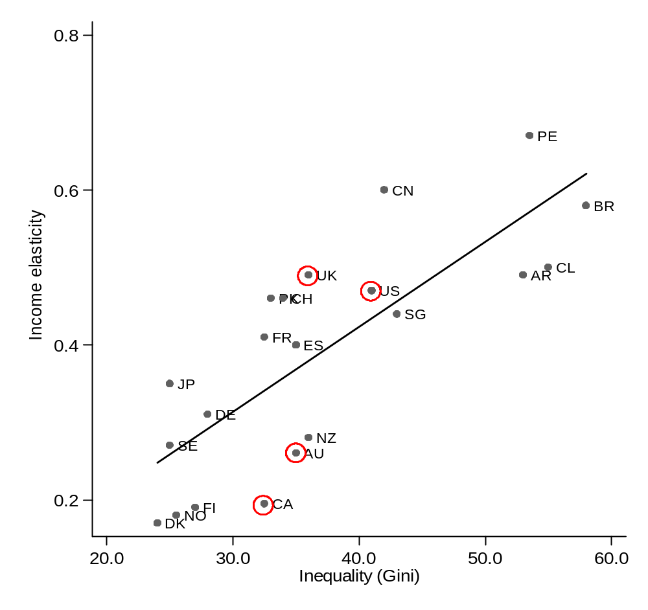
Inequality versus intergenerational income mobility
Anglophone countries similar in terms of income inequality…..
….. but intergenerational income elasticity bigger in UK/ US than Australia or Canada

Slide 10
Data

Slide 11
Data – PISA 2009
Study of 15 year-olds’ skills in reading, maths and science held every three years
Average response rate of both schools and pupils high (≈ 90%)
In 2009, reading was assigned the “major domain” (my focus)
40 test points ≈ 1 year of additional schooling
Family background – quintiles of parental occupation based on ISEI index.
Compare High SES (Top quintile) VS Low SES (Bottom quintile)
E.g. Doctors/Lawyers VS Labourers/Roofers

Slide 12
Methods

Slide 13
Model specification
Follow existing literature (Schuetz 2008, Woessman 2004) in estimating ‘capture all’ regressions with only basic controls (gender, immigrant status).
Hence estimates will reflect all the channels by which family background influences children’s performance
I focus on results for:
the most advantaged 20% in each country VS the least advantaged 20% (i.e. top versus bottom ISEI quintile)
On average, and at each decile of the PISA reading test distribution

Slide 14
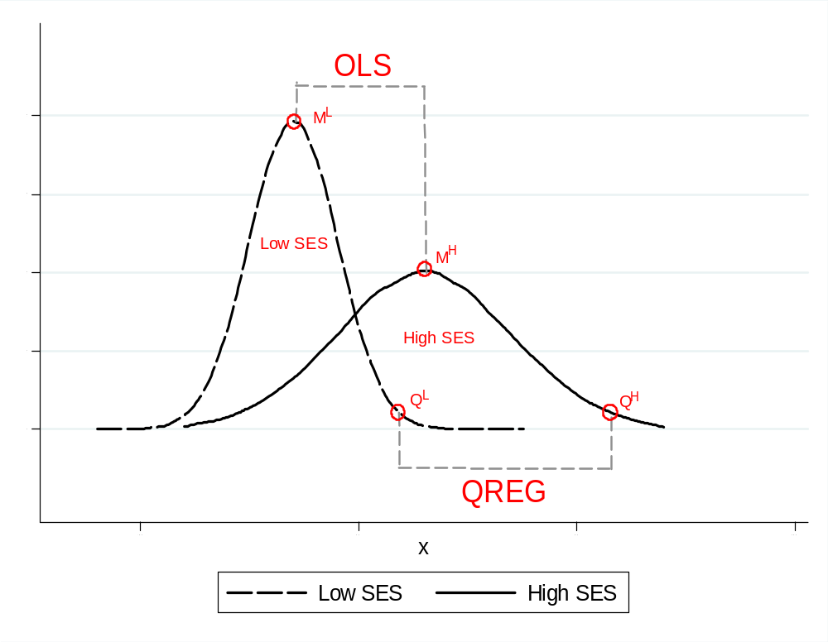
Methodology – OLS & Quantile regression

Slide 15
Results
Relationship between family background and test scores by ability: 2009

Slide 16
Results – Difference in average test scores

Slide 17
BUT the relationship between SES and high achievement in England seems particularly strong
Q10 | Q20 | Q30 | Q40 | Q50 | OLS | Q60 | Q70 | Q80 | Q90
IS* | IS* | IS* | IS* | IS* | IS* | FI* | FI* | FI* | FI*
FI* | FI* | FI* | FI* | FI* | FI* | IS* | IS* | IS* | IS*
NL | NO* | CA* | CA* | NO* | CA* | CA* | CA* | CA* | DE*
NO | CA* | NO* | NO* | CA* | NO* | NO* | DK* | ES* | CA*
CA | DK | DK | ES | ES* | DK* | ES* | NO* | DK* | DK*
CH | NL | CH | DK | DK* | CH | IE* | ES* | DE* | ES*
DK | CH | PL | CH | IE* | IE | DK* | IE* | NO* | IE*
GB(E) | IE | NL | IE | CH | ES | CH** | DE* | NL* | AT*
IT | PL | IE | PL | SE | NL | IT | CH* | IE* | CH*
IE | GB(E) | GB(E) | IT | IT | IT | PL | NL | CH* | NL*
SE | IT | ES | SE | AU | DE | AU | IT | IT** | IT*
PL | GB(S) | IT | AU | NL | PL | NL | PL | FR | NO*
GB(S) | ES | GB(S) | NL | PL | SE | SE | FR | PL | SE**
AU | SE | SE | GB(E) | GB(E) | AU | DE | AU | BE | PT**
ES | AU | AU | GB(S) | DE | GB(E) | PT | BE | AT | PL**
AT | CZ | CZ | FR | GB(S) | AT | FR | PT | AU | BE
CZ | PT | DE | CZ | PT | PT | GB(E) | SE | PT | AU
US | AT | PT | DE | FR | GB(S) | GB(S) | AT | SE | FR
DE** | US | FR | PT | CZ | CZ | CZ | GB(E) | GB(E) | CZ
PT* | DE** | US | US | AT | FR | AT | CZ | CZ | GB(E)
FR* | FR* | AT** | AT** | US | US | BE | GB(S) | GB(S) | US
NZ* | BE* | BE* | BE* | BE* | BE* | US | NZ | NZ | NZ
BE* | NZ* | NZ* | NZ* | NZ* | NZ* | NZ** | US | US | GB(S)

Slide 18
Quantile regression results
Comparatively Strong association between SES and high achievement

Slide 19
Results – Change over time
Evidence of change in family background effect: 2000-2009

Slide 20
Results – Change over time

Slide 21
……But caution is required
How comparable is PISA data over time for England?
I discuss this issue in another paper:
“England's "plummeting" PISA test scores between 2000 and 2009: Is the performance of our secondary school pupils really in relative decline?”
Some major changes to how survey is conducted……
- Test month
- Survey population
- Response rates
But evidence of weakening relationship between SES and educational attainment consistent with other papers (Gregg and Macmillan 2010; Sullivan et al, 2011)

Slide 22
Implications for policy
Access to “elite” universities and top professions require candidates to have high level skills…….
……but very strong association in England between SES and high achievement (SES gap > 2 years of schooling)
Such pathways are hence currently not viable options for most disadvantaged teenagers
Key to widening university access, entry to top professions and top end social mobility is to reduce the link between family background and high achievement

Slide 23
Possible policy options…..
Raising aspirations of disadvantaged young people (to boost attainment)?
Change incentives of schools / pupils away from “floor targets”?
Targeted gifted and talented schemes?
A return to CSE / O-Levels !!?

Slide 24
Conclusions
The difference between advantaged and disadvantaged children’s PISA 2009 reading test scores in England is similar (on average) to that in most other developed countries
Yet the association between family background and high achievement seems to be stronger in England than elsewhere
Some evidence of a reduction in the association between family background and average test scores since 2000
Any reduction that has happened since 2000 seems to have occurred due to a narrowing of SES differences at the bottom of the test distribution

