Slide 1
The socio-economic gradient in children’s reading skills and the role of genetics
Notes:
Introduce myself!
Teaching today about ‘distributional techniques’
Mainly focus on Qreg. But also cover some additional bits and pieces (e.g. kernel density estimation, bootstrapping)
Workshop – Apply these techniques. First look at STATA programming.

Slide 2
Background
Strong link between family background and later lifetime outcomes
Also strong link between SES and educational achievement
Many possible mechanisms by which these links may occur
E.g. Parental investment, cultural capital, scholarly culture etc

Slide 3
....one constantly recurring explanation is genetics
“the tendency to be unemployed may run in the genes of a family about as certainly as bad teeth do now”.
Herrnstein and Murray (1994)
“Sons and daughters from more prestigious origins may disproportionately end up in more prestigious destinations simply because they are more likely than offspring from less prestigious origins to inherit genes that allow entry into more prestigious destinations”
Nielsen and Roos (2011)

Slide 4
....Also evidence of a genetic link to reading skills
Estimates of heritability of reading skills / dyselxia from twin studies:
Light et al (1998) = 40%
Petrill et al (2006) = 40%
Gayan and Olson (2001) > 50%
Davies et al (2001) > 50%
Harlarr et al (2005) = 75%
These are big figures……..

Slide 5
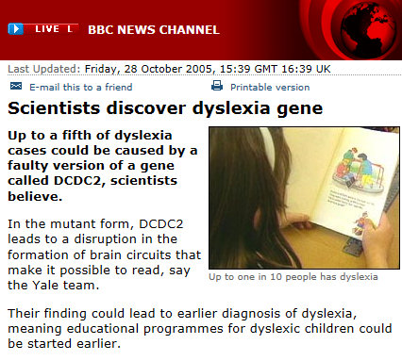
....Also bio-molecular evidence?
Paper by Scerri et al (2011) highlight three particularly promising candidate genes for dyslexia / reading skills (KIA30019, CIMP and DCDC2)

Slide 6
This paper
Three broad aims:
Re-investigate the link between the 3 most promising candidate reading skill genes and their association with children’s test scores.
To what extent can these three genes explain the large socio-economic gap in children’s? reading test scores?
Is there any evidence of gene-by-environment interactions

Slide 7
Data
ALSPAC
Children born in AVON in 1991 / 92
Numerous measures of reading test scores
- ALSPAC ‘clinic’ data (specific but quality?)
- KS 1 and KS 2 reading sub-tests
Genetic data collected as part of the study
Issues – missing data; few ethnic minorities
Sample size used = approx 5,000.

Slide 8
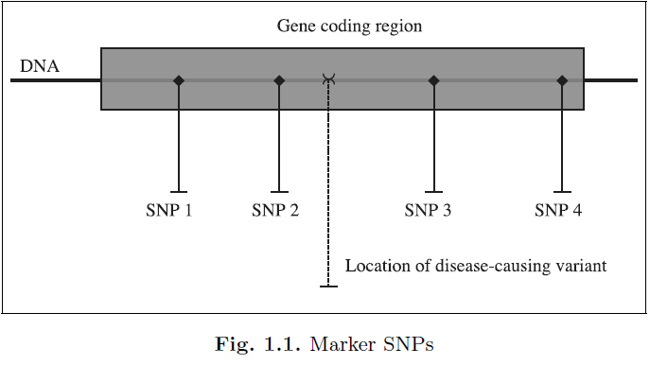
What is genetic data? (SNP’s)
Notes:
A gene comprises a region of DNA, representation a portion of the human genome = GREY SHADED AREA
‘Mutation’ at a single point within this gene leads to the ‘disease’ / problem.
BUT – the precise location of this point is unknown.
Instead researchers take several SNP’s which are highly correlated with ‘true’ disease causing varient.
E.g. In a situation of multiple proxies

Slide 9
SNP’s
For each SNP there are two ‘alleles’ (DNA bases)
Possible ‘values’ = A, T, G or C.
For each SNP each individual will fall into one of three mutually exclusive groups.
Example
At a given SNP, the alleles A and T may occur.
A is the more frequent in the population (‘wildtype’)
Each person then falls into one of the following:
AA = ‘Homozygous wildtype’
AT = ‘hetrozygous’
TT = ‘Homozygous rate’
WE HAVE THESE GROUPINGS FOR A NUMBER OF SNP’s IN THE ALSPAC DATA

Slide 10
‘Risk’ SNP’s / alleles for reading
A number of ‘risk’ SNP’s have been identified for reading skills.
Based partly on evidence from ALSPAC (Scerri et al 2011).
These are the SNPs we use in this paper
Gene | SNP | Major allele | Risk Allele
DCDC2 | rs793862 | G | A
 | rs807701 | A | G
 | rs807724 | T | C
KIAA0319 | rs9461045 | C | T
 | rs2143340 | A | G
CMIP | rs12927866 | C | T
 | rs6564903 | C | T
 | rs16955705 | A | C

Slide 11
Methods
Very simple regression models

Slide 12
i. Is there a link between genes & reading skills?
ii. Can genes explain the SES reading gap?
iii. Can genes explain the SES reading gap?

Slide 13
‘Allelic Trend Model’
Using terminology from genetic literature, these are ‘allelic trend’ models.
Basically means that the SNPs enter the model as continuous linear terms……
…..not as dummy variables as one might expect.
So coefficients give change in reading test scores for each additional risk allele (up to a maximum of 2).
Reason – maximise power.
Problems – ignores potential non-linearities.

Slide 14
Results
Re-considering the link between genes and reading skills

Slide 15
Replication of Scerri et al (KIAA0319)
Simple bi-variate association between snp and single word reading test scores

Slide 16
What happens when we use a different reading test measure?

Slide 17
What happens when we use different sample selection? (single word reading)
Notes:
Selection 1: As Scerri et al but children missing all age 7 to 9 clinic data are not automatically excluded
Selection 2: As selection 1 but with children missing IQ data not automatically excluded
Selection 3: As selection 2 but children with missing ethnicity data not automatically excluded
Selection 4: Full sample with only limited restrictions (white only, IQ>85, child never had speech therapy)

Slide 18
Results
Genes and socio-economic differences

Slide 19
Is genetic ‘risk’ unevenly distributed by SES?
All Chi-squared tests for association between SES and SNP insignificant

Slide 20
To what extent can these three genes explain the socio-economic gap?
Notes:
Selection 1: As Scerri et al but children missing all age 7 to 9 clinic data are not automatically excluded
Selection 2: As selection 1 but with children missing IQ data not automatically excluded
Selection 3: As selection 2 but children with missing ethnicity data not automatically excluded
Selection 4: Full sample with only limited restrictions (white only, IQ>85, child never had speech therapy)

Slide 21
Any evidence of G*E interactions?
Class * Gene | Beta | SE | T-STAT | Significant?
Managerial * Gene | 0.048 | 0.071 | 0.68 | No
Skilled * Gene | 0.047 | 0.076 | 0.62 | No
Semi - skilled * Gene | 0.116 | 0.089 | 1.30 | No
Unskilled * Gene | 0.005 | 0.133 | 0.04 | No

Slide 22
Conclusions
The ultimate null results…..
Evidence of link between most promising candidate genes and reading skills is very weak
Find no evidence genetic ‘risk’ unevenly distributed across social classes
Combined, these genes explain less than 3% of the SES reading skills gap
Find no evidence of G*E interactions

Slide 23
i. Conflict between twin studies and bio-molecular evidence ii. ‘Missing heritability’ iii. Flaky results? Crazy claims?
-e.g. The ‘entrepreneurship gene’ iv. How do we analyse this data?
- Hundreds of SNPs / genes each with independent effects
V. A million miles away from causation.
- Still looking for bi-variate associations. Confounding from other G? vi. Really going to be good IV’s?
Implications for genes and social science research

