Slide 1
England’s “plummeting” PISA test scores between 2000 and 2009: Is the performance of our secondary school pupils really in relative decline?

Slide 2
International studies of pupil achievement
One of the major advances in educational research over the last twenty years is the collection of cross-nationally comparable information on pupil achievement
Three major surveys (PISA, PIRLS and TIMSS)
Children from around 40 countries sit an achievement test (in science/reading/maths) at the same age

Slide 3
International studies of pupil achievement
Results from these studies are highly regarded – especially policymakers
Often presented as a “league table” where countries are ranked by mean performance of children who sat the test
E.g. England is ranked 25th (out of 65) in PISA 2009 for reading
This is very politically sensitive

Slide 4
International studies of pupil achievement
Another aim of these studies is to track educational performance of countries over time
It is this that has grabbed all the attention since the PISA 2009 were released in December 2010.
England has apparently dropped dramatically down the international ranking

Slide 6
“This is conclusive proof that Labour’s claim to have improved Britain’s schools during its period in office is utter nonsense. Spending on education increased by £30 billion under the last government, yet between 2000-09 British schoolchildren plummeted in the international league tables”
Daily Telegraph (national newspaper)

Slide 7
“The truth is, at the moment we are standing still while others race past. In the most recent OECD PISA survey in 2006 we fell from 4th in the world in the 2000 survey to 14th in science, 7th to 17th in literacy, and 8th to 24th in mathematics”
David Cameron (Prime Minister)

Slide 8
““I am surprised that the right hon. Gentleman has the brass neck to quote the PISA figures when they show that on his watch the standard of education which was offered to young people in this country declined relative to our international competitors. Literacy, down; numeracy, down; science, down: fail, fail, fail.”
Michael Gove (Secretary of State for Education)

Slide 9
But is this true???
Here I consider the robustness of the finding that secondary school children in England are rapidly losing ground relative to those in other countries
Look at this in two international datasets (PISA and TIMSS)
Provide some concerns about the data

Slide 10
Data: PISA and TIMSS

Slide 11
PISA
Conducted by the OECD in 2000, 2003, 2006 and 2009
Test of 15 year old children’s “functional ability”
Three subjects covered (reading, science, maths)
Two stage sample design:
  Schools selected as PSU (with probability proportional to size)
  35 children then randomly selected from within
“Replacement schools” used to limit impact of non-response
Survey weights
– help correct for non-response
– scale data from sample to size of national population
Test scores created by item response theory (“plausible values”)

Slide 12
PISA – number of countries
  In PISA 2000 around 40 countries took part.
  By PISA 2009 this had risen to 65
  Most of the countries added were non-OECD, but does include some with high achievement levels (e.g. Singapore, Shanghai-China)
  Impact – Means England can fall down the international league table, even if performance of children has not changed
  I.E. It is easier to come 5th in a league of 40 than it is in a league of 65
  England’s performance has declined, however, even relative to the other OECD countries (who have taken part in all waves)

Slide 13
TIMSS
Conducted by the IEA in 1995, 1999, 2003 and 2007
Test of “8th grade” pupils (13/14 year olds) performance on an agreed “international curriculum”
Two subject areas covered (maths and science)
Two stage sample design:
  Schools selected as PSU (with probability proportional to size)
  1 or 2 classes then randomly chosen
“Replacement schools” used to limit impact of non-response
Survey weights
– help correct for non-response
– scale data from sample to size of national population
Test scores created by item response theory (“plausible values”)

Slide 14
Comparability of PISA test scores over time
I focus on maths test scores in this paper (subject covered in both PISA and TIMSS).
Issue - The PISA survey organisers state that the maths scores from 2000 are not fully comparable between 2000 and later waves (2003, 2006, 2009)
Robustness checks:
(a) Present results for all subject – survey combinations (reading is comparable across all waves)
(b) Check results are consistent when using 2003 as the base year

Slide 15
Countries included in this study
Only include countries that took part in all the PISA and TIMSS waves since 1999.
Compare change in PISA (2000 to 2009) to change in TIMSS (1999 to 2007)
Leaves ten countries:
Developed (Australia, England, Italy, US)
Asian Tigers (Hong Kong, Japan, South Korea)
Lower income (Hungary, Indonesia, Russia)
Robustness – loosen inclusion criteria and add six more countries into analysis:
Norway, Sweden, Czech Republic, Netherlands, Scotland, New Zealand

Slide 16
International z-scores
PISA and TIMSS raw test scores are not directly comparable – based on a different array of countries.
Convert into international z-scores.
Each country’s mean test score (for each wave of the survey) is adjusted by subtracting the mean score achieved amongst all children in the ten countries for that particular year and dividing by the standard deviation
Estimates refer to English pupils’ test performance relative to that of children in the other nine countries

Slide 17
Results:
Do PISA 2009 and TIMSS 2007 agree on where England currently stands?

Slide 18
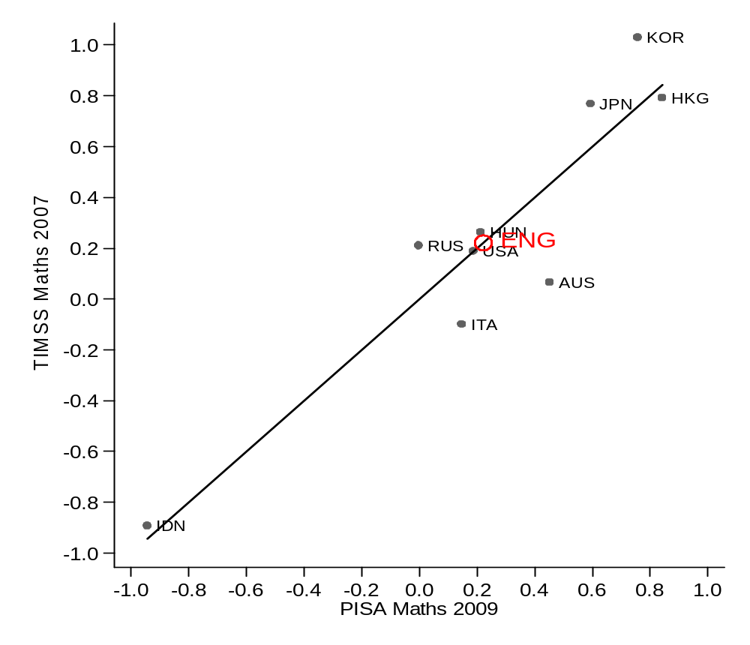
PISA 2009 versus TIMSS 2007 (cross-sectional)

Slide 19
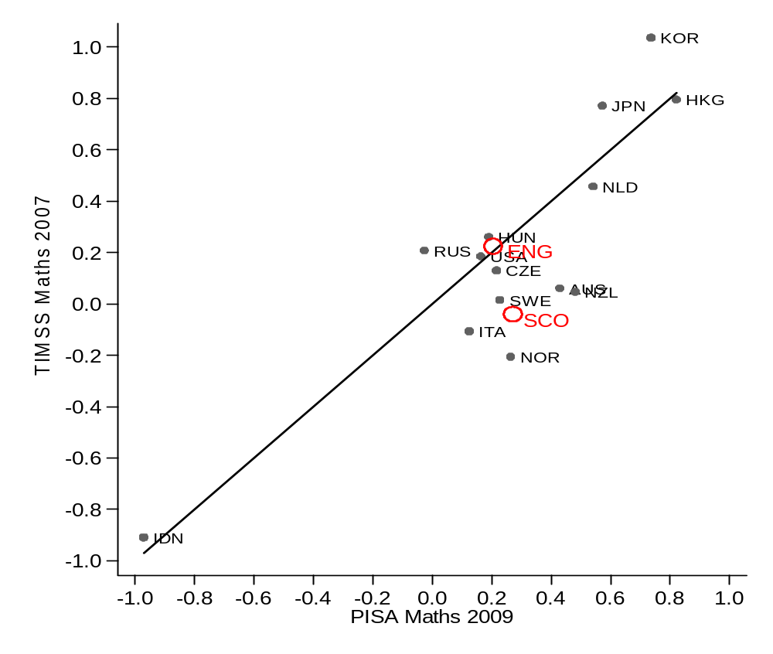
Robustness – broader array of countries

Slide 20
Results:
Do PISA and TIMSS agree on change in average test scores over time?

Slide 21
PISA versus TIMSS in England (change over time)

Slide 22
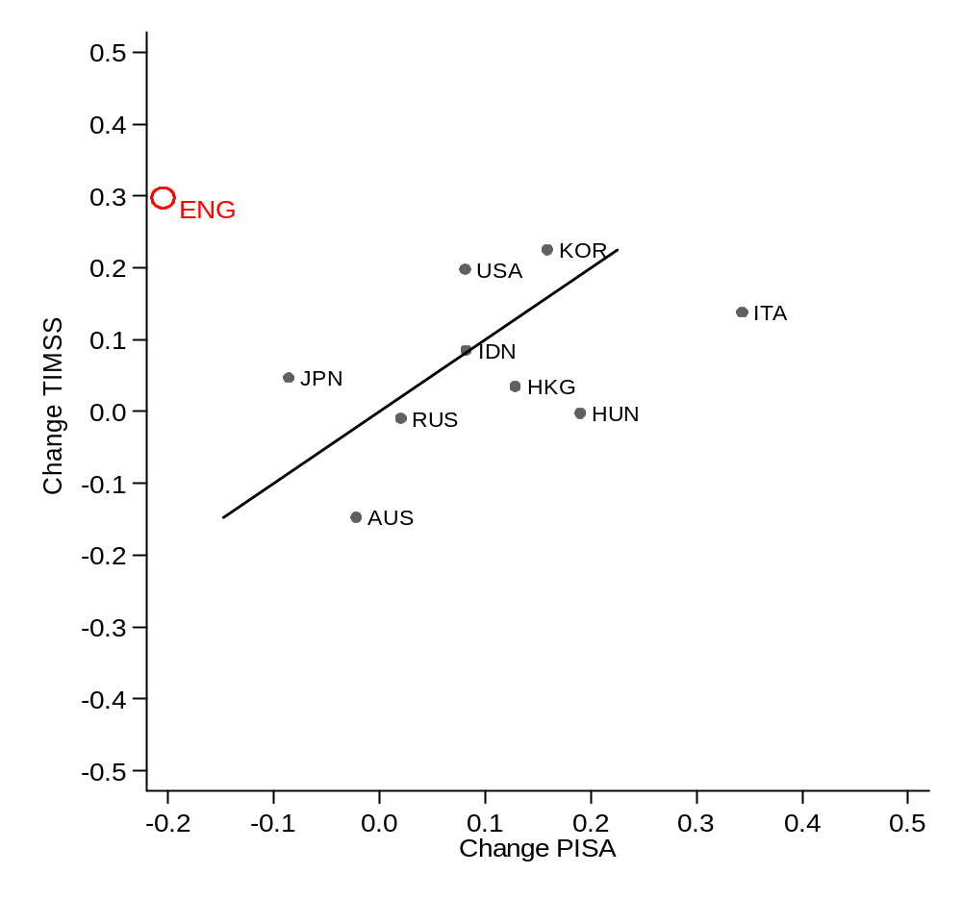
Change in TIMSS (99 -07) versus change in PISA (00 – 09)

Slide 23
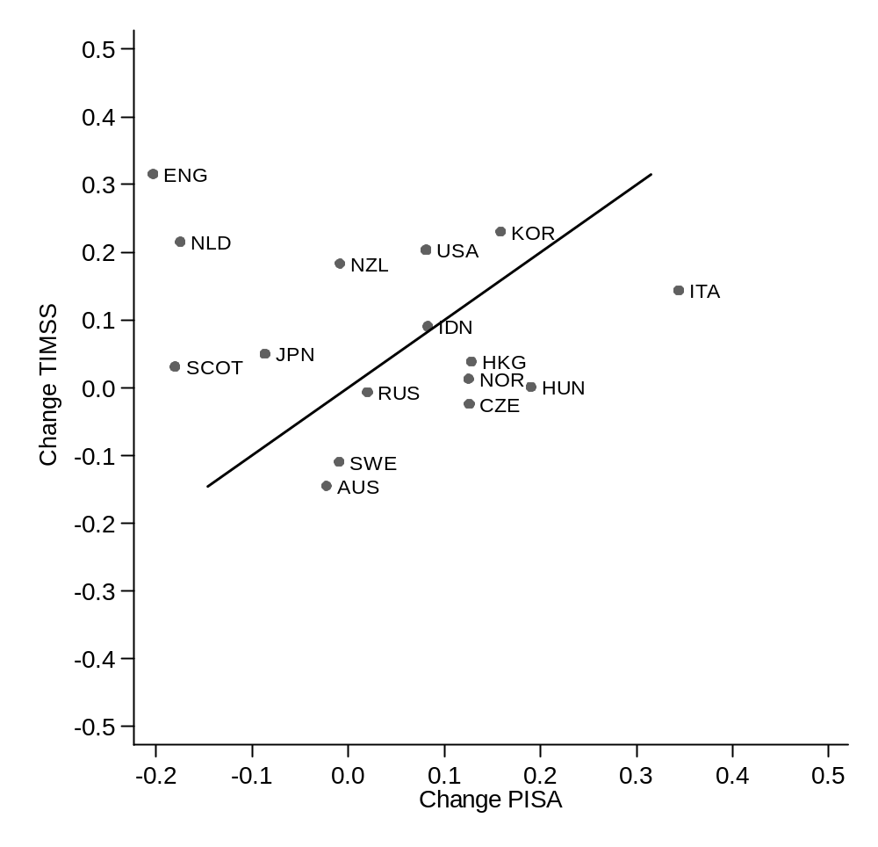
…using a larger number of countries

Slide 24
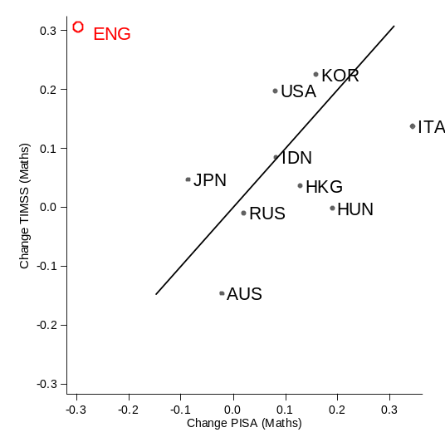
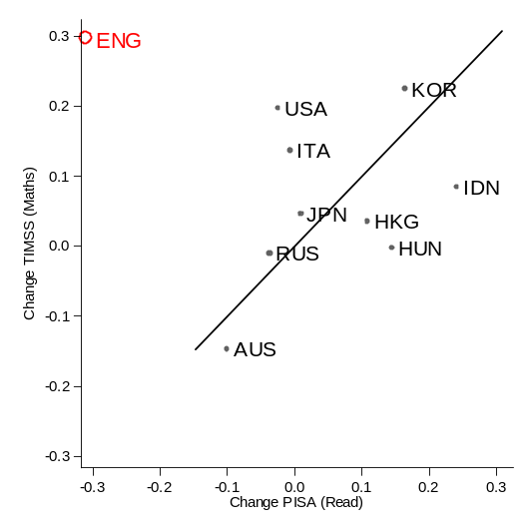
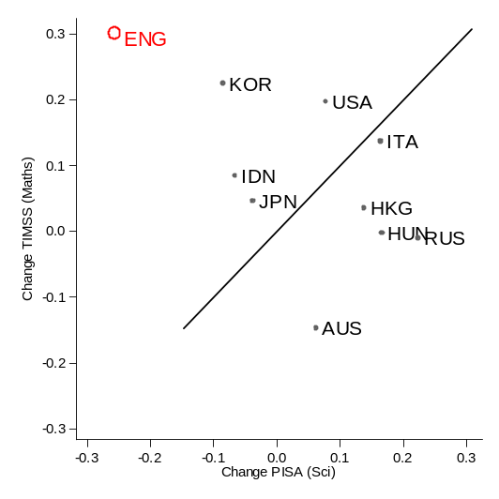
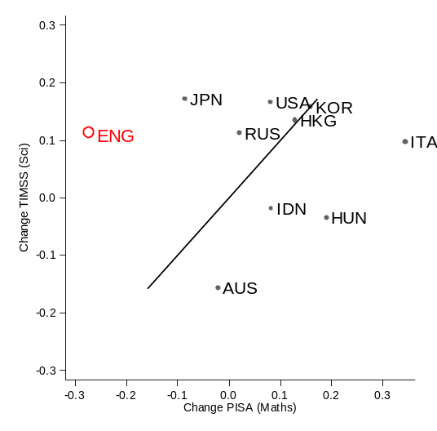
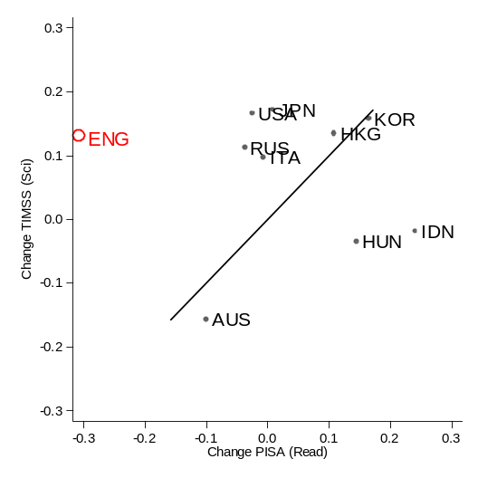
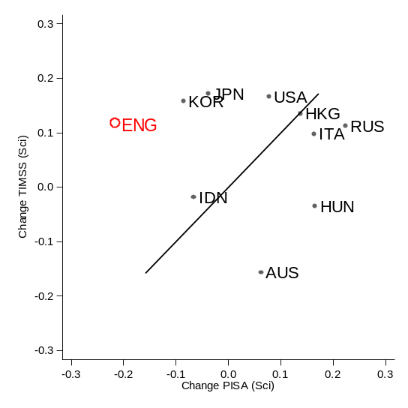
Change looking at different PISA/TIMSS combinations
TIMSS (MATH)
TIMSS (SCI)
PISA (MATH)
PISA (READ)
PISA (SCI)

Slide 25
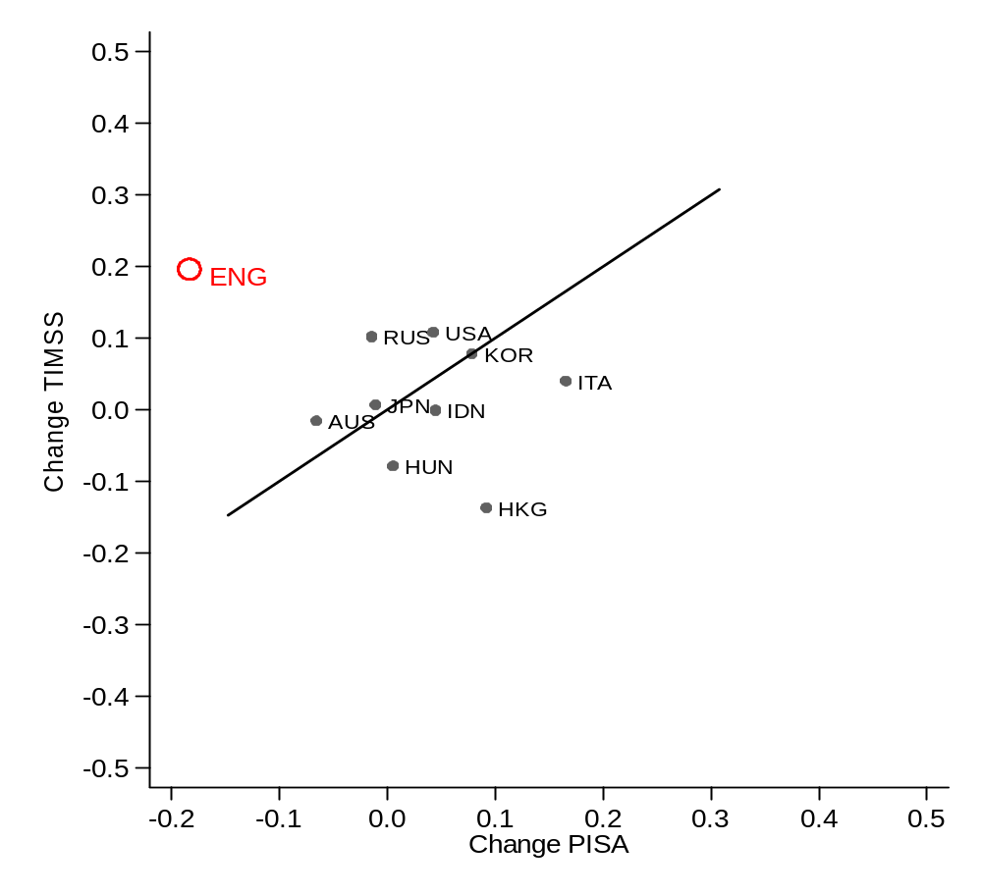
PISA 2003-2009 versus TIMSS 2003-2007 instead

Slide 26
Why might this conflict between PISA and TIMSS occur:
Data issues

Slide 27
Target population change 1:
WALES

Slide 28
Data issues – TARGET POPULATION 1
Children from Wales were not included in PISA 2000 (but were from 2003 onwards).
Children from Wales typically perform worse than those from England:
  Average PISA score for England (492)
  Average PISA score for Wales (472)
Hence potentially drags down the score for England in later PISA waves……
…… does this have much impact?

Slide 29
Trend in PISA test scores when excluding Wales

Slide 30
Target population change 2:
Year 10/Year 11 pupils

Slide 31
Data issues – TARGET POPULATION 2
PISA 2000 / 2003 are AGE BASED samples (children born in the same calendar year)
  Thus PISA 2000 / 2003 includes both year 10 (a third) and year 11 (two-thirds) pupils
PISA 2006 / 2009 are (for all intents and purposes) GRADE BASED samples
  - Thus 99.6% of PISA 2006 / 2009 pupils are year 11 pupils
England had special dispensation to make this change
Implications
Potential impact upon average performance
Educational inequality …..

Slide 32
 | PISA 2000 |  | PISA 2003 |  | PISA 2006 |  | PISA 2009
 | Birth year | Grade | Birth year | Grade | Birth year | Grade | Birth year | Grade
Birth month | st01q03 | % Year 11 | st02q03 | % Year 11 | ST03Q03 | % Year 11 | ST03Q03 | % Year 11
January | 1984 | 98.7 | 1987 | 82.3 | 1991 | 100.0 | 1994 | 99.8
February | 1984 | 99.3 | 1987 | 82.0 | 1991 | 100.0 | 1994 | 100.0
March | 1984 | 98.4 | 1987 | 99.4 | 1991 | 99.5 | 1994 | 99.7
April | 1984 | 98.6 | 1987 | 99.0 | 1991 | 99.3 | 1994 | 99.7
May | 1984 | 99.1 | 1987 | 98.8 | 1991 | 99.8 | 1994 | 99.4
June | 1984 | 98.0 | 1987 | 98.7 | 1991 | 99.8 | 1994 | 99.7
July | 1984 | 98.6 | 1987 | 99.0 | 1991 | 99.3 | 1994 | 99.7
August | 1984 | 96.4 | 1987 | 99.7 | 1991 | 100.0 | 1994 | 98.9
September | 1984 | 2.2 | 1987 | 0.9 | 1990 | 99.5 | 1993 | 99.4
October | 1984 | 1.0 | 1987 | 0.6 | 1990 | 99.8 | 1993 | 100.0
November | 1984 | 0.5 | 1987 | 2.0 | 1990 | 100.0 | 1993 | 99.7
December | 1984 | 0.6 | 1987 | 0.3 | 1990 | 99.4 | 1993 | 99.4

Slide 33
Month of test

Slide 34
Data issues – change of the test month
PISA 2000 / 2003
PISA test conducted around April (2 months before GCSE’s)
PISA 2006 / 2009
PISA test conducted in November (7 months before GCSE’s)
England has special dispensation to make this change (it did NOT occur in other countries)

Slide 35
Data issues – change of the test month
Impact?
Imagine you gave a mock GCSE maths exam to one group of children in November and another in April.
You would expect former to perform worse than the latter.
In other words, PISA 2006/2009 test scores dragged down relative to PISA 2000/2003
By how much?
OECD estimates one year of schooling = 40 PISA test points
Change of five months ≈ 15 PISA test points.

Slide 36
Non-response

Slide 37
Data issues: PISA Non - response
 |  | School |  | Pupil
Year | Source | Before replacement | After replacement
2000 | Micklewright & Schnepf (2006) | 59 | 82 | 81
2003 | Micklewright & Schnepf (2006) | 64 | 77 | 77
2006 | Bradshaw et al (2007a) | 77 | 89 | 89
2009 | Bradshaw et al (2010a) | 69 | 87 | 87
Not included in PISA 2003 international report
Investigations (e.g. Micklewright et al 2010):
PISA 2000 maths scores upwardly bias by between 4 and 15 points
PISA 2003 maths scores upwardly bias by around 7 points

Slide 38
PISA Non - response
Of limited use to understand change over time.
Really want to know bias the impact of non-response bias in 2006 and 2009 aswell.
PISA 2009 – England missed target response rate (again) – but we know very little about the impact of this……….
NFER
“the NFER was asked to provide some analysis of the characteristics of responding and non-responding schools in England, since it was here that school participation had failed to meet requirements. This showed no significant differences and it was accepted by the PISA sampling referee that there was no evidence of possible bias in the sample as a result of school non-participation”

Slide 39
PISA Non - response
…. BUT what does this mean? No information on what the NFER actually provided
“no significant differences” between responding and non-responding schools – Not surprising because of low power
What school characteristics compared?
What significance level used?
Similar “evidence” was provided in PISA 2000 – but there was still a lot of bias in those figures

Slide 40
Data issues: TIMSS Non - response
 |  | School |  | Pupil
 | Source | Before replacement | After replacement
1999 | Martin et al (2000) | 49 | 85 | 90
2003 | Ruddock et al (2004) | 40 | 54 | 86
2007 | Sturman et al (2008) | 78 | 86 | 88
Less attention has been paid to non-response in TIMSS ……
…. but also England does rather poorly here too
NOTE the jump in school response rate in 2007 - and how this relates to the TIMSS trend.

Slide 41
Cumulative impact on the PISA average test score trend in England

Slide 42
How does this impact the PISA trend?
Four alternative PISA trends estimated making different assumptions about the comparability of the data.
Raw data are unbiased
Correct for change in target population
As 2 but correct for change in test month
As 3 but correct for response bias

Slide 43
Raw data

Slide 44
Adjustment for change in target population

Slide 45
… and adjustment for change of test month

Slide 46
… and adjustment for non response

Slide 47
Conclusions
Statements suggesting that England is “plummeting down” international rankings may simply not be true.
The decline seen by England in the PISA international rankings is not, in my opinion, statistically robust enough to base public policy upon.
The decline in PISA test scores does not suggest that the Labour government’s investment in education was a waste of money, just as the ascendency in TIMSS rankings does not prove it was well spent.
Indeed, even if the data were of high enough quality to accurately estimate changes over time, such statements seem to fall into the trap of confusing correlation with causation.

