Slide 1
Introduction
Lecture 1

Slide 2
What this course is about…
An introductory course …….
Aimed at researchers with basic stats skills (know about inference, regression)….
…but have never really used international education datasets
Mixture of lectures, practical activities and computer workshops
Roughly half of your time will be spent using / analysing the data….
Course not just about PISA!
Will use data from TALIS also…..
….and learn about other international assessments

Slide 3
Structure
Four lectures
Lecture 1 → Types of questions, data available, challenges faced, history and future…
Lecture 2 → How to handle the complex survey design
Lecture 3 → ‘Nuts and bolts’ of cross-national comparisons
Lecture 4 → Test design, plausible values, methods of analysis
Four computer workshops
Workshop 1 → Analysis of TALIS data in a single country (England) using Stata
Workshop 2 → Testing for significant differences across countries
Workshop 3 → National and international z-scores
Workshop 4 → Analysis international assessment data using Stata (focus = PISA)

Slide 4
Day 1
Day 1.
1000-1115. Why do international comparisons (JJ)
1115 - 1145 Coffee break
1145 - 1300. Survey design in PISA (TM)
1300-1400. Lunch.
1400 - 1515. Computer workshop 1 (TM).
1515-1530. Coffee break.
1530-1645. Lecture nuts and bolts of international comparisons (NS)

Slide 5
Day 2
930 – 1100 Computer workshop 2 and 3
1100 – 1130 Coffee break
1130 – 1300 Lecture 4
1300 – 1400 Lunch
1400 – 1530 Computer workshop 4
1530 – 1600 Five things you might not know about PISA…..
1600 – 1630 Concluding comments / questions

Slide 6
What this course will not cover…
Not a course about item-response theory (though will touch upon this….)
Will not discuss methods for establishing / testing cross-national comparability
Will not discuss all the details of the background questionnaire data
Focus upon data design and collected to be cross-nationally comparable (e.g. PISA)….
…not on comparisons between ‘ex-post’ harmonised data

Slide 7
Aims of the course
By the end of the course you should:
Know what the major international education datasets are, the type of questions that they can address, challenges researchers face and how they will develop in the future.
Understand the complex survey design used, including response rate requirements, national exclusions, cluster sampling, and the purpose and use of replicate weights.
Be able to perform basic cross-national comparisons, including formal tests of statistical significance across countries and important methodological issues such as multiple hypothesis testing
Understand how PISA / TIMSS test scores are created, and how they can be appropriately analysed using Stata.

Slide 8
What is an international comparison?

Slide 9
What is an international comparison?
A comparison of a key feature of a sovereign state to one or more other sovereign states
These comparisons come in many shapes and sizes.
Examples include
- Economic indicators (e.g. Unemployment / GDP)
- Human development (HDI index)
- Entrepreneurship
- Football teams (e.g. FIFA world rankings)
- Educational attainment!

Slide 10
Why do international comparisons?
(and the type of questions you can answer….

Slide 11
Reason 1: Benchmarking
How does the UK perform relative to other countries?
This helps us understand our strengths and weaknesses
Example: Is income inequality high in the UK?
Inequality often measured using something called the GINI coefficient.
UK GINI = 0.34 → Is this big or small !?
Compare to GINI in other countries → Give results context
Sweden = 0.25 ; Germany = 0.28 ; Australia = 0.30
UK = 0.34 ; US = 0.45 ; Hong Kong = 0.53

Slide 12
Reason 2: Impact of ‘institutions’
All population exposed to the same ‘institutional structure’ within a given country.
-E.g. Universal healthcare coverage in the UK (NHS)
-E.g. Comprehensive education in England
Different institutional structures in other countries
-E.g. Medical insurance in the US
How do these different institutional arrangements impact upon individual’s outcomes?
-E.g. Children’s test scores?
ANSWER: Cross-national comparison!

Slide 13
Example: ‘School Tracking’
‘Tracking’ = Separating children into different schools by academic ability
Occurs at a young age in certain countries
- Germany: Age 10
- Netherlands: Age 12
- Belgium: Age 12
What impact does such tracking have on pupils test scores?
Cross-country comparison by Hanushek and Woessmann (2005)
- Little impact on average test scores……
- ….but reduction in educational equality
NOTE → Problem of small n (limited number of countries)
Notes:
See http://www.google.co.uk/url?sa=t&rct=j&q=&esrc=s&frm=1&source=web&cd=4&ved=0CEIQFjAD&url=http%3A%2F%2Fwww.zew.de%2Fen%2Fpublikationen%2Fdfgflex%2FWOESSMANN%2520Paper.pdf&ei=4ShJUqL5FfHX7Ab7xYD4DQ&usg=AFQjCNFA_t1wvqNgJTRYYfvKrmQ6YpDPvg&bvm=bv.53217764,d.Yms for Hanushek paper

Slide 14
Reason 3: Impact of ‘macro-forces’
Similar to the ‘institutional structure’ argument…..
There may be certain ‘environmental’ type factors that influence individual outcomes.
These environmental factors may more obviously vary (and potentially have an impact) across countries rather than in countries….
Example
Income inequality
Much attention how this varies between countries (compared to relatively little on regions within countries)….
Why?
→ Not sure! More variation across countries? Considered to be a macro/country level force?

Slide 15
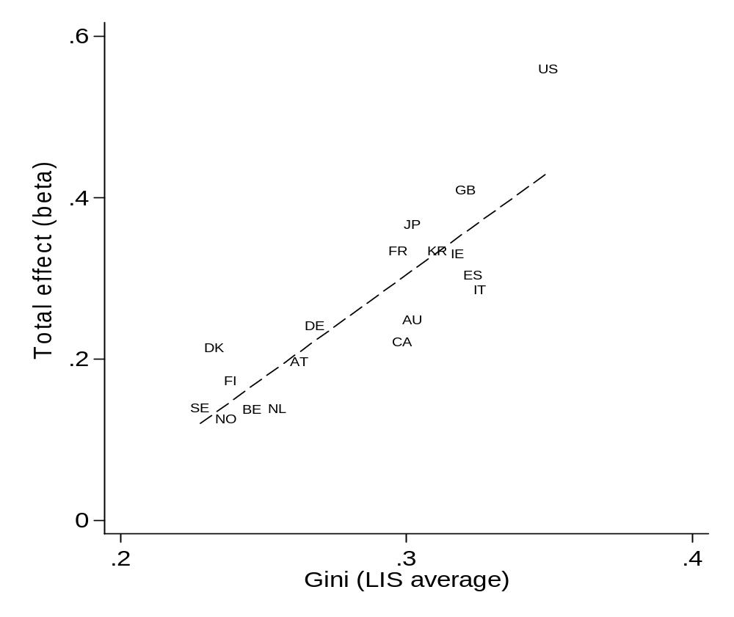
Example: The Great Gatsby Curve
Countries with higher levels of income inequality have lower levels of social mobility…..
Hypothesis
Income inequality a ‘macro force’ that helps to entrench social and economic advantages across generations.
See https://johnjerrim.files.wordpress.com/2013/07/qsswp1418.pdf

Slide 16
Reason 4: Generalise results
Does the same social phenomena hold across the world?
Much academic research stems from the United States (or based upon US data)……
…..but do the findings from the US hold in other national settings?
Examples
Gender gap in reading test scores.
Is mother’s education more important than father’s education for children’s test scores?
Are children realistic about their chances of completing higher education?

Slide 17
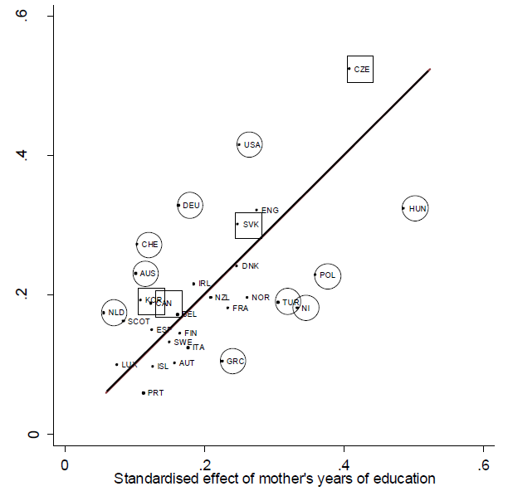
Mother vs Father education and kids test scores
Some countries Father education more important…..
…other countries mother education more important.
One finding does not hold everywhere!
See http://johnjerrim.files.wordpress.com/2013/07/jj__jm_madison_jan_26_2011_rsf.pdf

Slide 18
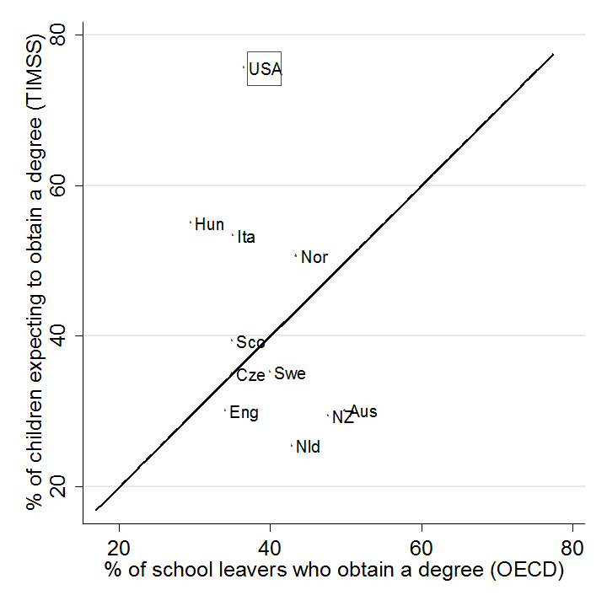
Are children everywhere unrealistic about their chances of completing university?
Large US literature on how children are unrealistic about chances of completing university……..
…. But little evidence that this holds everywhere
United States is ‘exceptional’ (rather than generalisable)
http://johnjerrim.files.wordpress.com/2013/07/summary_socio_quarterly.pdf

Slide 19
Reason 5: Change in educational standards over time?
Long concern in UK regarding the problem of ‘grade inflation’
Have standards improved? Or have tests got easier? (Or marked more leniently?)
International assessments (like PISA) potentially offer an independent benchmark….
What the large-scale assessments provide
An independent tool (free from national government) to judge change in educational standards over time…..
Evidence of whether any given country may be in relative decline….
→ E.g. standards in a country could be going up…..
→ …but at a slower rate relative to competitors

Slide 20
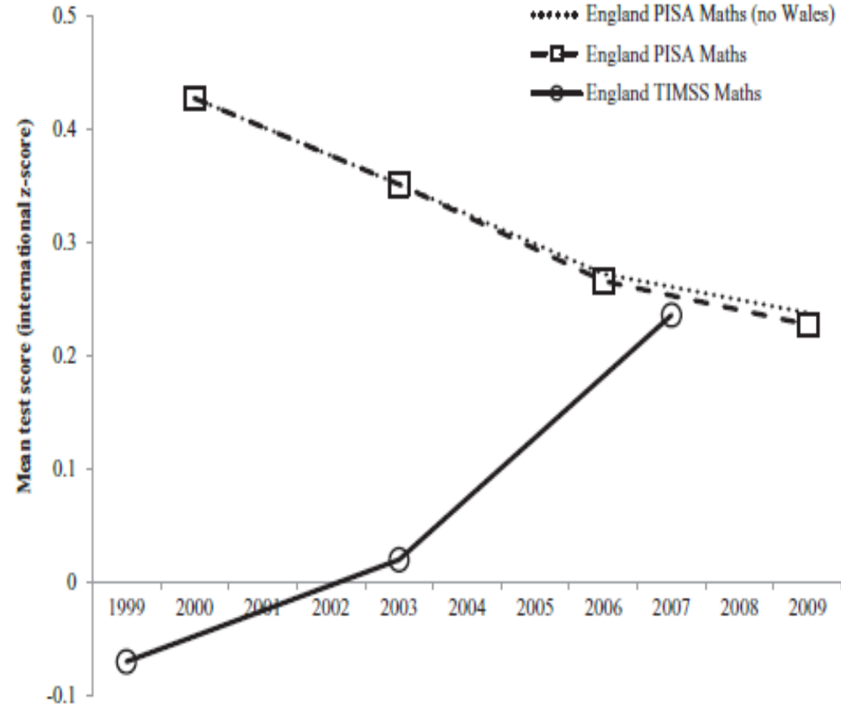
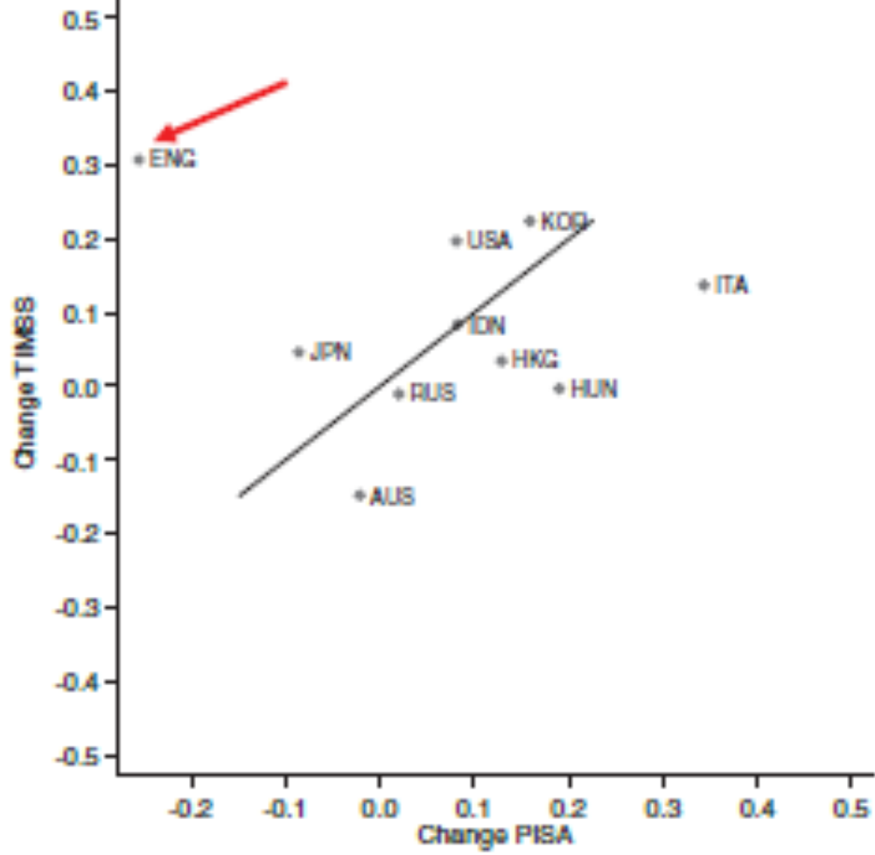
But only when conducted robustly……
http://johnjerrim.files.wordpress.com/2013/07/published_paper.pdf

Slide 21
Reason 6: Politicians / policymakers care!
Even if you don’t believe the above are important……..
…other people do!
International comparisons tend to have big influence on policymakers
-E.g. Heavily cited by Michael Gove (PISA)
-E.g. Heavily cited by the White House (Gatsby Curve)
-E.g. Popular media (The Spirit Level)
Therefore
  Important we get them right!
  Important we understand what they can (& can not) tell us

Slide 22
Cross-national comparative data

Slide 23
Thus to conduct research in this area we require…….
CROSS-NATIONALLY COMPARABLE DATA
And ideally….
For a large number of countries……
…. particularly to answer certain questions
e.g. role of institutions; ‘impact’ of macro-forces

Slide 24
What does “comparable” mean?
Survey design (i.e. target population)
Response rates (i.e. bias) and weights
Same outcome and explanatory variables
Consistent definitions
Same point in time (e.g. if we think recession has an impact on outcomes ……….)
And much more………..

Slide 25
Cross-national comparability is not easy to achieve, but is fundamental to this type of research.
What data has been used in cross-national research?
(1) Researcher-harmonised
(2) Ex – post harmonised
(3) Ex – ante harmonised

Slide 26
Researcher-harmonised data
Take datasets from various countries, that have not been designed with cross-national comparisons in mind, and do the best job we can
(1) But really comparable?
Different target populations, survey years, response rates, timing of surveys, ordering of questions, variables measures etc
If No, then how can we distinguish a genuine difference between countries from the above?
(2) The problem of small N (limited number of countries)
Despite limitations, used regularly.

Slide 27
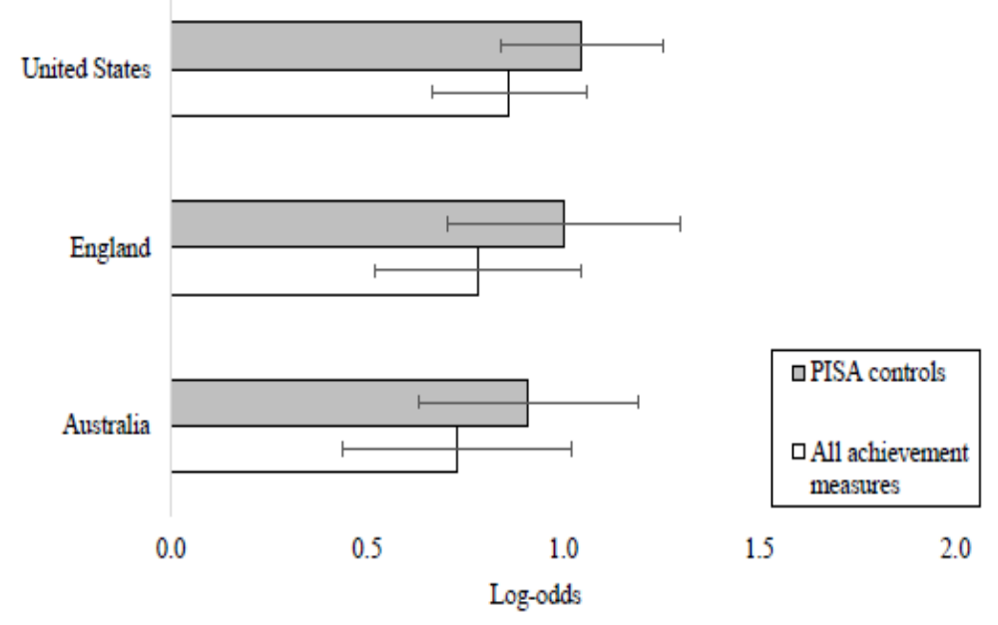
Example: Access to elite universities across countries….
Use three longitudinal youth datasets…
Similar designs….
Similar ages…..
Similar years….
But
Data not designed to be cross-nationally comparable
We have harmonised the data as best we possibly can….
See Jerrim, Chmielewski and Parker (forthcoming …..)

Slide 28
“Ex-post harmonisation”
Datasets where a group of individuals have spent significant time and money on making data from different countries as close to comparable as possible – after data collection has taken place
Examples:
Luxemburg Income/Wealth Study
CNEF (available from Cornell)
+ ive: More comparable than being left to individual researchers
Large number of countries (big N)
- ive: Only a few datasets
Unlikely to overcome all the problems discussed

Slide 29
“Ex-ante” harmonisation
Data that has been collected with the specific intention to compare cross-nationally
Examples:
PISA, PIRLS, TIMSS
European Social Survey
+ ive: Specifically designed to be comparable across nations
- ive: Cross-sectional data only
Other measurement problems
STILL DOES NOT GAURANTEE COMPARABILITY

Slide 30
Focus of this course is upon ex-ante harmonised data

Slide 31
Examples of this type of data
PIRLS (10 year olds)
TIMSS (10 and 14 year olds)
PISA (15 year olds)
PIAAC / IALS (Adult competencies)
TALIS (International study of teachers)
SACMEQ (Southern / East Africa)
CIVED (Civic education)
ETLS 2017 (Proficiency in English language)

Slide 32
Challenges faced we face when using these data

Slide 33
Comparability
Central to everything we are trying to do…..
Designing surveys / studies to be comparable helps…..
….but does not ensure comparability across countries
→ Some things are just ‘different’ across countries
→ No matter what we do to try and make them comparable, differences will remain
Example: Education / qualification levels
ISCED designed to ‘enhance’ cross-national comparability……
…but qualifications simply are different across countries (see Steadman 2001)
E.g. GCSE’s in England → Fit very poorly into ISCED framework
Headache for anyone who has ever used them!!
Notes:
See http://oep.oxfordjournals.org/content/53/3/564.abstract

Slide 34
Causality
International assessments = cross-sectional data
Mainly used for descriptive / association analysis…..
…very hard to get causality
Issue
Knowing causal relationships important if we want to design policy to improve education
Some ‘causal’ work by economists
School tracking (Hanushek and Woessmann 2005)
School autonomy (Hanushek, Link and Woessmann 2013)
My view
International assessments are effective ‘benchmarking’ tools….
…but not so great at actually identify what countries should do to improve
Notes:
See http://hanushek.stanford.edu/sites/default/files/publications/Hanushek%2BLink%2BWoessmann%202013%20JDevEcon%20104_0.pdf

Slide 35
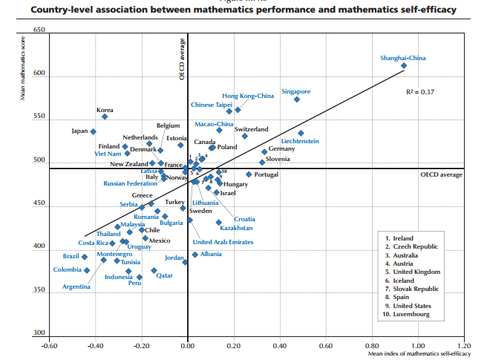
There are also issues with simply looking at broad cross-country relationships…….
Relationship between self-efficacy in maths and average PISA scores……

Slide 36
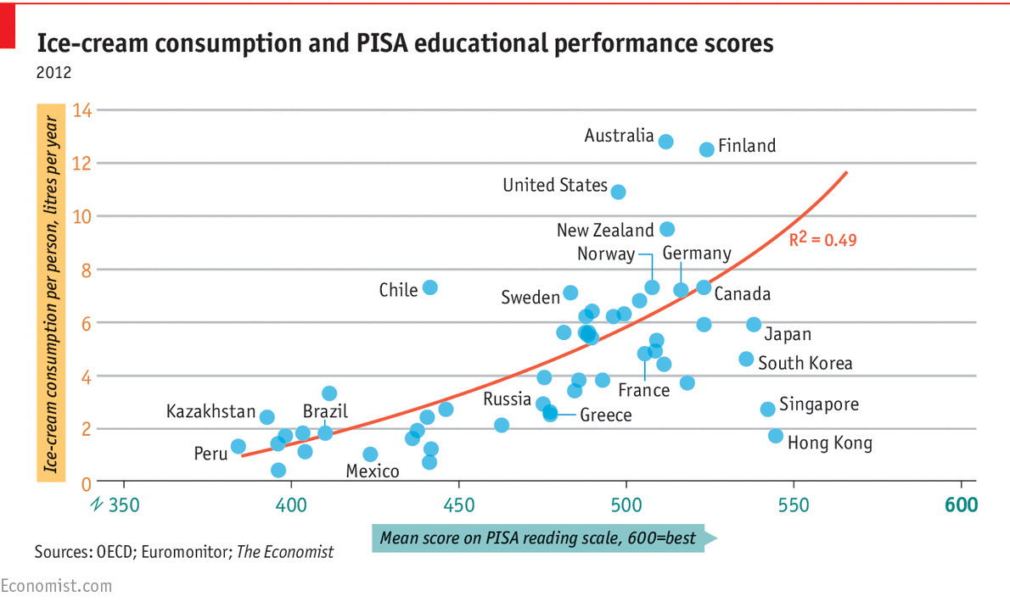
There are also issues with simply looking at broad cross-country relationships…….
Graph shows the relationship between PISA scores and ice-cream consumption per capita.
Policy ‘advice’?
Eat more ice-cream!
Notes:
http://www.oecd-ilibrary.org/education/pisa-2015-results-volume-i_9789264266490-en
Table

Slide 37
Technicalities
Methods used in designing and implementing the international assessments are complex….
Not widely understood…..
The psychometric methods used stretch the data to the limit…..
Trying to be ‘cutting edge’ in many areas (test design, sample design, psychometrics, questionnaire design)…..
…..puts burden on even secondary analysts to used data ‘correctly’
Analogy
→ ‘Great Recession’ of 2008 initially caused by very complex financial tools (derivatives) that very few people in the world could understand and knew how they were created……
→ Is the situation with the international assessments (like PISA) that different?

Slide 38
Transparency
Certain strengths
Most data publicly available and free to download….
Now getting huge public / academic scrutiny….
….more so than any other dataset I know of
International organisations (e.g. OECD) do take criticisms on board and try to improve…
Many weaknesses
Information in technical reports not exhaustive…..
Only partial information on how test scores are actually generated…..
Test scores are not easily replicable with available public-use data…..
…. (I am not actually sure it is possible!)
International contractors = private firms. No interest in making things open…..
Power of any individual country to influence things is very limited

Slide 39
Key point
The international assessments strengths and weaknesses….
They can help inform education policy….….
…..BUT also needs to be considered in relation to wider evidence base!!!
Example: East Asian success in PISA
To what extent is this due to particular ‘teaching methods’ in these countries? And should we introduce these here in the UK?
PISA alone can not answer this question (actually provides very little insight).
FACT: East Asian immigrants to ‘average’ performing PISA countries (e.g. Australia) do just as well as children in top East Asian countries (e.g. Singapore)
EEF RCT of ‘Maths Mastery’ → Provides much more insight into whether introducing East Asian teaching methods into UK schools is a good idea than PISA!

Slide 40
The history of the educational assessments

Slide 41
The history of the educational assessments
OECD PISA
IEA Science
International assessments not new….
But are now…
Higher quality
More countries
More regular
More impact!
IEA Literacy
IEA Maths

Slide 42
The international studies pre 1990
Not directly comparable with the studies of today.
Did not use Item-response theory
Not as strict on national representativeness
Not as strict on response rates
Some recent studies have used these data….
E.g. Hanushek and Ludger Woessmann. Cost to low PISA performance across all OECD countries is $100 trillion!
E.g. on-going investigations of SES inequality by Chmielewski and Pfeffer
…But have probably have been under-utilised
Caveat = Issues with comparability over time. But still interesting to look at the results….
Notes:
See http://hanushek.stanford.edu/sites/default/files/publications/Hanushek%2BWoessmann%202010%20OECD_0.pdf

Slide 43
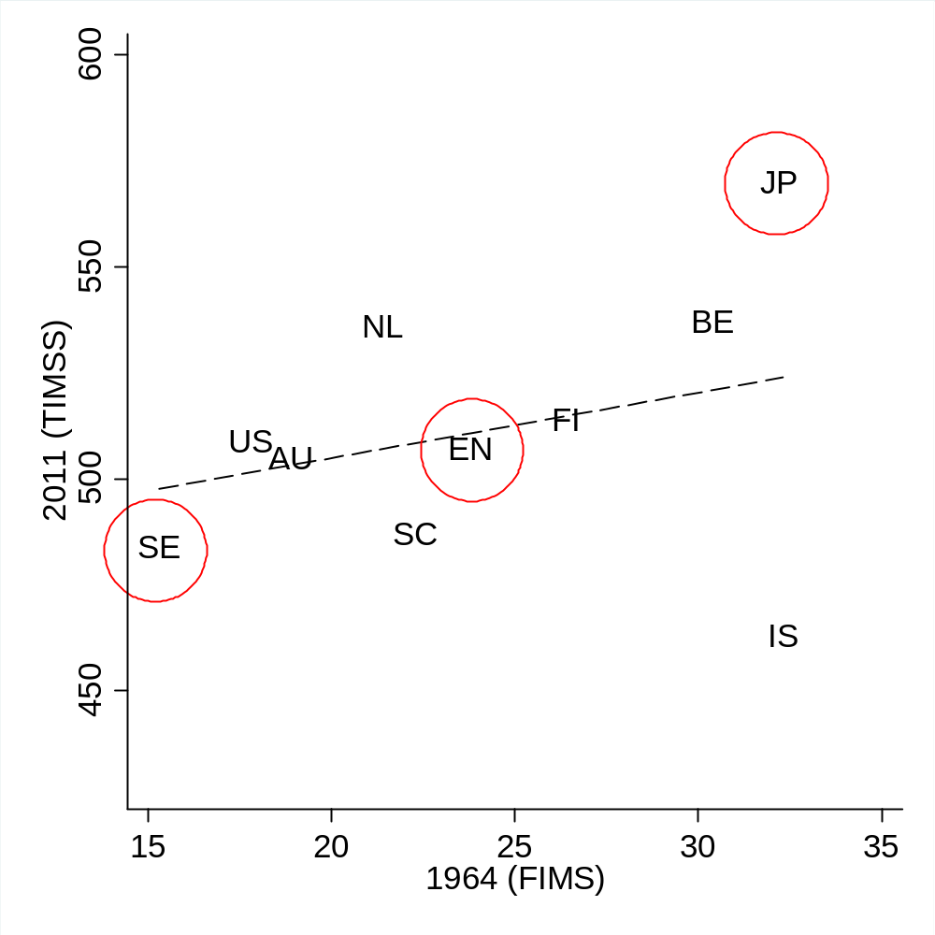
FIMS (1964) vs TIMSS (2011)
Has that much changed over the last 50 years?
East Asian (e.g. Japan) countries at top of the maths rankings
England around the international average
Sweden does surprisingly poorly
Cross-country correlation
All countries = 0.40
Israel excluded (outlier) = 0.78
Notes:
Note: TIMSS data from 2011 or closest available year (2007 or 2003)

Slide 44
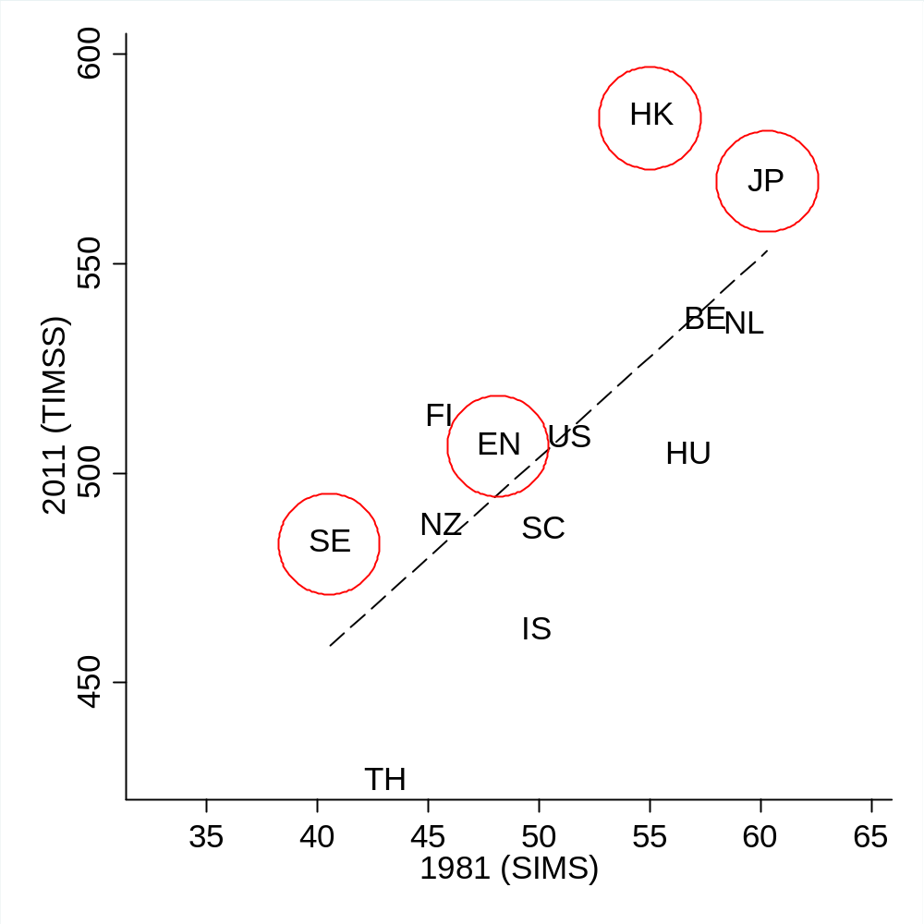
SIMS (1981) vs TIMSS (2011)
Has that much changed over the last 25-30 years?
East Asian (e.g. Japan / Hong Kong) countries at top of the maths rankings
England around the international average
Sweden does surprisingly poorly
Cross-country correlation
All countries = 0.72
Thailand excluded (outlier) = 0.66
Notes:
Note: TIMSS data from 2011 or closest available year (2007 or 2003)

Slide 45
Implication
Remember that international assessments of children are not new!!
Data from these historical studies are available (free) to download:
http://www.iea.nl/data.html
These data have probably been under-exploited…..
Interesting to put the results we see today into a historical context (something which I don’t think has been done that much – or at least not enough….)
Notes:
See http://hanushek.stanford.edu/sites/default/files/publications/Hanushek%2BWoessmann%202010%20OECD_0.pdf

Slide 46
The future of the educational assessments
Notes:
See page 18 of http://www.oecd.org/callsfortenders/2014%2002%2021%20FINAL%20CFT%20PISA%202018%20Cores%20A%20B%20EDU.pdf

Slide 47
The move to computer-based testing….
PISA 2015 will be done on computers in vast majority of countries
Will be ‘linear-progression’ rather than ‘computer adaptive’
Many benefits of moving to computer
- Time taken to answer questions
- ‘Log-files’ = Every mouse click (how pupils answer questions)
- Different types of questions / skills (e.g. interactive questions)
- Less question non-response
- Test questions tailored to child ability (if/when becomes ‘adaptive’)
Issue: Mode effects
→ Change from paper to computer has implications for how we think about trends over time.

Slide 48
Starting to measure student progress….
Currently cross-sectional data only = ‘snapshot’ only…..
Real interest is in progress – how much do children improve their skills during secondary school?
Recognised as important and ‘the future’ by organisations like the OECD…..
….but is a huge administrative burden (very ambitious!)
Nevertheless, there is real appetite to start thinking about measures of progress…
…including links to ongoing development of early years assessments (e.g. i-PIPS)
Longitudinal PISA studies
Some countries already some insight here…..
…PISA as a baseline for a longitudinal study
E.g. Australia, Canada, Czech Republic, Denmark, Uruguay
ISSUE → Is PISA more relevant as a baseline point or as an outcome point?

Slide 49
Linking to national assessments….
Keen interest internationally in links between national assessments and countries own administrative data…..
Gives a longitudinal component to the international assessments….
E.g. has been used in the US to try and benchmark all states on TIMSS
See http://nces.ed.gov/nationsreportcard/studies/naep_timss/
England very well placed here
TALIS. Linked in school level information for England.
PISA 2015. (Hopefully) linked to NPD data.
Unlike other countries, we have very good administrative data…..
Unlike other countries, we have ‘test scores’ between 5 and 16…..
Unlike other countries, we can follow individuals through to at least age 18….

Slide 50
Broaden global coverage….
PISA 2012 = 65 economies
Some countries only partially represented (e.g. China only Shanghai)
Increase country penetration in the future (PISA and other surveys….)
E.g. Five more regions from China participating in PISA 2015….
E.g. Some notable countries (e.g. South Africa) not yet taken part…..
PISA for development
PISA moving into the developing world….
Possible link to post-2015 Millennium Development Goals (MDG)
Planned attempts to test both the school population and children who are not attending / enrolled (important – but a challenge)…..
Purpose → Post 2015 MDG to focus on outcomes in terms of skills (rather than inputs).

Slide 51
Widen access to PISA for children with SEN
→ PISA currently has special test booklets for children with SEN (UH booklet)….
→ ….typically contain half as many test questions as a normal booklet
→ ….and fewer questionnaire items
→ Currently for use in schools where all children have SEN (i.e. special-needs schools)
Looking to develop this further in future PISA waves
→ E.g. Further accommodation for pupils with SEN?
→ E.g. Extend use of UH booklet beyond just special needs schools?
Notes:
See https://books.google.co.uk/books?id=fLXVAgAAQBAJ&pg=PA179&lpg=PA179&dq=pisa+uh+booklet&source=bl&ots=gN-gMjk4AF&sig=ukpsc4EjRe0kEELzbVIbMg0T0hY&hl=en&sa=X&ei=D4uzVKPZBOKY7gbK9oHYDQ&ved=0CDsQ6AEwBQ#v=onepage&q=pisa%20uh%20booklet&f=false for a study….

Slide 52
Conclusions
Notes:
See page 18 of http://www.oecd.org/callsfortenders/2014%2002%2021%20FINAL%20CFT%20PISA%202018%20Cores%20A%20B%20EDU.pdf

Slide 53
Conclusions
There are different ‘types’ of cross-national comparative data…..
….with different strengths and limitations
International assessment data can be used to answer several different types of questions…. (benchmark, institutional structures, standards over time)
Still a number of challenges that we face in our work (comparability, technicalities, transparency)
International assessments are not new (50 year history)….
…but they are evolving rapidly!

