Slide 1
Nuts and bolts of conducting international comparisons
Lecture 3

Slide 2
Aims
To develop thinking of which countries to include in the analysis.
To understand the strengths and limitations of different ways of comparing different countries (e.g. multi-level modelling versus separate country estimates)
How to conduct two-sample t-tests to test for significant differences between countries
To understand corrections for ‘multiple hypothesis testing’ and whether these should be applied
To understand what ‘senate weights’ are, how they can be calculated, and when they might be needed.
Gain experience of conducting basic cross-national comparisons using the TALIS 2013 dataset.

Slide 3
Which countries should I include?

Slide 4
Often one of the hardest things to decide!
Things I have done (or seen done):
- Compare every country with data available (e.g. PISA rankings).
- Compare within a well-defined group of countries (e.g. OECD or EU).
- Language spoken (e.g. English speaking; Finland vs Estonia)
- Compare against ‘top performers’ (e.g. Micklewright et al 2014)
- Self-selection based upon some factor of interest
- Selection because data available (e.g. Jerrim, Vignoles and Finnie 2012)
Often no right or wrong (or clear-cut) answer. Judgement call!!
My advice – always link it back to your research question …..
  ….. Following slides offer some advice / guidance
Notes:
See http://finnish-and-pisa.blogspot.co.uk/#Estonia for Finland versus Estonia

Slide 5
Question type and country selection
Question type: Generalisability
  Example = Girls out-performing boys in reading
  Which countries do you hypothesise this will hold in?
  Every country in the world? Then include every country with data available
  Developed countries only? Then include only OECD countries
  Only countries with sufficient female rights? Then include only those countries which meet some objective criteria (e.g. http://www.theguardian.com/news/datablog/2013/oct/25/world-gender-gap-index-2013-countries-compare-iceland-uk)
  Key point: Becomes harder for people to argue with your choice if it is explicitly linked to your hypothesis / theoretical argument.
Notes:
See http://finnish-and-pisa.blogspot.co.uk/#Estonia for Finland versus Estonia

Slide 6
Question type and country selection
Question type: Impact of institutional structures
  Example = Impact of ‘between school’ tracking and equality in pupil achievement
  Countries = Relevant sample size
  Sample size is never going to be large. But want to maximise!
  Include all countries with relevant data available.
  What is the minimum # of countries you need to reasonably answer this question?
  N ≈ 20 in Hanushek and Wößmann (citations = 620!)
  Is a sample size of 20 really enough?
  My opinion
  Small sample size (# of countries) is why cross-national comparisons will always be limited in answering ‘institutional structure’ questions.
Notes:
See http://finnish-and-pisa.blogspot.co.uk/#Estonia for Finland versus Estonia

Slide 7
Question type and country selection
Question type: Macro forces
  Example = Association between income inequality and social mobility
  Countries = Relevant sample size
  Want to maximise sample size……..……but also want to base on theory.
  Should only include countries where link between income inequality and social mobility will (theoretically) hold.
  Has been argued in literature that former communist countries should be excluded:
  - See Andrews and Leigh (2008)
  - Lots of political / social change when growing up
  - Income inequality data of low quality
  - Reasonable arguments put forward. Does this choice make a difference?
Notes:
See http://finnish-and-pisa.blogspot.co.uk/#Estonia for Finland versus Estonia

Slide 8
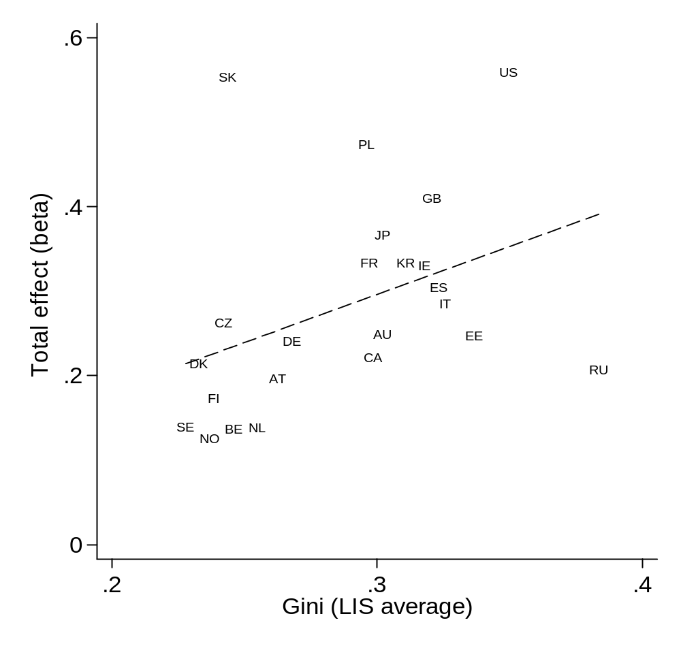
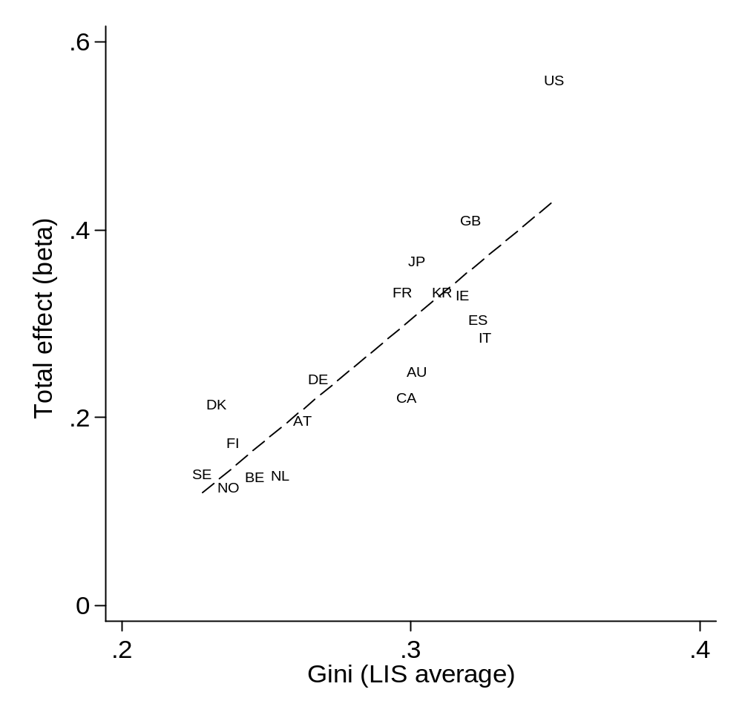
The Great Gatsby Curve….
Jerrim and MacMillian (2014)
A good example of where country selection was difficult…..
….and this choice makes a big difference to the result!
Correlation ≈ 0.40
N = 23
Correlation ≈ 0.85
N = 18
Notes:
See http://finnish-and-pisa.blogspot.co.uk/#Estonia for Finland versus Estonia

Slide 9
Question type and country selection
Question type: Benchmarking
  Example = How does the SES gap in achievement compare in UK to other countries?
  Key point → Who do you want to benchmark the UK against?
  Every country in the world?
  Probably not. Do I care about UK compares in this respect against Malawi?
  Other rich countries?
  Possibly (given benchmarking exercise). But some (e.g. Australia, US, Canada) likely to be more relevant comparators than others (e.g. Estonia, Chile, Mexico).
  Countries of particular interest?
  - Ok. But this then really starts to move away from a benchmarking exercise……
Notes:
See http://finnish-and-pisa.blogspot.co.uk/#Estonia for Finland versus Estonia

Slide 10
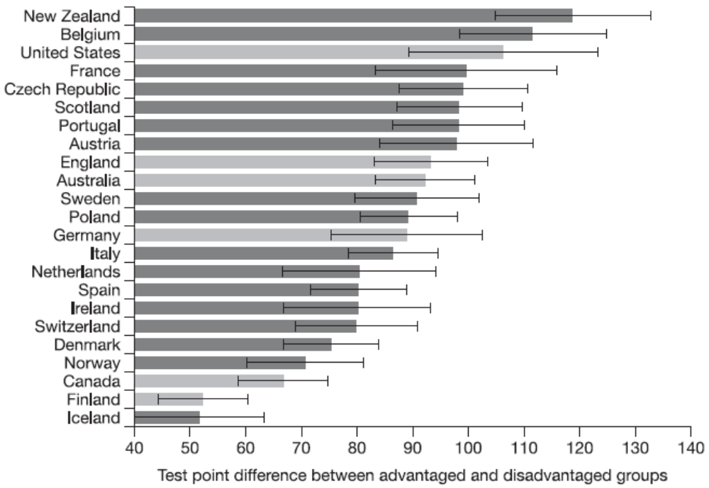
Benchmarking: SES gap in UK in comparative perspective
Source:
Jerrim (2012)
Benchmark England against 23 OECD countries……
….but then also highlight comparison with five countries of particular interest.
Notes:
See http://finnish-and-pisa.blogspot.co.uk/#Estonia for Finland versus Estonia

Slide 11
How do I compare estimates across countries?

Slide 12
Two common approaches: Multi-level model
Approach 1
  Estimate a multi-level (random effects model)
  Pupil = level 1; School = level 2; country level 3
  Very popular to cross-national comparisons in sociology
  E.g. ESR published 340 papers 2005-2012. 43 (13%) used MLM
  Data for all countries has to be pooled together into a single datafile.
  Typically attempting to identify “macro-effects” (e.g. income inequality) or of “institutional structures” (e.g. between school tracking)
Notes:
See http://www.ifs.org.uk/docs/Jenkins%20slides.pdf page 6
See PISA 2003 user guide bottom page 131

Slide 13
Two common approaches: Separate country estimates
Approach 2
  Analyse each country one-by-one
  Data for each country may be in a separate datafile for each
  Popular in economics (and education?)
  Approach (implicitly) advocated by the OECD for PISA
  Similar to estimating model using pooled data from all countries and including country fixed effects
  The approach I have used in almost all my papers using PISA / TIMSS…..
  See PISA 2003 User Guide for further information
Notes:
See http://www.ifs.org.uk/docs/Jenkins%20slides.pdf page 6
See PISA 2003 user guide bottom page 131

Slide 14
I have never used approach 1……
Why?
Issue 1: Are the countries included in your analysis really a random sample from a population? (Can you really generalise your results outside your sample of countries)?
Issue 2: Do you really have enough countries to produce reliable estimates at the country level?
- See Bryan and Jenkins (2013) for discussion
- Problems even when C ≈ 25. (More than many people use)
Issue 3: It never feels very upfront regarding the sample size often of most interest
  - Remember, often interested in country factors – so sample size is small!
Issue 4: It becomes very tempting to start over-fitting the data!
  - E.g. including lots of country-level factors (when sample size is so small!)

Slide 15
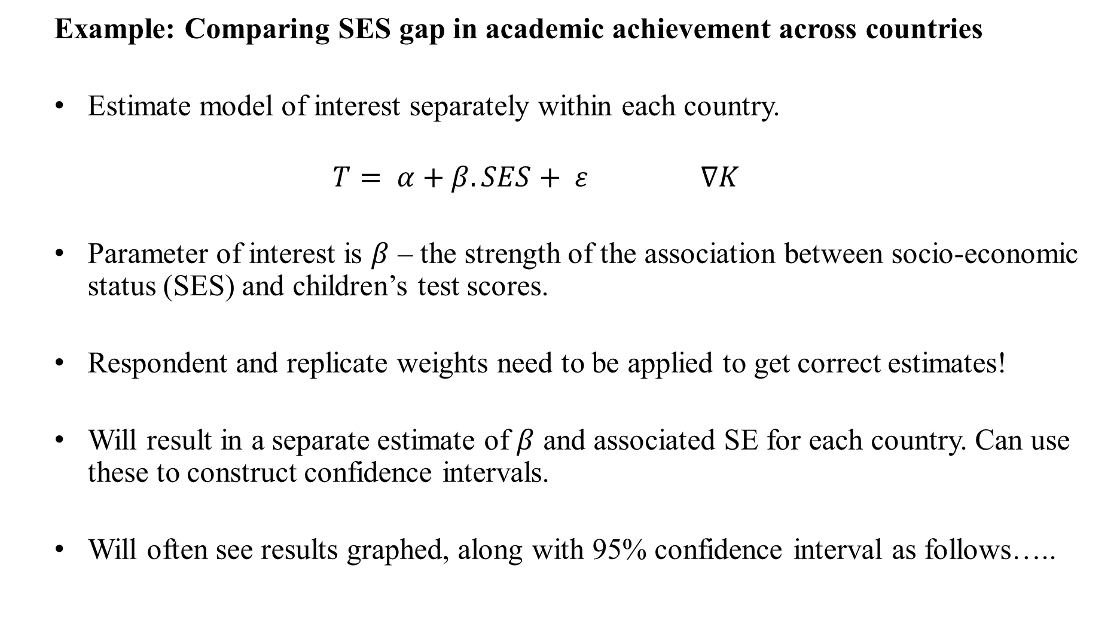
How to execute approach 2
  Example: Comparing SES gap in academic achievement across countries
  Estimate model of interest separately within each country.
  $$T= α+β.SES+ ε ∇K$$
  Parameter of interest is $β$ – the strength of the association between socio-economic status (SES) and children’s test scores.
  Respondent and replicate weights need to be applied to get correct estimates!
  Will result in a separate estimate of $β$ and associated SE for each country. Can use these to construct confidence intervals.
  Will often see results graphed, along with 95% confidence interval as follows…..

Slide 16
Hypothetical example of results
Bar = Estimated association between SES in pupil achievement
Line = Estimated 95% confidence interval
Question
Can we tell from this graph which countries are significantly different from one another at the 5 percent level?
Is Country A sig diff to Country B?
Is Country A sig diff to Country C?
Is Country B sig diff to Country C?

Slide 17
Answer…..
  Country A versus Country B
  CI for country A overlaps with the point estimate for country B.
  Can therefore be sure that one can not reject null hypothesis of no difference between country A and country B at the five percent level.
  Country A versus Country C
  CI for country A does not overlap with the CI for country C.
  Can therefore be certain that one can reject null hypothesis of no difference between country A and country C at the five percent level.
  Country B versus Country C
  CI for country B overlaps with CI for country C…..
  ….BUT neither CI overlaps the other country’s point estimate
  We can not tell whether difference between country B and country C is statistically significant at the five percent level from this graph.

Slide 18
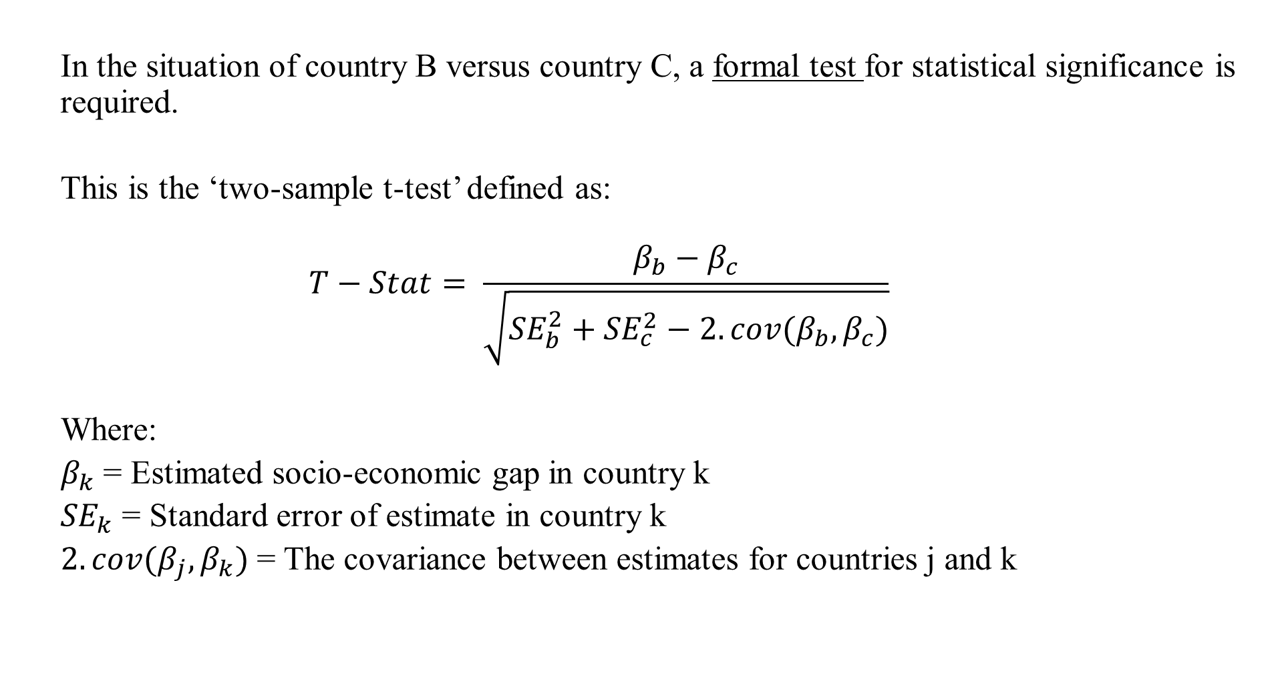
Two-sample t-test
  In the situation of country B versus country C, a formal test for statistical significance is required.
  This is the ‘two-sample t-test’ defined as:
  $$T−Stat= \frac{β_{b}−β_{c}}{\sqrt{{SE}_{b}^{2}+{SE}_{c}^{2}−2.cov(β_{b},β_{c})}}$$
  Where:
  $β_{k}$ = Estimated socio-economic gap in country k
  ${SE}_{k}$ = Standard error of estimate in country k
  $2.cov(β_{j},β_{k})$ = The covariance between estimates for countries j and k

Slide 19
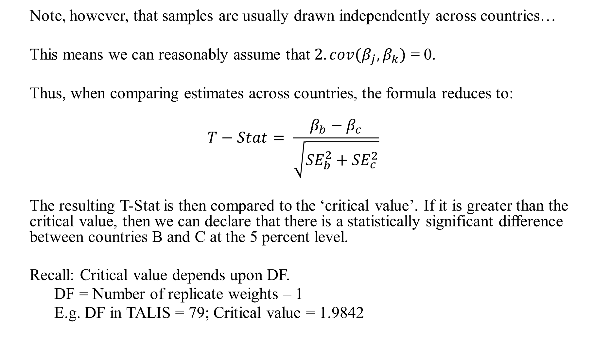
Two-sample t-test
  Note, however, that samples are usually drawn independently across countries…
  This means we can reasonably assume that $2.cov(β_{j},β_{k})$ = 0.
  Thus, when comparing estimates across countries, the formula reduces to:
  $$T−Stat= \frac{β_{b}−β_{c}}{\sqrt{{SE}_{b}^{2}+{SE}_{c}^{2}}}$$
  The resulting T-Stat is then compared to the ‘critical value’. If it is greater than the critical value, then we can declare that there is a statistically significant difference between countries B and C at the 5 percent level.
  Recall: Critical value depends upon DF.
  DF = Number of replicate weights – 1
  E.g. DF in TALIS = 79; Critical value = 1.9842

Slide 20
Task: Use figures below to formally test for a significant difference between each of the countries
 | SES Gap (β) | SE
Country A | 50 | 16
Country B | 80 | 7
Country C | 100 | 7
Note
When reaching your conclusion, assume that the critical value is 1.984.

Slide 21
Answers
 | T-statistic for difference
 | Country A | Country B | Country C
Country A | - | - | -
Country B | -1.72 | - | -
Country C | -2.86* | 2.02* | -
No significant difference between country A and B (possible to tell this from CI’s alone)
Significant difference between country A and C (possible to tell this from CI’s alone)
Significant difference between country B and C (needed formal t-test)

Slide 22
Corrections for multiple hypothesis testing

Slide 23
The problem……
  Typically, we do not compare our country of interest (e.g. the UK) against just other country of interest (e.g. France).
  Rather, our country is compared to many other countries (e.g. around 60 in PISA).
  However, the more countries we draw comparisons to, the greater the probability that we will find a difference with respect to at least one other country simply by chance.
  We should thus not be too confident that this significant difference is ‘real’.
  If you look hard enough you will find something!
  Something important to take into account when comparing across multiple countries….
  Choice → Whether this issue is recognised implicitly or explicitly

Slide 24
Example of problem
  Two country comparison
  We compare the SES gap in UK to France. and test for significance at the 5% level.
  The ‘real’ difference in the population is 0 (SES gap equal across the two).
  Only 5 percent chance that we will incorrectly reject null hypothesis (declare that there is a difference between UK and France when there is not).
  Multi-country comparison
  We compare the SES gap in UK to 100 other countries.
  The ‘real’ difference is 0 (SES gap equal across all countries)
  → But, as performing 100 tests, your likely to conclude UK sig diff for 5 other countries purely by chance!
  → 99.5% chance you will make at least one incorrect rejection!

Slide 25
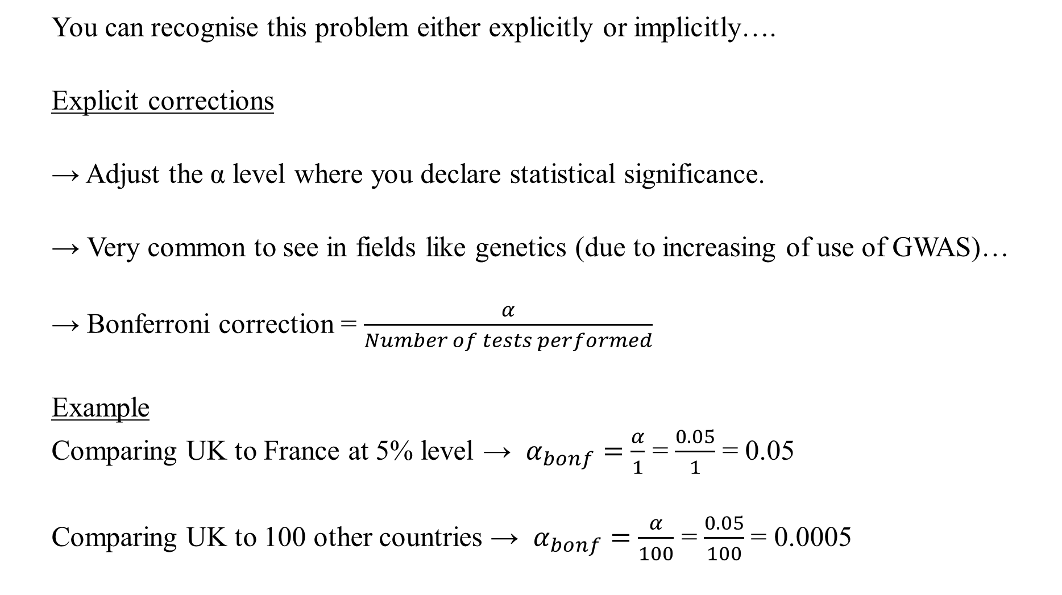
Bonferroni corrections….
  You can recognise this problem either explicitly or implicitly….
  Explicit corrections
  → Adjust the α level where you declare statistical significance.
  → Very common to see in fields like genetics (due to increasing of use of GWAS)…
  → Bonferroni correction = $\frac{α}{Number of tests performed}$
  Example
  Comparing UK to France at 5% level → $α_{bonf}=$ $\frac{α}{1}$ = $\frac{0.05}{1}$ = 0.05
  Comparing UK to 100 other countries → $α_{bonf}=$ $\frac{α}{100}$ = $\frac{0.05}{100}$ = 0.0005

Slide 26
Exercise
  Using the T-statistics you calculated previously:
  Convert these into p-values using the following link:
  http://www.socscistatistics.com/pvalues/tdistribution.aspx
  Calculate the ‘bonferroni corrected’ 5 percent significance level
  For which countries do you now find there to be a significant difference?
  Have your conclusions regarding ‘significant differences’ changed now that a correction for multi-hypothesis testing has been made?

Slide 27
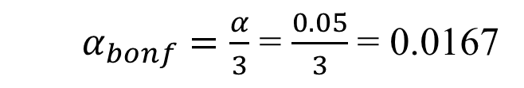
Answers
 | P-value for difference
 | Country A | Country B | Country C
Country A | - | - | -
Country B | 0.0886 | - | -
Country C | 0.0052 | 0.0461 | -
  $α_{bonf}=$ $\frac{α}{3}$ = $\frac{0.05}{3}$ = 0.0167
No significant difference between country A and B
Significant difference between country A and C
No Significant difference between country B and C (CHANGED FROM BEFORE)

Slide 28
Issues…
  Widely recognised Bonferroni correction goes too far the other way….
  Too conservative!
  Reduces chance of making a ‘Type I’ error (Incorrect rejection of null)…..
  ….by increasing the chance of a ‘Type II’ error (Incorrectly not rejecting the null)
  Alternatives have been proposed
  Benjamini and Hochberg correction
  http://nebc.nerc.ac.uk/courses/GeneSpring/GS_Mar2006/Multiple%20testing%20corrections.pdf
  Less conservative, but a little more complex to implement.
  Conclusion
  Important issue to recognise / understand in cross-country comparisons….
  …whether you make this explicit (via a correction) = judgement call!

Slide 29
Use of multiple corrections in PISA……
  OECD policy on whether to make Bonferroni correction when declaring statistical significance in their rankings seems to have changed over time…..
  2000 results – Presented results with Bonferroni correction
  2003 results – Presented results both with and without Bonferroni correction applied
  2006 onwards – No Bonferroni correction made
  Reason given:
  A lot more countries took part in 2006 than 2000.
  Adjusted p-value would fall from 0.0017 (2000) to 0.00009 (2006)
  Considered prohibitively strict
  Implication
  Different critical values have been applied across cycles
  Some differences declared as NS in 2003 would have been declared as SIG in 2006
Notes:
See page 59 of 2003 http://www.oecd.org/education/school/programmeforinternationalstudentassessmentpisa/34002216.pdf
See Scotland 2009 report for statement of OECD non-use of Bonferroni http://www.scotland.gov.uk/Publications/2010/12/10141122/1
See http://www.oecd.org/pisa/pisaproducts/39703267.pdf
“As the number of countries increases, so does the critical value associated with the Bonferroni-adjusted multiple comparisons. In PISA 2000, 31 simultaneous comparisons gave rise to adjusting an = 0.05 significance level to = 0.00167. In PISA 2006, the number of simultaneous comparisons would give rise to an adjusted significance level of = 0.000091. This means that different critical values are applied across cycles. This is especially important to countries when comparing results to other countries with similar results. It is possible that countries with small but significant differences in results in one cycle may be classified as having non-significant differences in the next cycle, despite having much the same results, simply because there are an increased number of participants. For this reason, it was decided not to employ the Bonferroni method for making comparisons in PISA 2006.

Slide 30
International averages and senate weights

Slide 31
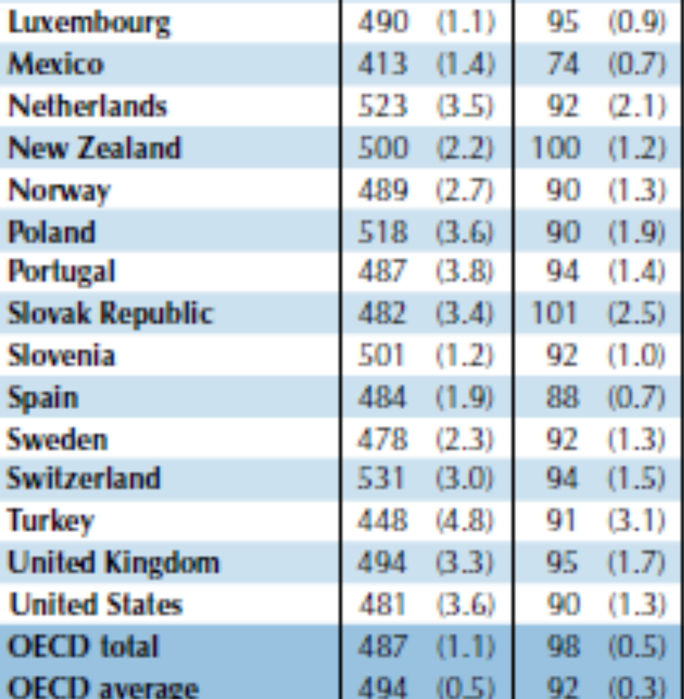
International total and averages
  The OECD reports contain two statistics that, at face value, seem quite similar:
  OECD total (aka ‘house average’)
  OECD average (aka ‘senate average’)
  But they contain different results!
  What is the difference between them?
  How do we calculate them?
  When is it appropriate to prefer one over the other?
Source: PISA 2012 report

Slide 32
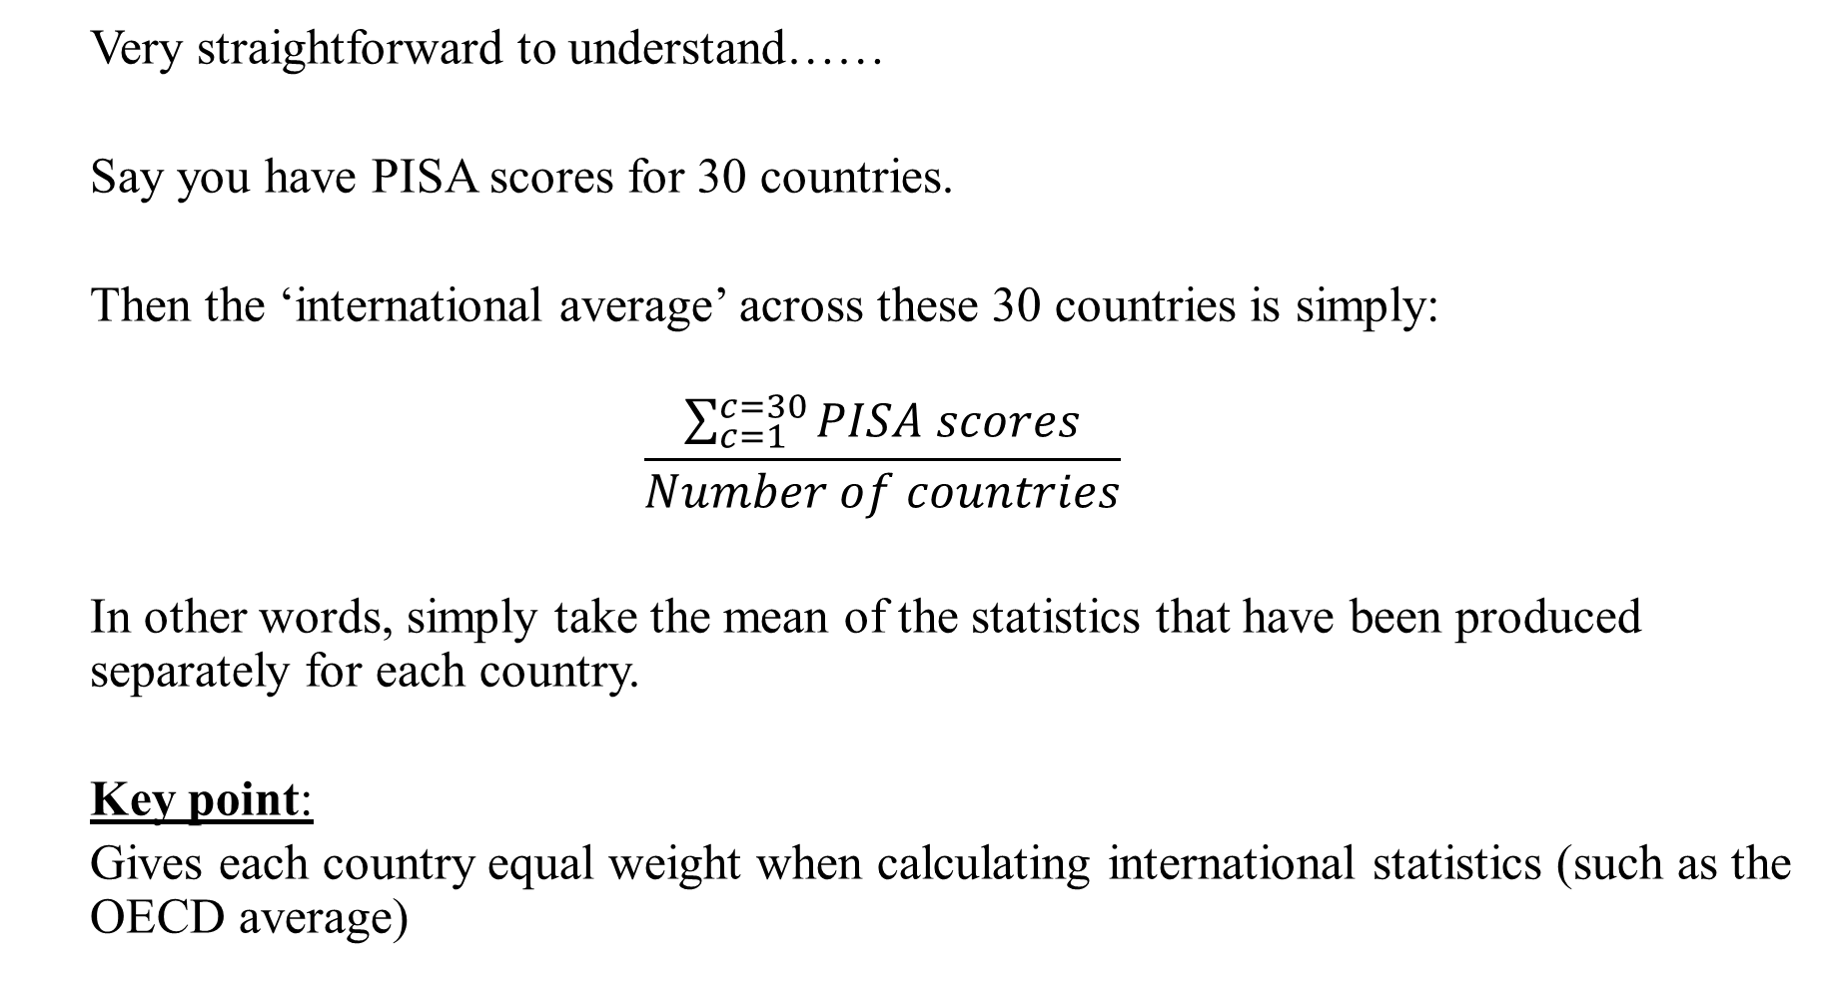
International average
  Very straightforward to understand……
  Say you have PISA scores for 30 countries.
  Then the ‘international average’ across these 30 countries is simply:
  $$\frac{\sum_{c=1}^{c=30}{PISA scores}}{Number of countries}$$
  In other words, simply take the mean of the statistics that have been produced separately for each country.
  Key point:
  Gives each country equal weight when calculating international statistics (such as the OECD average)

Slide 33
‘Senate weights’
  ‘Senate weights’ often provided in international databases for ease of calculation
  These weights basically re-scale the final respondent weight (e.g. student weight in PISA)……
  ….so that the sum of these weights then equals the same value (e.g. 1,000) for each country.
  If you then have all countries included within one datafile…..
  ….you can apply this senate weight (rather than the final student weight) to easily calculated the international average (and other international statistics)
  A note of caution
  If you make sample selections (e.g. drop immigrants from your analysis) senate weights provided unlikely to continue to equal same constant in all countries…
  I.E. They will not longer weight each country in your analysis equally!
  ….so you will need to adjust them

Slide 34
International total / House average
  Also known as the ‘house average’
  Pool all of your countries of interest into a single datafile
  Estimate your statistic of interest using this pooled datafile, applying the final respondent weight
  Each country will then be weighted by its population size
  Large countries will have a much bigger influence upon the figure produced
  E.g. United States will drive the ‘house average’ if calculated for North America

Slide 35
Example: % who attend pre-school across 6 countries
Country | Sample size | Population size | Proportion who attended pre-school
USA | 4,914 | 3,495,270 | 98.5
Albania | 4,336 | 38,794 | 74.6
Croatia | 4,969 | 45,172 | 73.2
Lithuania | 4,590 | 32,847 | 35.0
Montenegro | 4,683 | 7,608 | 69.5
Kazakhstan | 5,798 | 208,013 | 67.2
House average (Population weighted) | 94.2
Senate average (Equally weighted) | 69.7
  In this example, choice between house and senate average make a big difference…..
  Why?
  US is an outlier compared to other countries…..
  …and has a particularly big weight

Slide 36
Which figure should I prefer / report?
  Depends upon your question / interest.
  Example
  You are interested in private schooling in South America
  The international (‘senate’) average will allow you take make statements like:
  ‘In the average South American country, X percent of children are enrolled in private school.’
  The international total (‘house average’) will allow you take make statements like:
  ‘X percent of 15 year olds across South America are enrolled in a private sector school.’
  Think → Are pupils/teachers or countries your unit of interest?

Slide 37
National and international z-scores

Slide 38
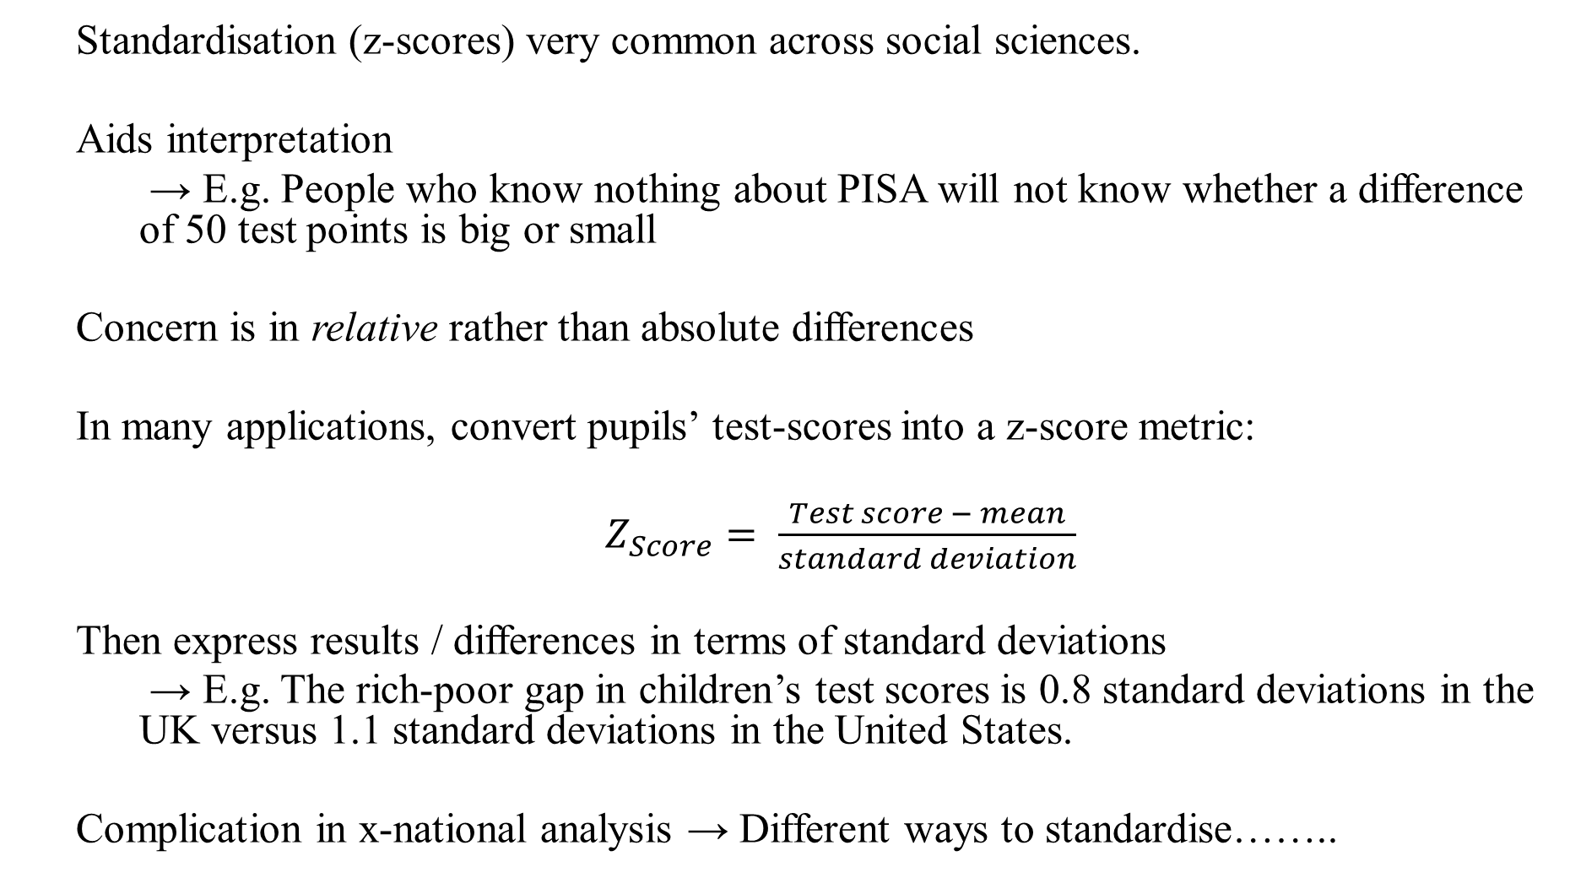
Why standardise?
  Standardisation (z-scores) very common across social sciences.
  Aids interpretation
  → E.g. People who know nothing about PISA will not know whether a difference of 50 test points is big or small
  Concern is in relative rather than absolute differences
  In many applications, convert pupils’ test-scores into a z-score metric:
  $Z_{Score}= \frac{Test score − mean}{standard deviation}$
  Then express results / differences in terms of standard deviations
  → E.g. The rich-poor gap in children’s test scores is 0.8 standard deviations in the UK versus 1.1 standard deviations in the United States.
  Complication in x-national analysis → Different ways to standardise……..

Slide 39
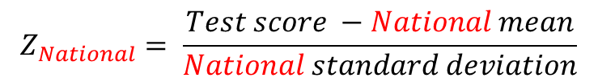
National z-scores (standardisation)
  Standardise variables separately within each country:
  Example
  UK: National mean = 490; national SD = 110
  Finland: National mean = 520; national SD = 85
  Difference mean and SD used in each country
  Implications
  Forces distribution of test scores to be similar (mean 0 and SD 1) within each country….
  Thus abstracts from differences in variance / inequality in variable across countries….
  Focus becomes upon differences in rank position across countries….
$$Z_{National}= \frac{Test score −National mean}{National standard deviation}$$

Slide 40
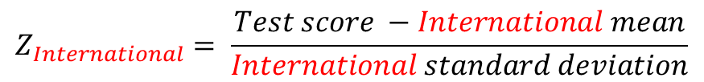
International z-scores (standardisation)
  Standardise variables across all countries together
  Same mean and SD used to standardise for each country
  Note → possible to use either house or senate international figures…..
  Implications
  Distribution of test scores continues to differ across countries (i.e. unequal variances)…
  Thus results continue of incorporate differences in variance / inequality across countries….
$$Z_{International}= \frac{Test score −International mean}{International standard deviation}$$

Slide 41
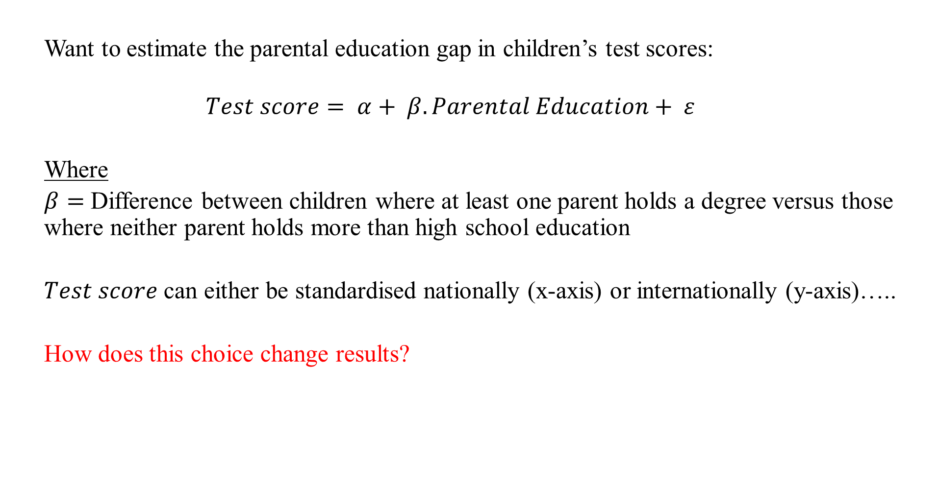
Example….
  Want to estimate the parental education gap in children’s test scores:
  $$Test score= α+ β.Parental Education+ ε$$
  Where
  $β=$ Difference between children where at least one parent holds a degree versus those where neither parent holds more than high school education
  $Test score$ can either be standardised nationally (x-axis) or internationally (y-axis)…..
  How does this choice change results?

Slide 42
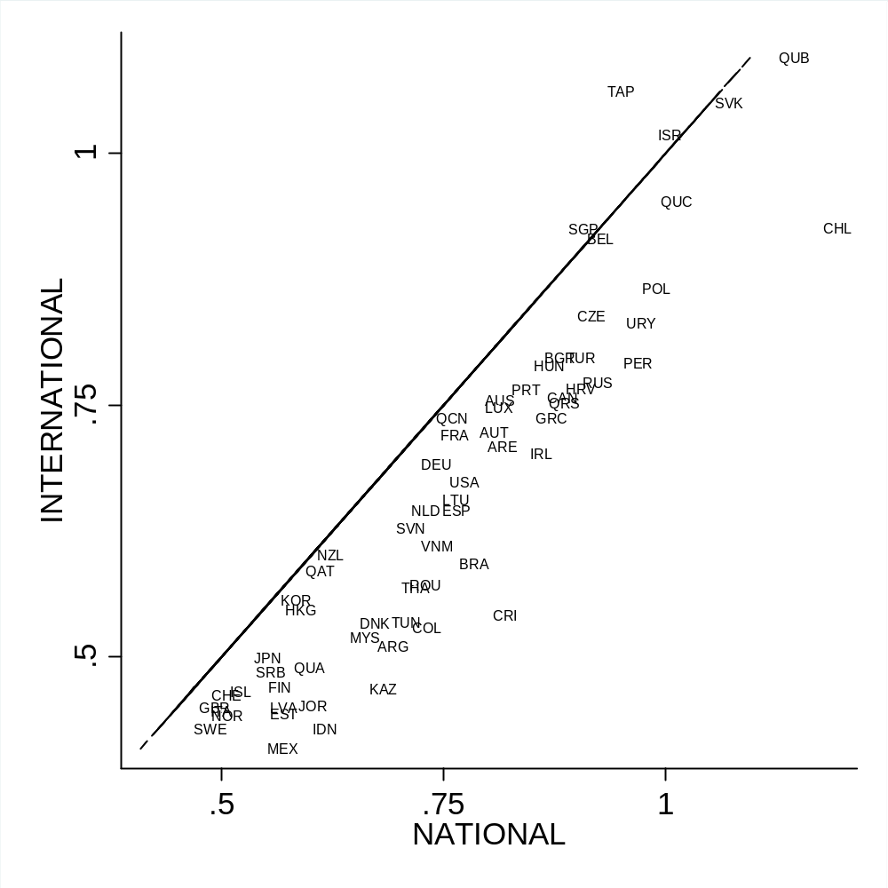
Results: National vs International (house) z-scores
Effect sizes tend to be bigger when using national z-scores (points fall below 45 degree line).
Why?
→ National SD tend to be smaller than international SD
→ Hence smaller value in denominator
→ Leads to bigger effect sizes
2. Some countries affected more than others
Why?
Chile has a particularly small national SD
Chinese Taipei particularly large national SD
3. Country comparisons can look quite different depending on which is used
E.g. France vs Columbia
Both 0.75 national standard deviation difference
But falls to 0.50 in Columbia when using international SD
Why?
National z-score abstracts from the low inequality (SD) in Columbia’s PISA test scores

Slide 43
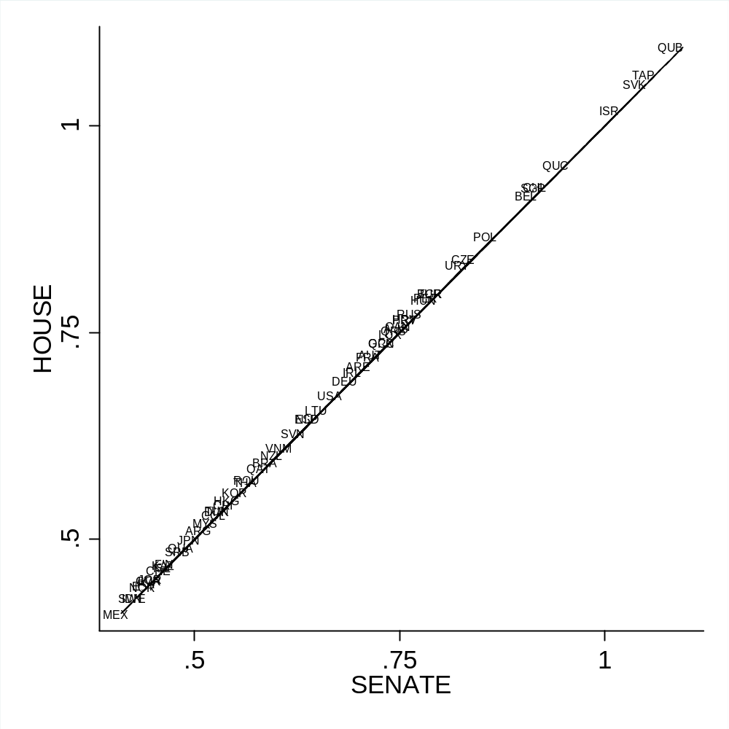
International house vs International senate z-scores
It makes almost no difference which approach you use when it comes to international standardisation!

Slide 44
Comparing binary outcome models across countries

Slide 45
Example question
  Outcome of interest may be binary….
  E.g. SES difference in a young person going to university (0 = No; 1 = Yes)
  Would be reasonable to investigate how this differs across countries…..
  Logistic regression would often be used to estimated such ‘binary outcome’ models…..
  ….with results often presented in terms of odds-ratios or log-odds
  However, these estimates may not be comparable across countries……
  …due to an infrequently discussed methodological issue

Slide 46
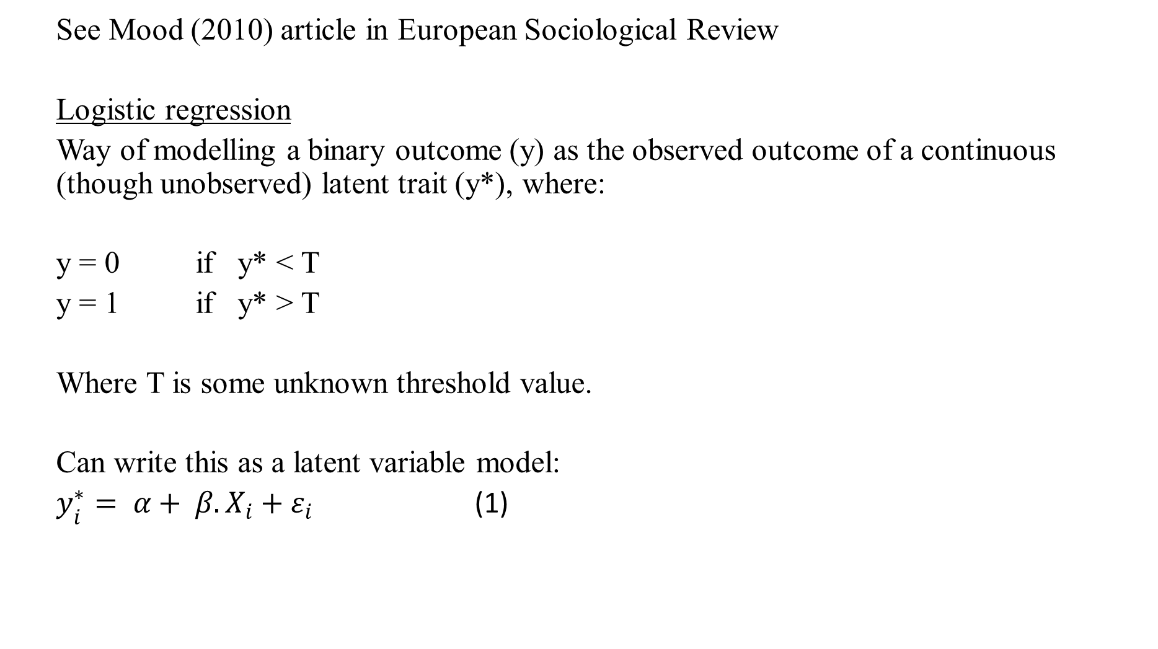
The issue
  See Mood (2010) article in European Sociological Review
  Logistic regression
  Way of modelling a binary outcome (y) as the observed outcome of a continuous (though unobserved) latent trait (y*), where:
  y = 0 if y* < T
  y = 1 if y* > T
  Where T is some unknown threshold value.
  Can write this as a latent variable model:
  $y_{i}^{∗}= α+ β.X_{i}+ε_{i}$ (1)
Notes:
Mood, C. 2010. ‘Logistic Regression: Why We Cannot Do What We Think We Can Do, and What We Can Do About It.’ European Sociological Review 26(1):67-82.

Slide 47
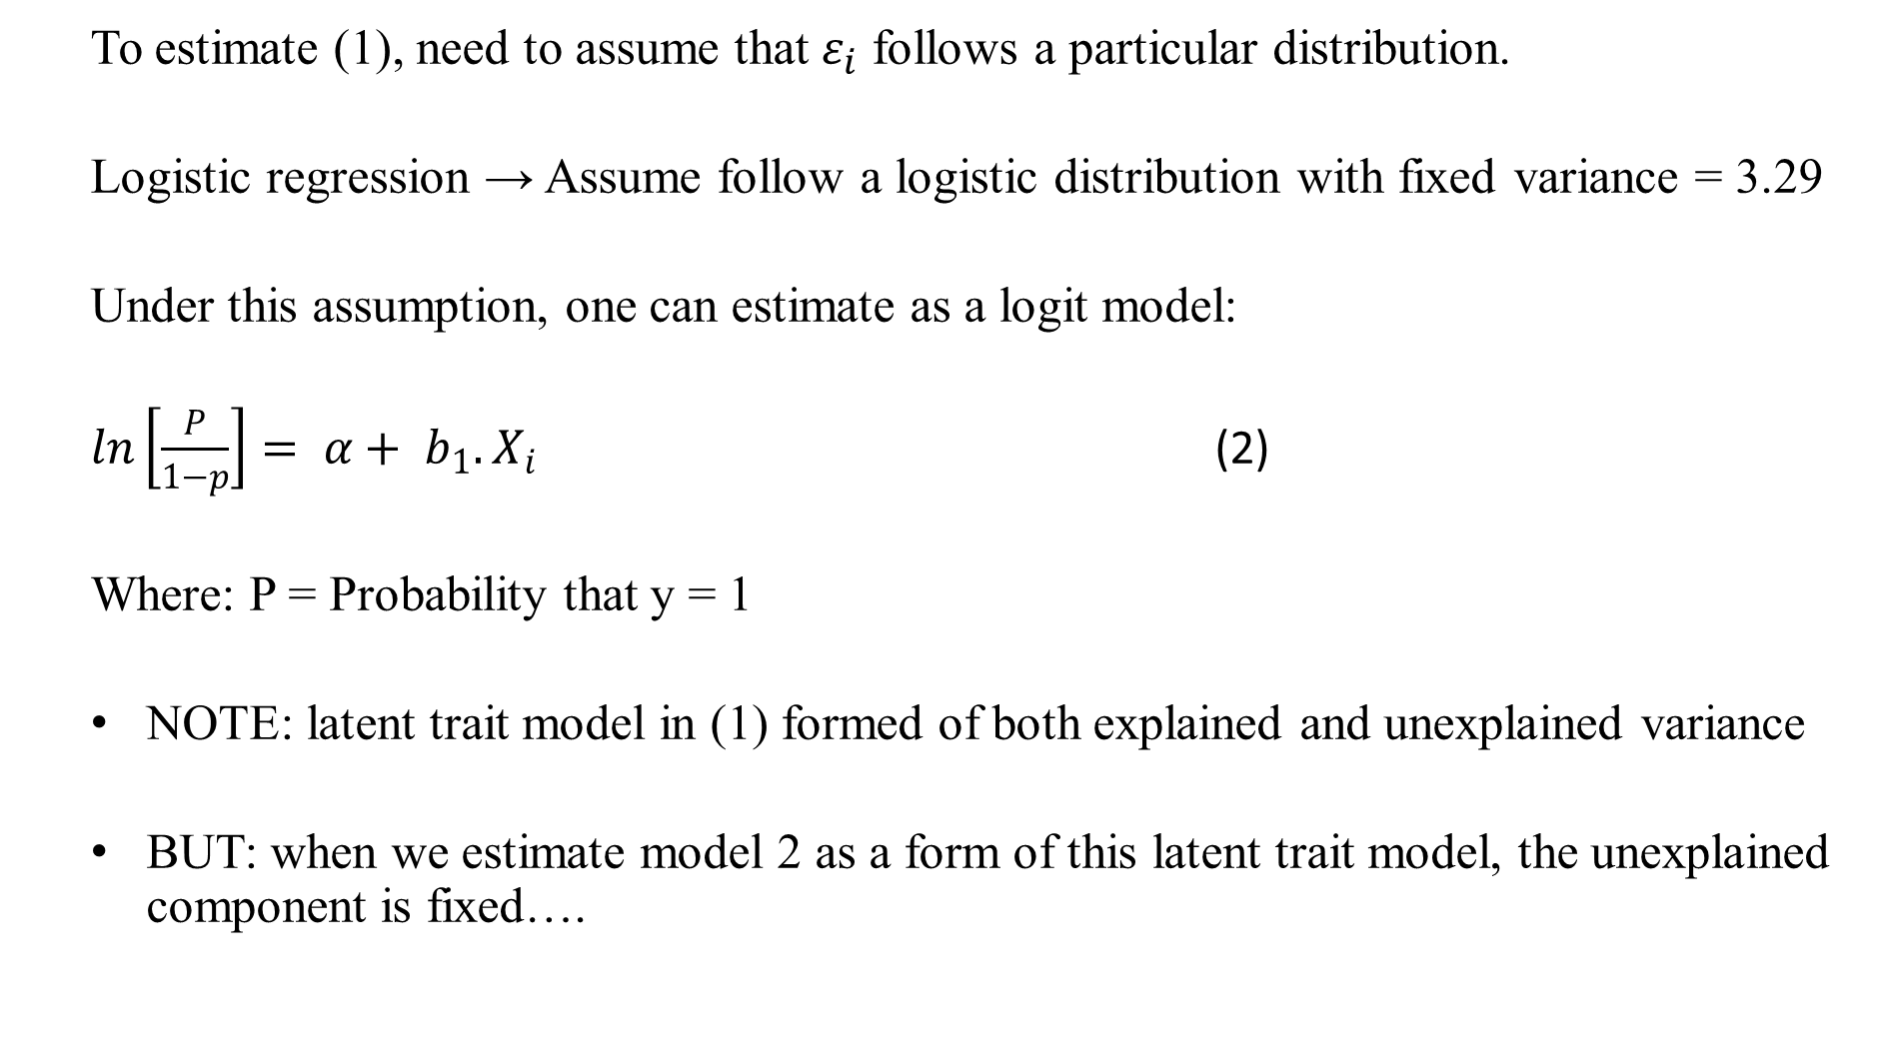
The issue
  To estimate (1), need to assume that $ε_{i}$ follows a particular distribution.
  Logistic regression → Assume follow a logistic distribution with fixed variance = 3.29
  Under this assumption, one can estimate as a logit model:
  $ln\left[\frac{P}{1−p}\right]= α+ b_{1}.X_{i}$ (2)
  Where: P = Probability that y = 1
  NOTE: latent trait model in (1) formed of both explained and unexplained variance
  BUT: when we estimate model 2 as a form of this latent trait model, the unexplained component is fixed….
Notes:
Mood, C. 2010. ‘Logistic Regression: Why We Cannot Do What We Think We Can Do, and What We Can Do About It.’ European Sociological Review 26(1):67-82.

Slide 48
The issue
  When covariates are added to the logistic regression model, the explained variance has to go somewhere!
  Can’t change the unexplained variance component (as fixed)…..
  …hence increases the variance (and hence the scale) of the dependent variable
  BUT → When the scale of the dependent variable changes, so does our estimate of the parameter of interest (b1)
  IMPLICATIONS
  Log-odds / odds-ratios can differ/change across groups (e.g. countries) simply because of differences in “unobserved heterogeneity” – rather than there being a “true” difference of substantive importance
  Adding controls that are not associated with the covariate of interest (but is nevertheless associated with dependent variable) influences parameter of interest….
  …… {different to situation under OLS}
Notes:
Mood, C. 2010. ‘Logistic Regression: Why We Cannot Do What We Think We Can Do, and What We Can Do About It.’ European Sociological Review 26(1):67-82.

Slide 49
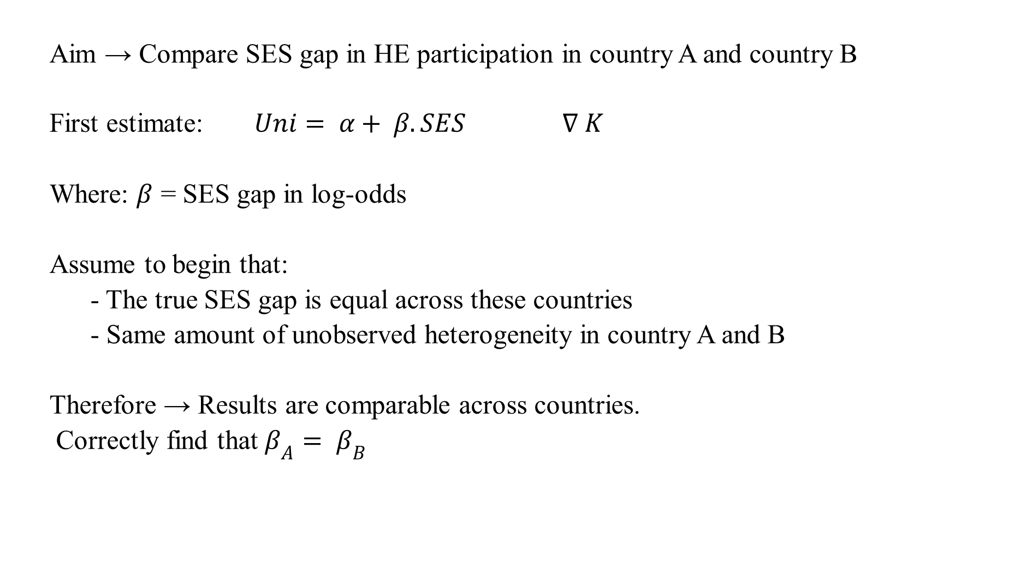
Implications for x-national comparisons: Example
  Aim → Compare SES gap in HE participation in country A and country B
  First estimate: $Uni= α+ β.SES ∇ K$
  Where: $β$ = SES gap in log-odds
  Assume to begin that:
  - The true SES gap is equal across these countries
  - Same amount of unobserved heterogeneity in country A and B
  Therefore → Results are comparable across countries.
  Correctly find that $β_{A}= β_{B}$
Notes:
Mood, C. 2010. ‘Logistic Regression: Why We Cannot Do What We Think We Can Do, and What We Can Do About It.’ European Sociological Review 26(1):67-82.

Slide 50
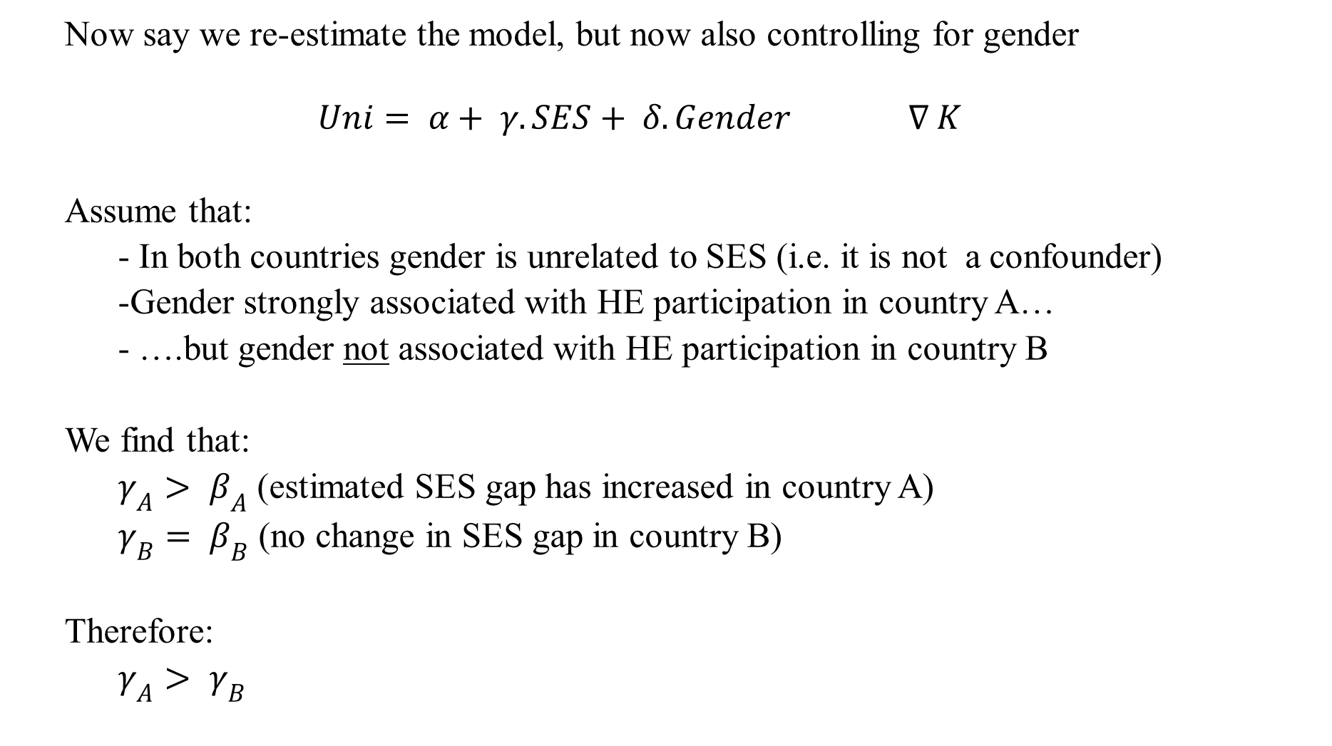
Example
  Now say we re-estimate the model, but now also controlling for gender
  $$Uni= α+ γ.SES+ δ.Gender ∇ K$$
  Assume that:
  - In both countries gender is unrelated to SES (i.e. it is not a confounder)
  -Gender strongly associated with HE participation in country A…
  - ….but gender not associated with HE participation in country B
  We find that:
  $γ_{A}> β_{A}$ (estimated SES gap has increased in country A)
  $γ_{B}= β_{B}$ (no change in SES gap in country B)
  Therefore:
  $γ_{A}> γ_{B}$
Notes:
Mood, C. 2010. ‘Logistic Regression: Why We Cannot Do What We Think We Can Do, and What We Can Do About It.’ European Sociological Review 26(1):67-82.

Slide 51
Example
  In other words, now (incorrectly) find that SES gap in HE access varies across countries!!
  ….(We should not find this – Gender not confounded with SES!)
  …Get this result (in this hypothetical example) because Gender explains variance in the outcome in country A but not in country B
  …This means dependent variable for country A no longer on the same scale as the dependent variable for country B
  Key point (Mood 2010:73)
  To compare logits /odds-ratios across countries, need to assume that
  “unobserved heterogeneity is the same across the compared groups [countries]”
  → This may be a strong assumption to make ←
Notes:
Mood, C. 2010. ‘Logistic Regression: Why We Cannot Do What We Think We Can Do, and What We Can Do About It.’ European Sociological Review 26(1):67-82.

Slide 52
Possible solutions…..
  Suggested solutions
    Various authors have come up with ways to ‘deal’ with this
    - Allison (1999) – Test for whether it seems to be a problem
    - Williams (2006) critical of this and offers alternative solution
    - Karlson et al (2011) – Create a Stata command (KHB) to adjust estimates for the problem
    Mood (2010) – May choose to use linear probability model instead
    None of these are ideal – or have certain limitations / constraints
    My advice
    Be aware of the problem!
    Linear probability model has particular attractions….
    Test robustness of results to producing estimates different ways

Slide 53
Conclusions
Choice of countries to include often not easy…..
….always link back to your RQ. What are you trying to achieve?
Need to formally conduct two-sample t-test for differences across countries….
…overlapping confidence intervals insufficient
Correction for multiple hypothesis testing → Judgement call….
…but important to at least understand and implicitly recognise the issue
Two different ways of calculating pooled (cross-country) statistics → (House and Senate)
Two different ways of standardising continuous variables → (national and international)
Comparing estimates from binary response model across countries → Not as straightforward as it may first seem (and often assumed)

