Slide 1
The design and use of test scores
Lecture 4

Slide 2
Aims of the lecture
To understand how the large scale international assessment tests are designed
To understand what ‘plausible values’ are, why they are used and how they should be analysed.
Provide a basic understanding of Item-Response Theory (IRT), including how their use differs across the large scale international assessments
Gain experience of analysing plausible values using the PISA dataset.

Slide 3
Item-response theory
Notes:
See Rutkowski (2013:83)

Slide 4
NOTE
This is not a course about IRT!
I am going to give you a quick ‘crash course’ in it….
Why?
Because the international assessments use it….
So you will need to know about it (even at a superficial level)…
Will also feed into what I say later in the lecture….
Notes:
See Rutkowski (2013:83)

Slide 5
What is item response theory (IRT)?
Idea → Ability in any given area is an unobserved ‘latent trait’
Want to be able to measure this trait on a reliable scale.
To measure this latent trait, we give children a test with a number of questions….
- Each question marked as 0 for incorrect and 1 for correct.
Classical test theory (CTT)
We simply add up the number of correct responses and give children a total score
Item-response theory (IRT)
Interest is whether child got each question right or not…..
….one models the probability of a correct response
Notes:
Problems with CTT:
- Examinee and test characteristics can not be separated from one another….
- Assumes standard error of measurement same for all examinees

Slide 6
Why use IRT over CTT?
IRT
→ Scores ‘test independent’….
….scores do not depend upon the particular questions you ask in the test
→ Scores ‘sample independent’….
….scores do not depend upon the particular sample you give the test
→ Examinee and test characteristics can be separated from one another…..
→ Standard error of measurement differs across ability of the examinees…..
….i.e. there is no single ‘reliability’
Notes:
Problems with CTT:
- Examinee and test characteristics can not be separated from one another….
- Assumes standard error of measurement same for all examinees

Slide 7
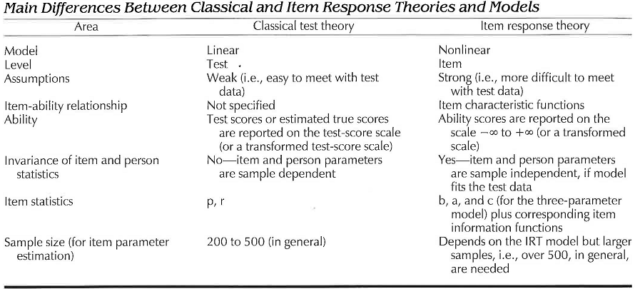
Why use IRT over CTT?
http://ncme.org/linkservid/66968080-1320-5CAE-6E4E546A2E4FA9E1/showMeta/0/
Notes:
Problems with CTT:
- Examinee and test characteristics can not be separated from one another….
- Assumes standard error of measurement same for all examinees

Slide 8
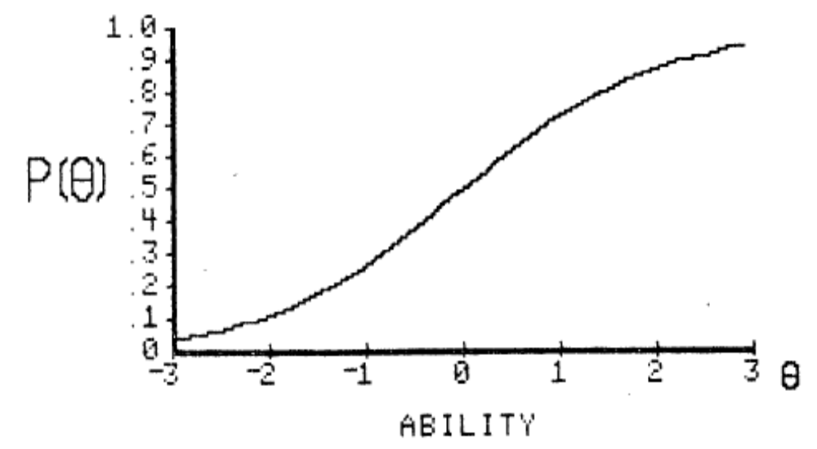
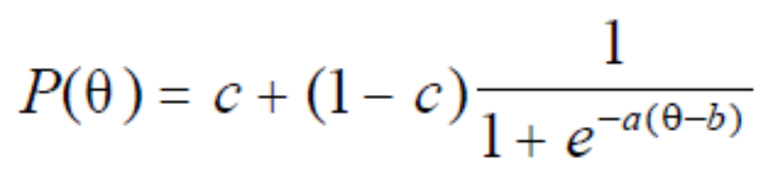
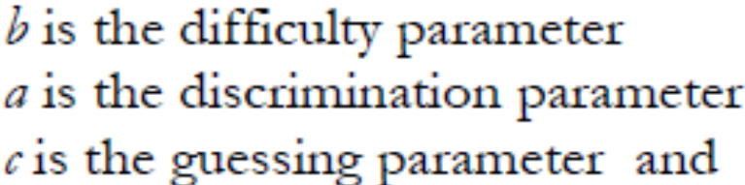
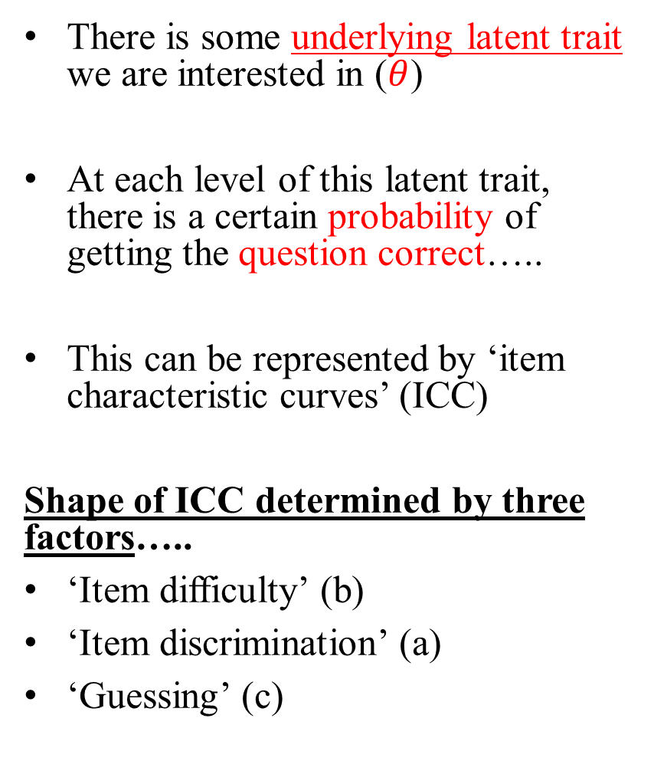
IRT: Item characteristic curves (ICC)
There is some underlying latent trait we are interested in ($θ$)
At each level of this latent trait, there is a certain probability of getting the question correct…..
This can be represented by ‘item characteristic curves’ (ICC)
Shape of ICC determined by three factors…..
‘Item difficulty’ (b)
‘Item discrimination’ (a)
‘Guessing’ (c)
Notes:
See Rutkowski (2013:83)

Slide 9
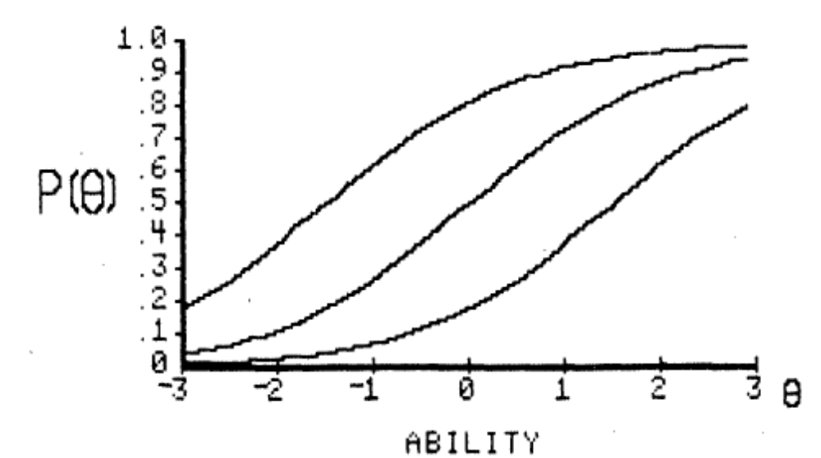
ICC – The ‘difficulty’ parameter (b)
Item difficulty influences the horizontal location of the ICC…..
Questions furthest to the right are ‘harder’…..
…lower probability of correct response at any given value of underlying latent trait
Note: ICC’s can’t cross if only b changes…..
Notes:
See Rutkowski (2013:83)

Slide 10
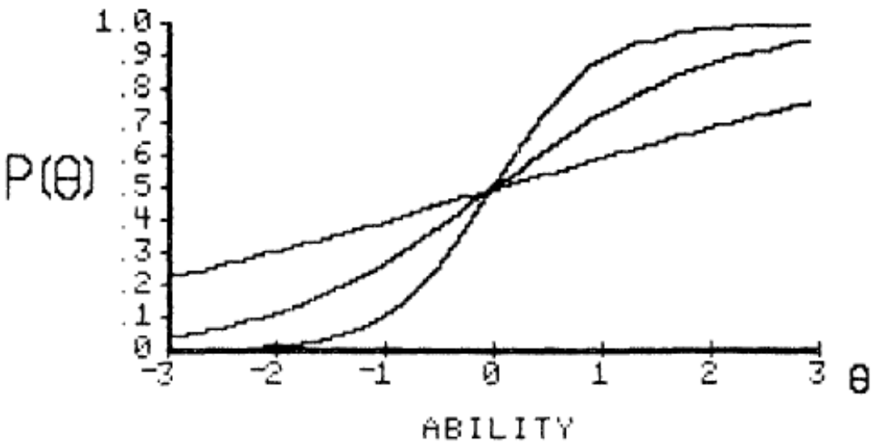
The ‘discrimination’ parameter (a)
Item discrimination influences the slope of the ICC…..
Some questions that ‘high ability’ children find (comparatively) hard (relative to other questions)……
….’low ability’ children find (comparatively) easy
ICC’s can cross when discrimination changes…..
Notes:
See Rutkowski (2013:83)

Slide 11
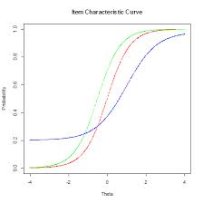
The ‘guessing’ parameter (c)
Asymptote not at 0…..
There is some non-zero probability that even a child with very low ability gets the test question correct……
E.g. Children can guess the correct answer…..
Notes:
See Rutkowski (2013:83)

Slide 12
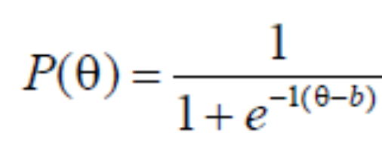
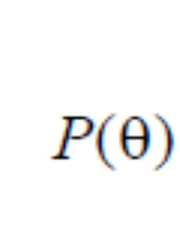
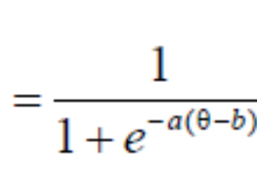
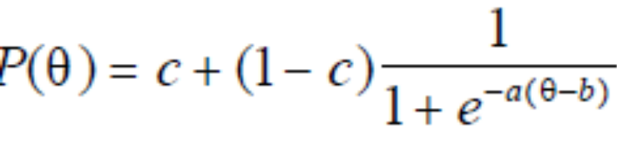
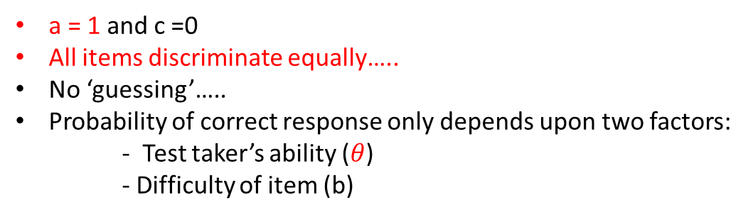
Three different types of IRT model…
1PL (Rasch) model
2PL model
3PL model
a = 1 and c =0
All items discriminate equally…..
No ‘guessing’…..
Probability of correct response only depends upon two factors:
- Test taker’s ability ($θ$)
- Difficulty of item (b)
c =0
Discrimination differs across items.
No ‘guessing’…..
a, b and c all estimated
Questions differ in discrimination….
‘Guessing’ can influence probability of correct response….
Questions of varying difficulty…..
Notes:
See Rutkowski (2013:83)

Slide 13
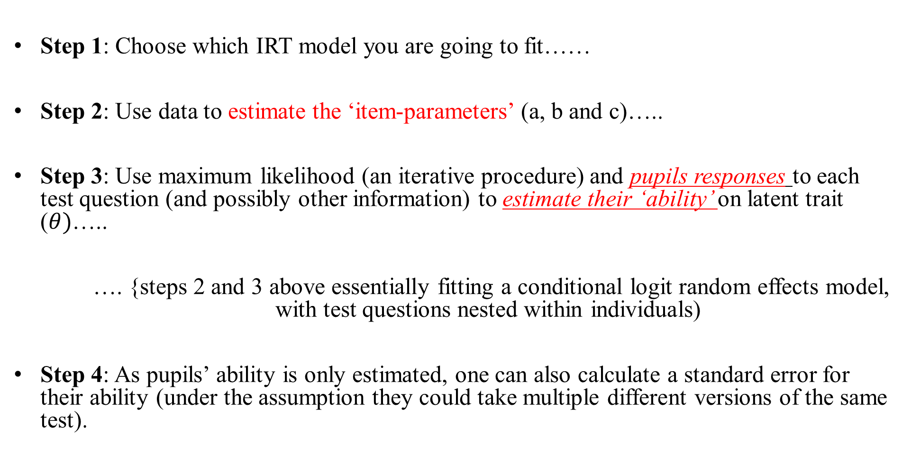
Using IRT to produce ‘test scores’…
Step 1: Choose which IRT model you are going to fit……
Step 2: Use data to estimate the ‘item-parameters’ (a, b and c)…..
Step 3: Use maximum likelihood (an iterative procedure) and pupils responses to each test question (and possibly other information) to estimate their ‘ability’ on latent trait ($θ)$…..
…. {steps 2 and 3 above essentially fitting a conditional logit random effects model, with test questions nested within individuals)
Step 4: As pupils’ ability is only estimated, one can also calculate a standard error for their ability (under the assumption they could take multiple different versions of the same test).
Notes:
See Rutkowski (2013:83)

Slide 14
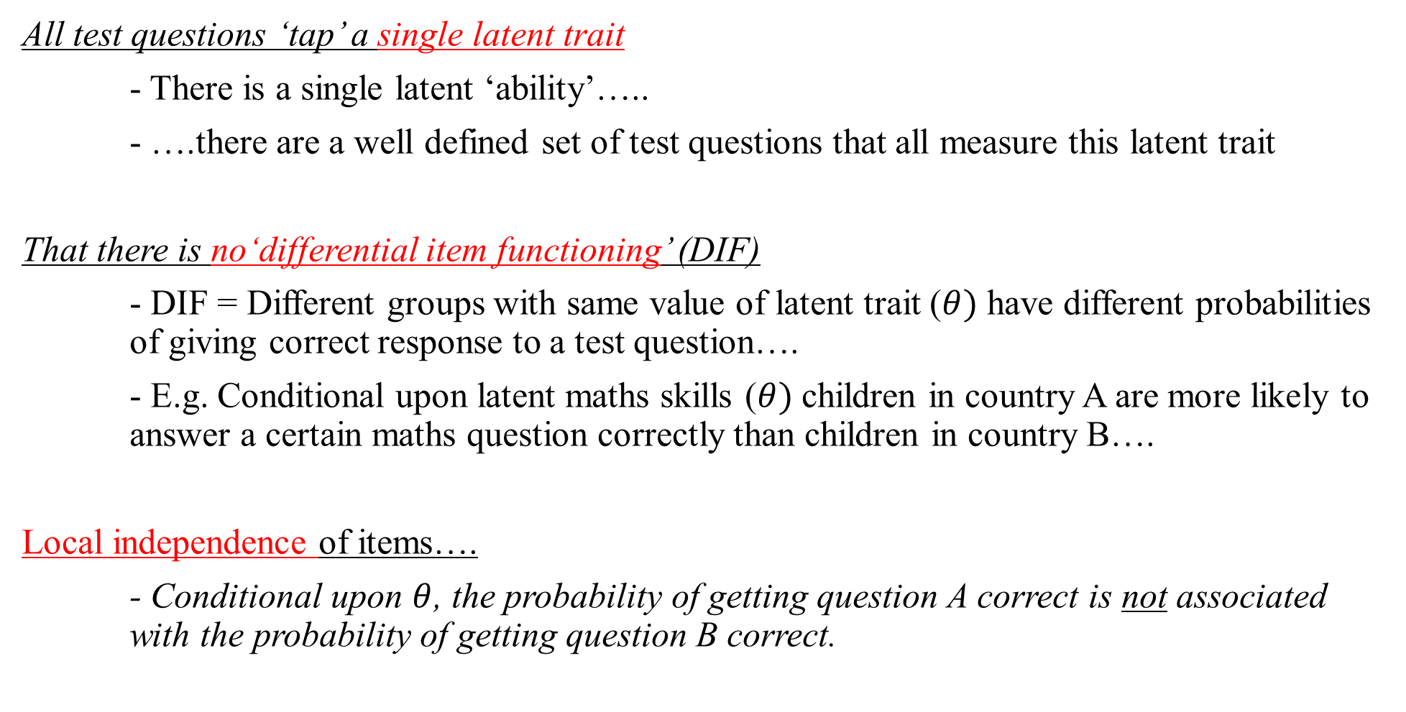
Assumptions of IRT modelling….
All test questions ‘tap’ a single latent trait
- There is a single latent ‘ability’…..
- ….there are a well defined set of test questions that all measure this latent trait
That there is no‘differential item functioning’ (DIF)
- DIF = Different groups with same value of latent trait ($θ)$ have different probabilities of giving correct response to a test question….
- E.g. Conditional upon latent maths skills ($θ)$ children in country A are more likely to answer a certain maths question correctly than children in country B….
Local independence of items….
- Conditional upon $θ$, the probability of getting question A correct is not associated with the probability of getting question B correct.
Notes:
See Rutkowski (2013:83)

Slide 15
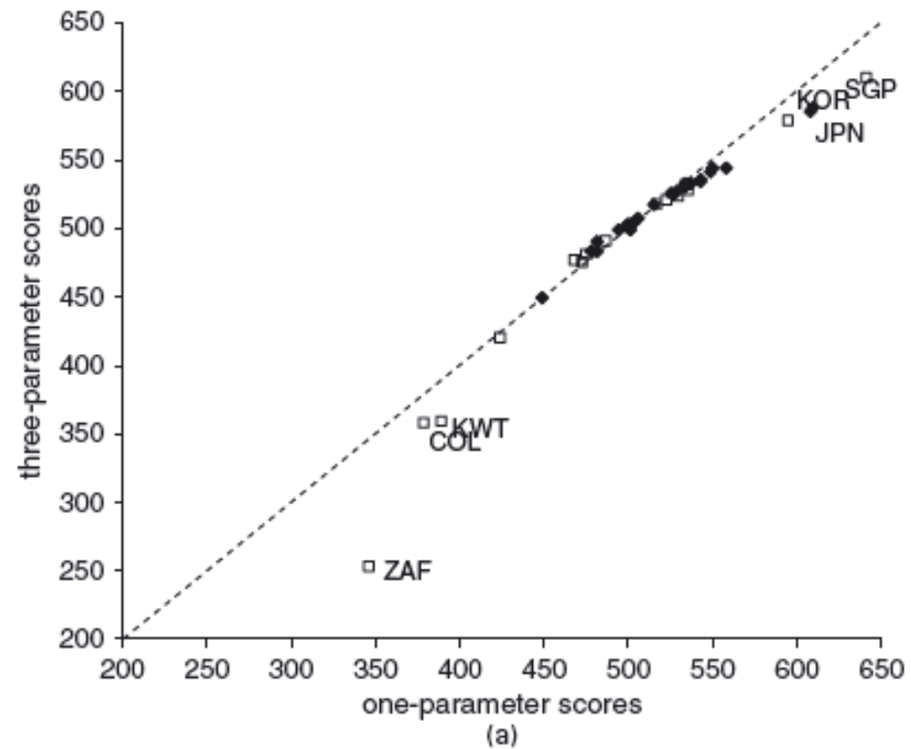
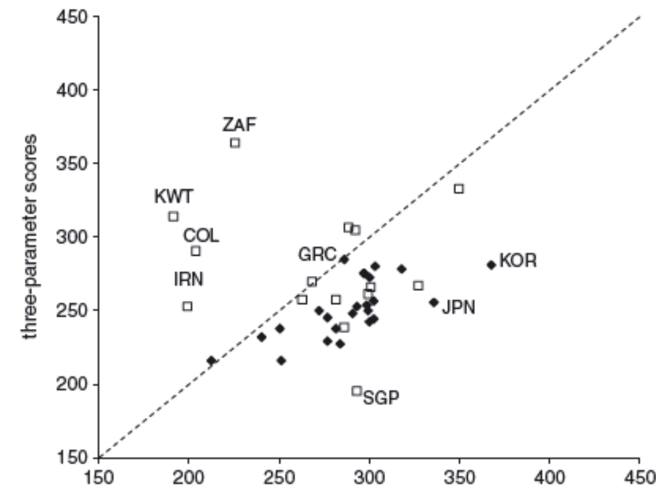
Does which IRT model you use make a difference?
Inequality (P95 – P5)
Median
Source: Brown et al (2007). ‘International surveys of educational achievement: How robust are the findings?’
Notes:
See Brown et al (2007). Figure 4 and Figure 6.

Slide 16
Why is all this important?
The large scale international assessments all use some form of IRT to scale children’s responses into overall test scores……
PISA = 1PL (Rasch) model → {Though soon moving towards a 2PL model as of 2015}
PIAAC = 2PL model
TIMSS = 3PL model
PIRLS = 3PL model
IRT is central to how ‘PISA scores’ are created…….
Notes:
See Rutkowski (2013:83)

Slide 17
How are the large scale international assessments designed
Notes:
See Rutkowski (2013:83)

Slide 18
The test design – an outline
Studies like PISA try to cover a lot of ground.
‘Tests’ children in three domains (reading, maths and science)……
….these domains are themselves made up of sub-domains.
E.g. PISA maths made up of the following sub-domains:
- Change and relationships
- Quantity
- Shape and space
- Uncertainty and data
A lot of ground to cover! And PISA is only a 2 hour exam…..
Therefore not all children can take all questions (or even cover all areas)
Hence the international assessments use ‘multiple-matrix’ sampling (MMS)

Slide 19
What is MMS?
In a nutshell…
Not every child takes every test question from each of the three domains….
….therefore, each child takes a random sample from the population of questions
Therefore, each child is measured using a sample of test items.
Advantages
Allows for broad content coverage (in reasonable time) across the pool of test takers….
So PISA 2012 provides estimate for reading, science, maths and 4 maths content sub-scales
Disadvantages
Large amount of measurement error at the pupil level…..
Not suitable for pupil level reporting (can’t feed back results to schools / pupils)

Slide 20
How is MMS implemented in PISA?
PISA 2009
- 131 reading items (‘major domain’)
- 34 maths items (‘minor domain’)
- 53 science items (‘minor domain’)
These test items were divided into 13 clusters
- 7 science clusters
- 3 reading clusters
- 3 maths clusters
Each cluster includes ≈ 30 minutes of test material
These clusters were then separated into 20
separate ‘test booklets’
- Each booklet contains 4 of the 13 clusters….
Notes:
See Rutkowski (2013:83)

Slide 21
How is MMS implemented in PISA?
Booklet | Clusters
1 | M1 | R1 | R3 | M3
2 | R1 | S1 | R4 | R7
3 | S1 | R3 | M2 | S3
4 | R3 | R4 | S2 | R2
5 | R4 | M2 | R5 | M1
6 | R5 | R6 | R7 | R3
7 | R6 | M3 | S3 | R4
8 | R2 | M1 | S1 | R6
9 | M2 | S2 | R6 | R1
10 | S2 | R5 | M3 | S1
11 | M3 | R7 | R2 | M2
12 | R7 | S3 | M1 | S2
13 | S3 | R2 | R1 | R5
14 | M1 | R1 | R3 | M3
15 | R1 | S1 | R4 | R7
16 | S1 | R3 | M2 | S3
17 | R3 | R4 | S2 | R2
18 | R4 | M2 | R5 | M1
19 | R5 | R6 | R7 | R3
20 | R6 | M3 | S3 | R4
Random allocation
Each child in PISA is randomly allocated one of these 20 booklets….
Notice
Not all booklets cover each domain
E.g. Booklet 2 → No maths questions!
But....
In the PISA file test scores will appear for every child in each domain
E.g. Maths test scores will be included for all children (even those who took test booklet 2)
Notes:
See Rutkowski (2013:83)

Slide 22
Implications
As different children take different versions of the test……
…..PISA / TIMSS etc not suitable for individual reporting
Raw scores and percentage correct not comparable across students…..
…as children have completed different booklets
But, it is argued, can provide robust estimates of performance at the group (e.g. country) and sub-group (e.g. gender) level
The large scale international assessments do this by using ‘latent regression item response theory’
Based upon Mislevy (1984, 1985) and development work by the Educational Testing Service.
Overview provided in the slides that follow…..
‘Latent regression’ = Random effect conditional logit model…..
Notes:
See Rutkowski (2013:83)

Slide 23
‘Latent regressions’ and the imputation of plausible values….
Notes:
See Rutkowski (2013:162). Bottom of page

Slide 24
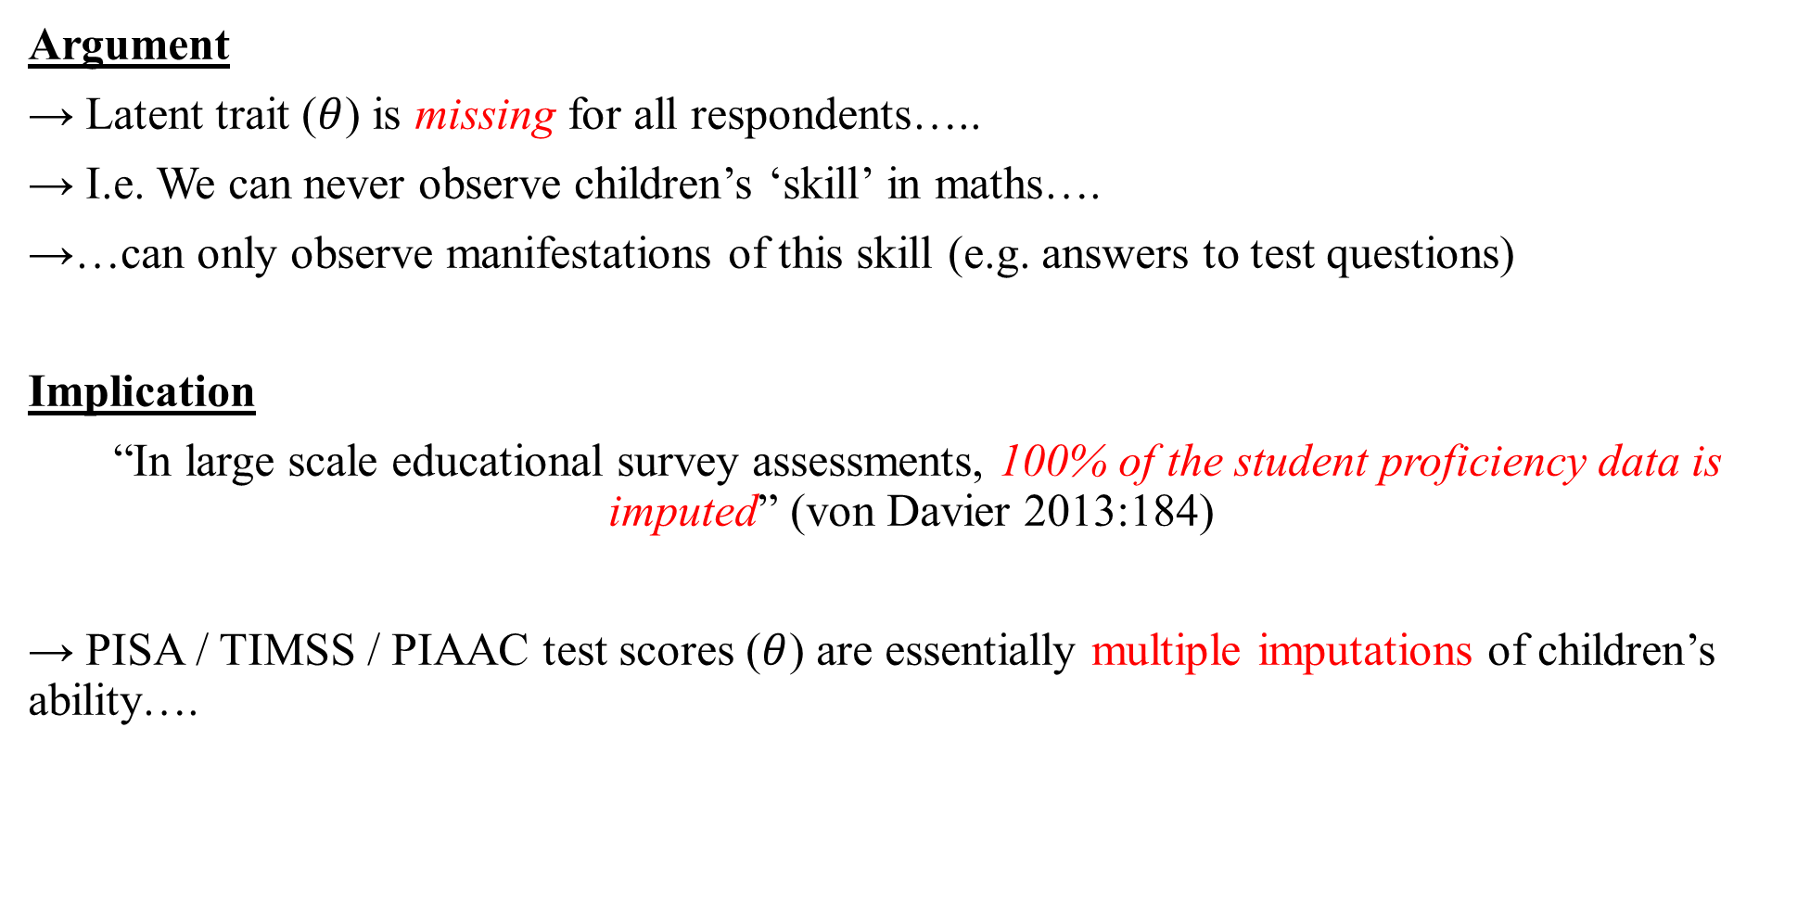
Starting point…..
Argument
→ Latent trait ($θ$) is missing for all respondents…..
→ I.e. We can never observe children’s ‘skill’ in maths….
→…can only observe manifestations of this skill (e.g. answers to test questions)
Implication
“In large scale educational survey assessments, 100% of the student proficiency data is imputed” (von Davier 2013:184)
→ PISA / TIMSS / PIAAC test scores ($θ$) are essentially multiple imputations of children’s ability….
Notes:
See Rutkowski (2013:83)

Slide 25
How does MMS test design feed into this??
Recall from IRT
IRT models are essentially random effect conditional logit models….
….where responses to test questions are nested within individuals…..
MMS
Each pupil will be missing some test question responses by design……
….but, as booklets (and hence test questions) randomly assigned,
….it is reasonable to assume that these data at Missing Completely At Random (MCAR)
→ The missing item data is ignorable ←
→ Unbiased estimates obtainable from sub-sample of responses….
…. But by using imputation we boost efficiency
Notes:
See Rutkowski (2013:83)

Slide 26
How are the multiple imputations produced?
Step 1: ‘Item calibration’
- Fit an IRT model to children’s responses to the test questions….
- Gets estimated item parameters (‘b’)
- E.g. ‘b’ = Item difficulty under Rasch model….
Step 2: PCA performed on the background variables
- All large scale international surveys contain ‘background variables’ (z)
- E.g. Gender, SES, immigrant status etc
- Perform a PCA on all these variables…..
- … retain as many components as needed to explain 90% of the variance
Notes:
See Rutkowski (2013:162). Bottom of page. Latent regression = multi-level model =
See http://faculty.education.illinois.edu/cja/homepage/Advances_Log_Reg_IRT_print.pdf

Slide 27
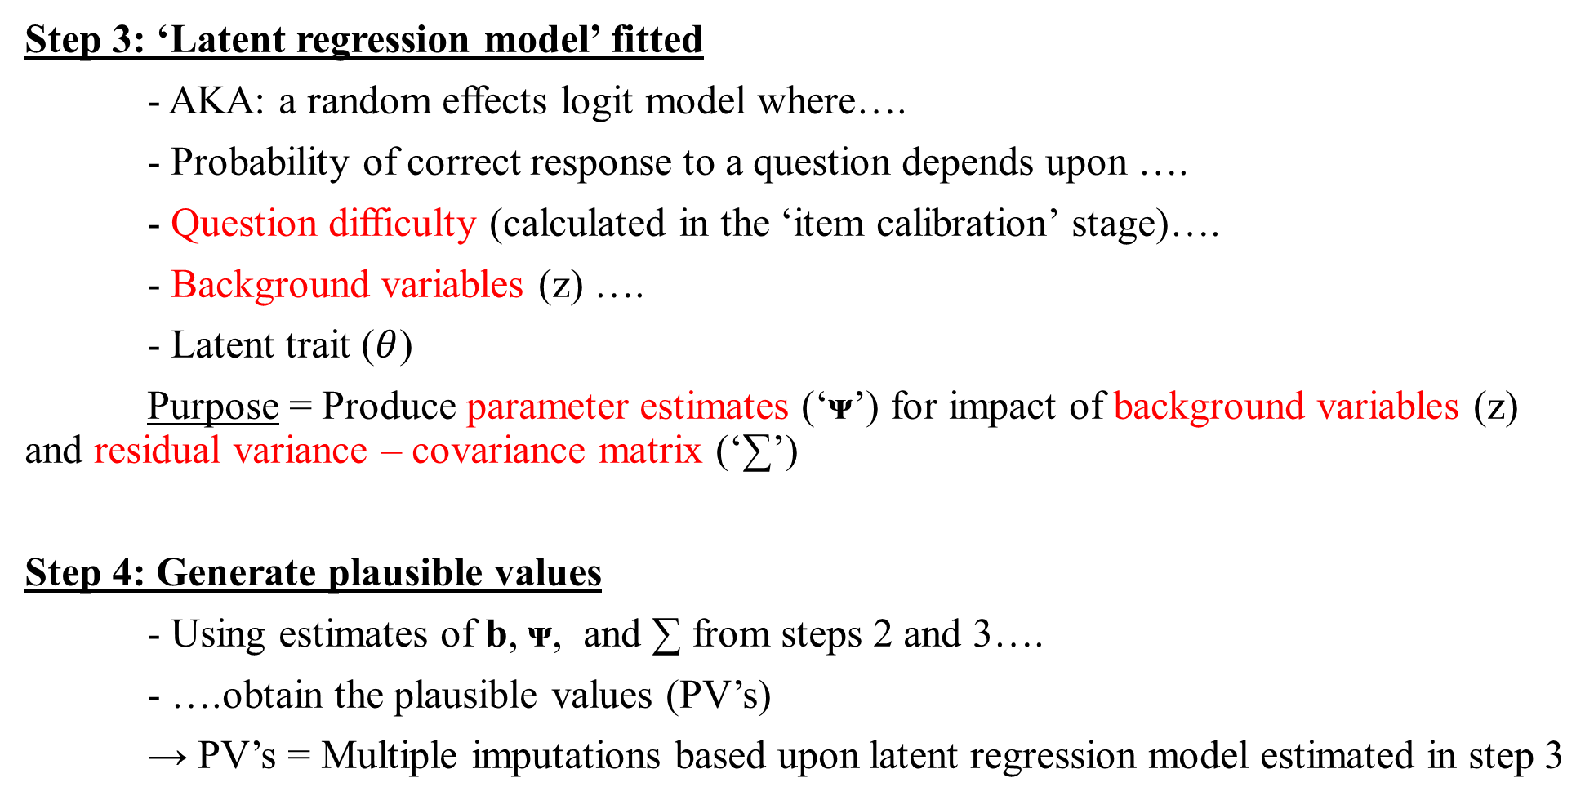
How are the multiple imputations produced?
Step 3: ‘Latent regression model’ fitted
- AKA: a random effects logit model where….
- Probability of correct response to a question depends upon ….
- Question difficulty (calculated in the ‘item calibration’ stage)….
- Background variables (z) ….
- Latent trait ($θ$)
Purpose = Produce parameter estimates (‘ᴪ’) for impact of background variables (z) and residual variance – covariance matrix (‘∑’)
Step 4: Generate plausible values
- Using estimates of b, ᴪ, and ∑ from steps 2 and 3….
- ….obtain the plausible values (PV’s)
→ PV’s = Multiple imputations based upon latent regression model estimated in step 3
Notes:
See Rutkowski (2013:157 and 161).

Slide 28
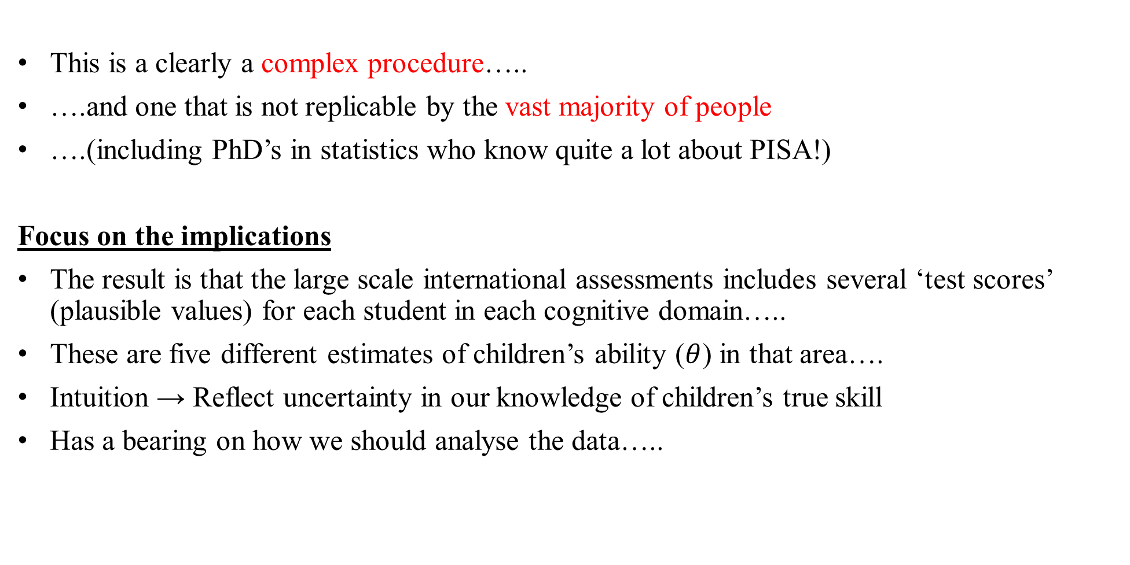
Result…
This is a clearly a complex procedure…..
….and one that is not replicable by the vast majority of people
….(including PhD’s in statistics who know quite a lot about PISA!)
Focus on the implications
The result is that the large scale international assessments includes several ‘test scores’ (plausible values) for each student in each cognitive domain…..
These are five different estimates of children’s ability ($θ$) in that area….
Intuition → Reflect uncertainty in our knowledge of children’s true skill
Has a bearing on how we should analyse the data…..
Notes:
See Rutkowski (2013:157 and 161).

Slide 29
How plausible values look in PISA….
Notice
A lot of variability in these PV at the individual level…
…difference of 150 points
(approx. 3 years of schooling)
Too much uncertainty in individual pupil results to report them back
Key point
This uncertainty is greatly reduced when looking at group (or sub-group) level…..
ID | PV1MATH | PV2MATH | PV3MATH | PV4MATH | PV5MATH
1 | 281 | 298 | 164 | 280 | 319
2 | 245 | 280 | 244 | 175 | 216
3 | 486 | 449 | 457 | 423 | 427
4 | 356 | 284 | 323 | 286 | 237
5 | 381 | 342 | 439 | 368 | 307
Notes:
See Rutkowski (2013:157 and 161).

Slide 30
How to use PV’s in your analysis
Notes:
See Rutkowski (2013:162). Bottom of page

Slide 31
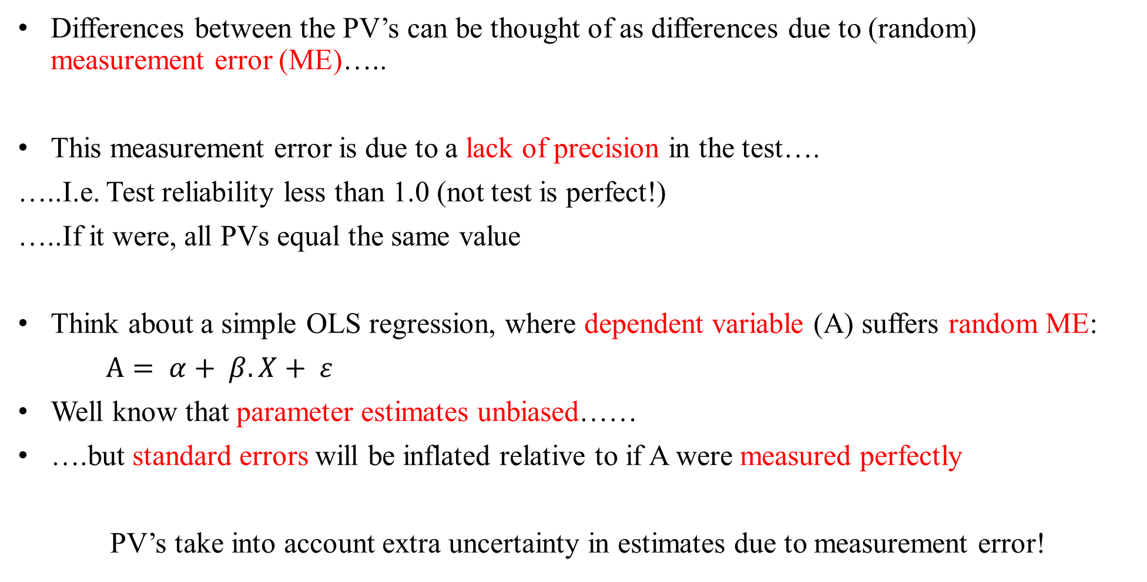
Intuition….
Differences between the PV’s can be thought of as differences due to (random) measurement error (ME)…..
This measurement error is due to a lack of precision in the test….
…..I.e. Test reliability less than 1.0 (not test is perfect!)
…..If it were, all PVs equal the same value
Think about a simple OLS regression, where dependent variable (A) suffers random ME:
$A= α+ β.X+ ε$
Well know that parameter estimates unbiased……
….but standard errors will be inflated relative to if A were measured perfectly
PV’s take into account extra uncertainty in estimates due to measurement error!
Notes:
See Rutkowski (2013:162). Bottom of page

Slide 32
In a nutshell….
Plausible values created using multiple imputation methodology….
Therefore, the appropriate use of PV’s essentially follows ‘Rubin’s Rules’ and the MI literature….
Estimate statistic of interest using each PV’s separately…..
…Then combine these estimates using what is essentially the same formula as for combing MI estimates for missing data
These estimates will reflect the uncertainty due to the ‘measurement error’ in the test score data
Notes:
See Rutkowski (2013:162). Bottom of page

Slide 33
Standard error now has two components….
Standard error
=
Sampling variance
+
Measurement error variance
Notes:
See Rutkowski (2013:162). Bottom of page

Slide 34
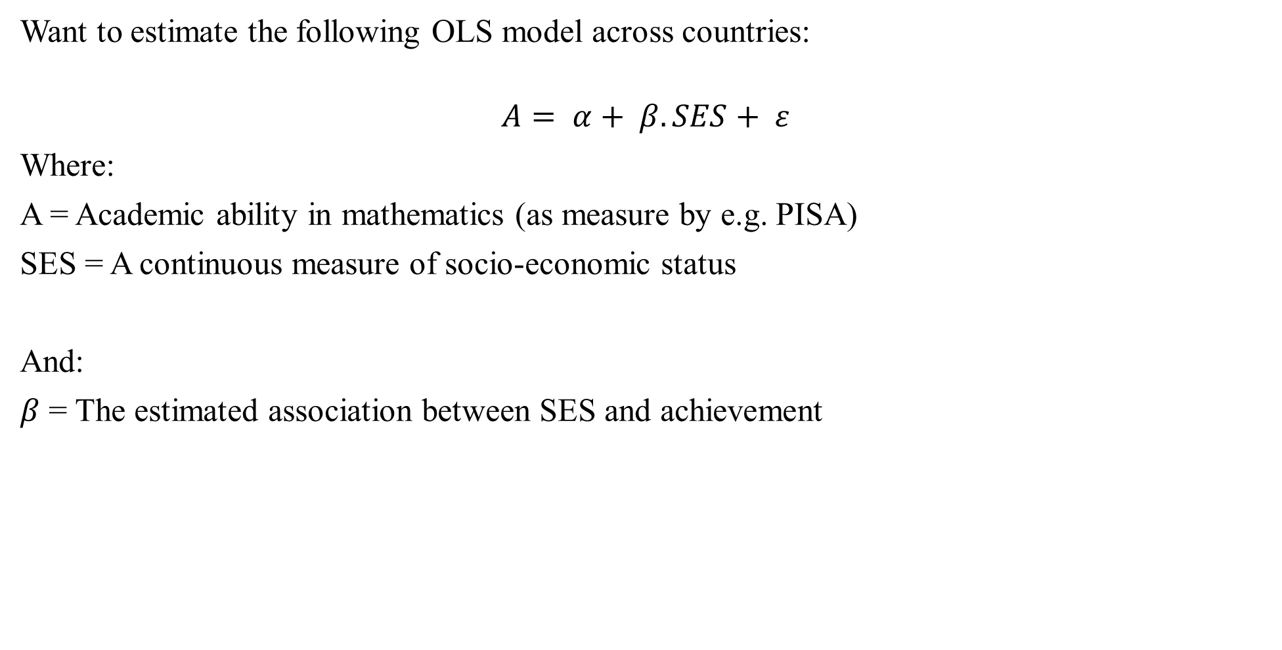

Illustrate through following example
Want to estimate the following OLS model across countries:
$$A= α+ β.SES+ ε$$
Where:
A = Academic ability in mathematics (as measure by e.g. PISA)
SES = A continuous measure of socio-economic status
And:
$β$ = The estimated association between SES and achievement
Following steps needed to obtain ‘correct’ point estimates and standard errors for $β$
Notes:
See Rutkowski (2013:162). Bottom of page

Slide 35
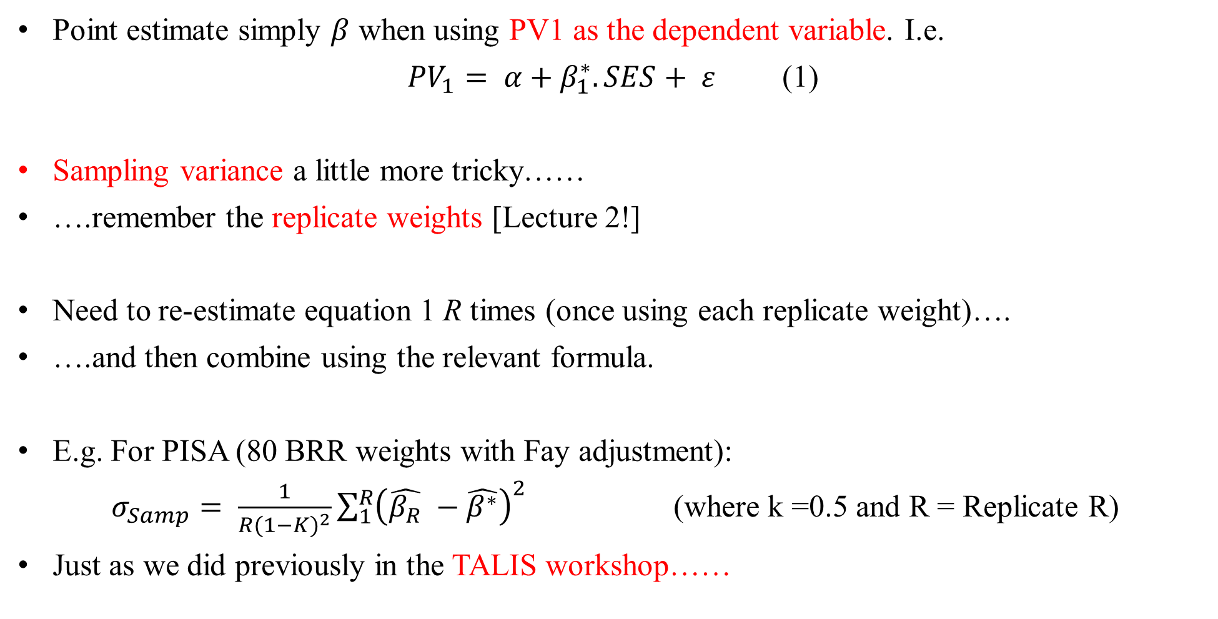
Step 1: Calculating the point estimate and sampling variance for PV1
Point estimate simply $β$ when using PV1 as the dependent variable. I.e.
${PV}_{1}= α+β_{1}^{∗}.SES+ ε$ (1)
Sampling variance a little more tricky……
….remember the replicate weights [Lecture 2!]
Need to re-estimate equation 1 R times (once using each replicate weight)….
….and then combine using the relevant formula.
E.g. For PISA (80 BRR weights with Fay adjustment):
$σ_{Samp}= \frac{1}{{R(1−K)}^{2}}\sum_{1}^{R}{{\left(\hat{β_{R}} −\hat{β^{∗}}\right)}^{2}}$ (where k =0.5 and R = Replicate R)
Just as we did previously in the TALIS workshop……
Notes:
See Rutkowski (2013:162). Bottom of page

Slide 36
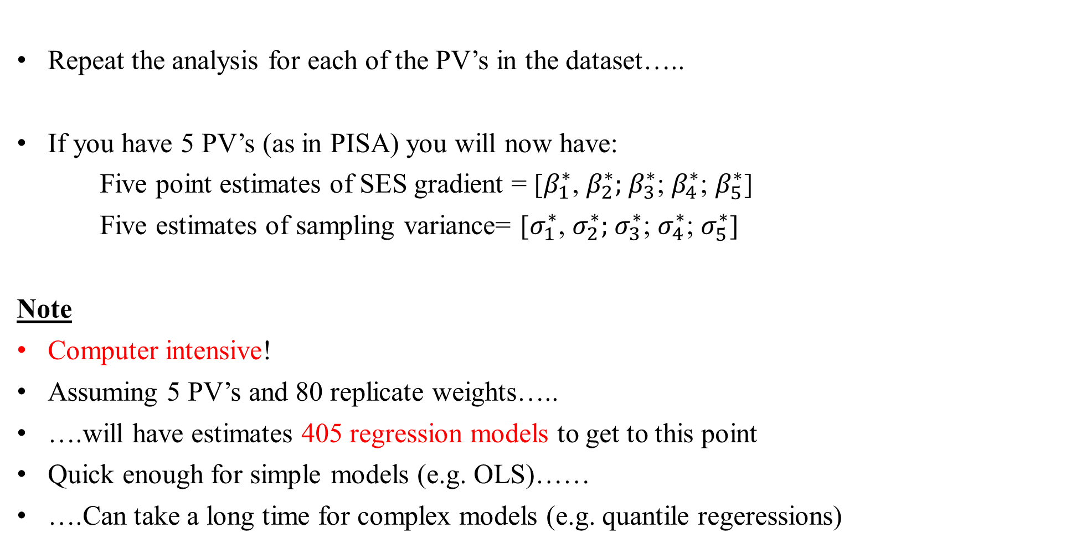
Step 2: Repeat step 1 for each PV…..
Repeat the analysis for each of the PV’s in the dataset…..
If you have 5 PV’s (as in PISA) you will now have:
Five point estimates of SES gradient = [$β_{1}^{∗}$, $β_{2}^{∗};$ $β_{3}^{∗}$; $β_{4}^{∗}$; $β_{5}^{∗}$]
Five estimates of sampling variance= [$σ_{1}^{∗}$, $σ_{2}^{∗};$ $σ_{3}^{∗}$; $σ_{4}^{∗}$; $σ_{5}^{∗}$]
Note
Computer intensive!
Assuming 5 PV’s and 80 replicate weights…..
….will have estimates 405 regression models to get to this point
Quick enough for simple models (e.g. OLS)……
….Can take a long time for complex models (e.g. quantile regeressions)
Notes:
NOTE: 80 replicates * 5 PV’s = 400. Plus the additional 5 regressions where you use the main student weight to get the point estimate for each PV

Slide 37
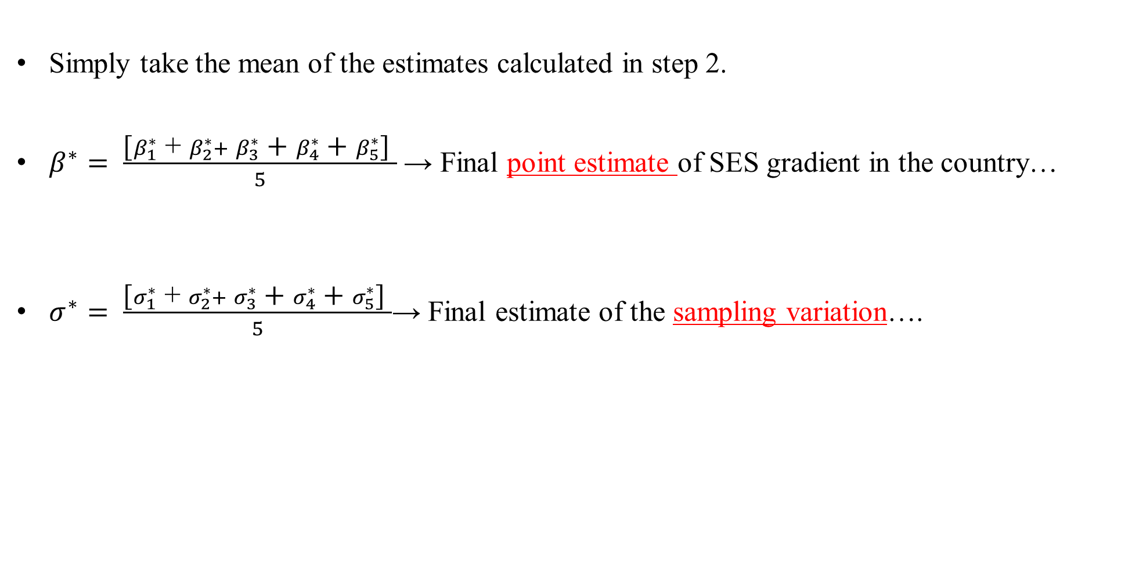
Step 3: Obtain ‘pooled’ estimate of $β_{}^{∗}$ and sampling variance
Simply take the mean of the estimates calculated in step 2.
$β^{∗}= \frac{\text{[}β_{1}^{∗} \text{+} β_{2}^{∗}+ β_{3}^{∗} \text{+} β_{4}^{∗} \text{+} β_{5}^{∗}\text{] }}{5}$ → Final point estimate of SES gradient in the country…
$σ^{∗}= \frac{\text{[}σ_{1}^{∗}\text{ + }σ_{2}^{∗}+ σ_{3}^{∗}\text{ +} σ_{4}^{∗}\text{ +} σ_{5}^{∗}\text{] }}{5}$→ Final estimate of the sampling variation….
Notes:
NOTE: 80 replicates * 5 PV’s = 400. Plus the additional 5 regressions where you use the main student weight to get the point estimate for each PV

Slide 38
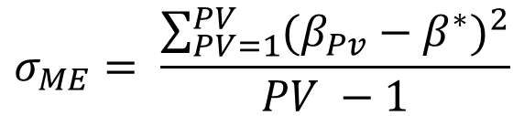
Step 4: Calculate the measurement error (imputation) variance
$$σ_{ME}= \frac{\sum_{PV=1}^{PV}{{(β_{Pv}−β^{∗})}^{2}}}{PV −1}$$
Calculate the difference between β1 (estimate using PV1) and β* (pooled estimate). Then square it….
Repeat for PV2, PV3, PV4 and PV5 (assuming that there are five PV’s)
Add these values together.
Divided this value by the number of PV – 1 ( i.e. divide by 4, if there are five PV’s)
Gives you uncertainty due to measurement error….
(This is the whole point of having five PV’s)
Notes:
NOTE: 80 replicates * 5 PV’s = 400. Plus the additional 5 regressions where you use the main student weight to get the point estimate for each PV

Slide 39
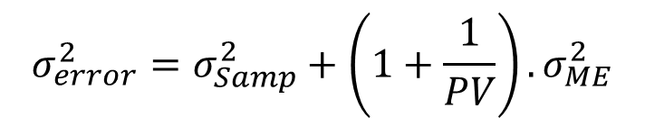
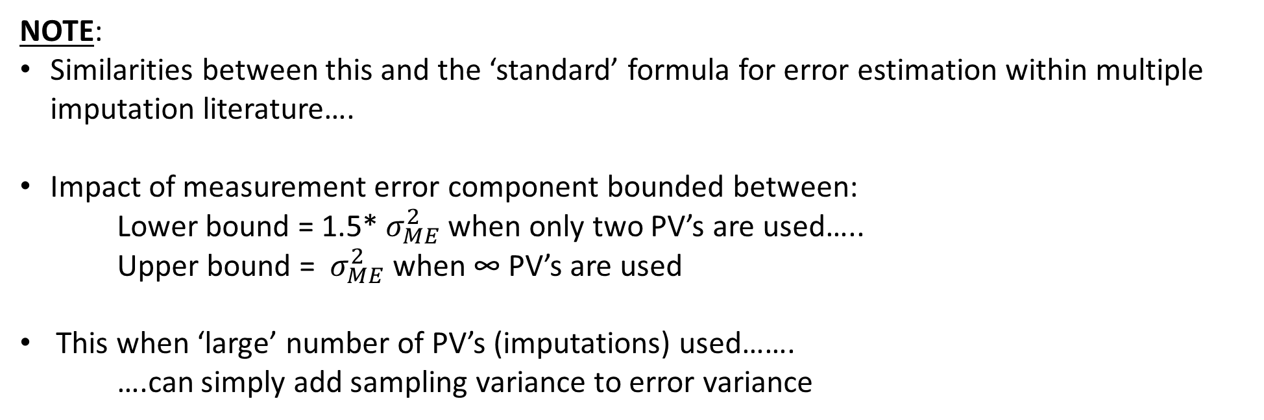
Step 5: Combine the sampling variance and measurement error variance
Sampling variance and measurement error variance are combined using the following formula…..
$$σ_{error}^{2}=σ_{Samp}^{2}+\left(1+\frac{1}{PV}\right).σ_{ME}^{2}$$
NOTE:
Similarities between this and the ‘standard’ formula for error estimation within multiple imputation literature….
Impact of measurement error component bounded between:
Lower bound = 1.5* $σ_{ME}^{2}$ when only two PV’s are used…..
Upper bound = $σ_{ME}^{2}$ when ∞ PV’s are used
This when ‘large’ number of PV’s (imputations) used…….
….can simply add sampling variance to error variance
Notes:
NOTE: 80 replicates * 5 PV’s = 400. Plus the additional 5 regressions where you use the main student weight to get the point estimate for each PV

Slide 40
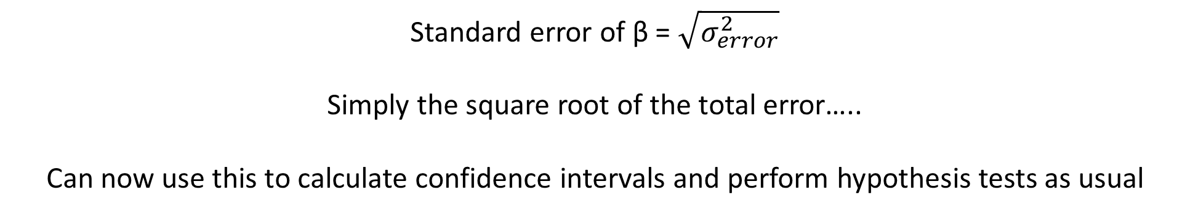
Step 6: Calculate the standard error….
Standard error of β = $\sqrt{σ_{error}^{2}}$
Simply the square root of the total error…..
Can now use this to calculate confidence intervals and perform hypothesis tests as usual
Notes:
NOTE: 80 replicates * 5 PV’s = 400. Plus the additional 5 regressions where you use the main student weight to get the point estimate for each PV

Slide 41
Numerical example
Estimate of mean PISA score for Germany in 2003
Notes:
Taken from PISA User Guide 2003……

Slide 42
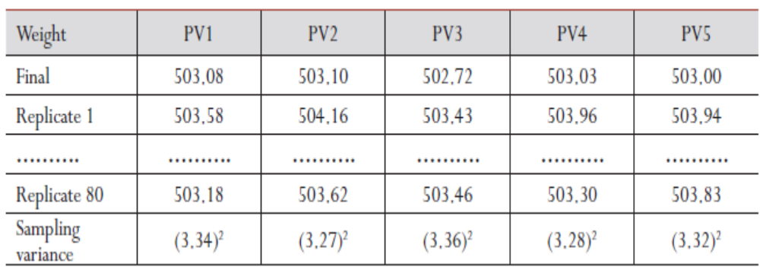
Steps 1 and 2: Calculate point estimate and sampling variance for each replicate
5 different point estimates
80 replicate estimates using each PV
5 sampling variance estimates
Notes:
See Rutkowski (2013:162). Bottom of page

Slide 43
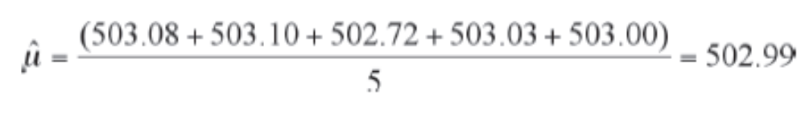
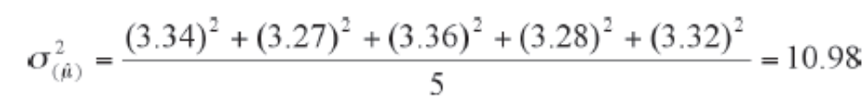
Step 3: Obtain ‘pooled’ point estimate and sampling variation…
This is the final estimate of the mean score for Germany…..
….everything else is about the standard error
Estimate of the sampling variance…..
… does not include the ME variance
Notes:
NOTE: 80 replicates * 5 PV’s = 400. Plus the additional 5 regressions where you use the main student weight to get the point estimate for each PV

Slide 44
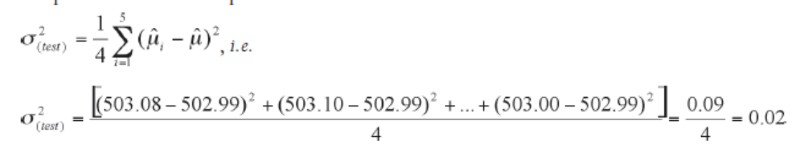
Step 4: Calculate the measurement error (imputation) variance
Final estimate of mean for Germany
Number of PV – 1 = 4
Notes:
NOTE: 80 replicates * 5 PV’s = 400. Plus the additional 5 regressions where you use the main student weight to get the point estimate for each PV

Slide 45
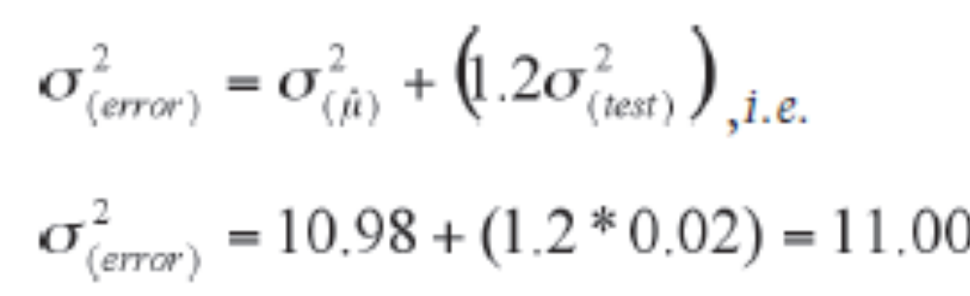
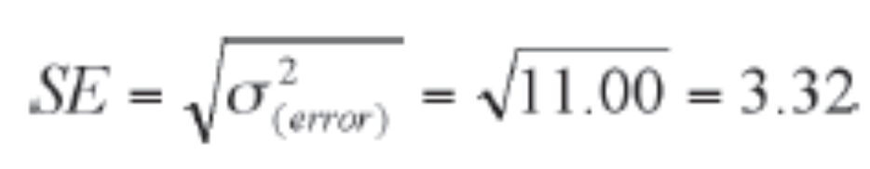
Step 5: Combine the sampling variance and measurement error variance
Sampling variance and measurement error variance are combined using the following formula…..
$$σ_{error}^{2}=σ_{Samp}^{2}+\left(1+\frac{1}{PV}\right).σ_{ME}^{2}$$
Step 6: Calculate standard error
Notes:
NOTE: 80 replicates * 5 PV’s = 400. Plus the additional 5 regressions where you use the main student weight to get the point estimate for each PV

Slide 46
Note: Tiny role ME actually plays here…..
Standard error excluding ME component = 3.3136
Standard error including ME component = 3.3166
→ Including the ME component has increased the SE by less than 0.1%.......
→ My experience = Including ME component makes very little substantive difference to PISA results….
…. To the point I believe it is largely ignorable!
Note
→ Doing your analysis using just one plausible value will actually give you:
- Unbiased point estimate of statistic of interest
- Unbiased estimate of sampling variance
→ What you miss out on is the imputation variance……
- But probably bigger fish to fry!?
- Isn’t life too short anyway!?
Notes:
See PISA 2003 User Guide page 109……..

Slide 47
PV’s as independent variables…..
Notes:
See Rutkowski (2013:162). Bottom of page

Slide 48
PV as independent variables
Thus far, have implicitly assumed that PISA scores are the outcome of interest……
….but we may want to use PV’s as a covariate in our study
Official line on how your analysis should proceed
There is a lot less discussion about this issue!
Implicitly assumed that same logic / methodology to be used……
…I.E. Estimate model several times using one PV each time and then average the results
But I am not sure this logic holds……

Slide 49
Problem with PV as independent variable....
As noted previously, recognised that the PV’s contain (random) measurement error….
When PV’s are the dependent/outcome variable, this will only impact upon standard error / efficiency of estimation…..
…. Hence why ME only contributions to standard error
But same logic does not hold true with classic measurement error in covariate…..
Leads to downward bias in point estimate (attenuation bias)…..
…. Will also lead to bias point estimates for all other variables included in the model
Not clear if / how PV’s can be used to overcome this problem

Slide 50
Example: SES and university expectations in Australia
Want to examine relationship between SES and expectations of going to university…..
….both before and after controlling for differences in reading ability
Two approaches
Option A: Estimate model 5 times, once use each PV, and average coefficient estimates.
Option B: Included all five PV in a single model.
Logic - Bollinger and Minier (2012).
Best way to control for unobserved latent factor is to include all available proxies….
Prediction
SES parameter estimate under option A will be higher than under option B
Why?
Option A will only partially control for confounding effect of reading ability (because of ME)
Option B will more fully control (better account of ME)……
Notes:
See Bollinger and Minier (2012): http://gatton.uky.edu/faculty/minier/bollingerminierAug12.pdf and http://www.econ.uiuc.edu/~roger/seminar/lubotsky.pdf

Slide 51
Results
Interpretation
Percentage point change in probability of expecting to go to university for a one standard deviation increases in socio-economic status (ESCS index)……
As predicted
SES estimate higher under option A (9.6 percentage points)……
….than under option B (8.9 percentage points)
Which estimate do you prefer?
My intuition tell me option B is preferable…
....accounts more fully for confounding effect of ME
 | Option A | Option B
Model 1 | 9.7 | -
Model 2 | 9.6 | -
Model 3 | 9.6 | -
Model 4 | 9.5 | -
Model 5 | 9.4 | -
Final result | 9.6 | 8.9
Notes:
See Bollinger and Minier (2012): http://gatton.uky.edu/faculty/minier/bollingerminierAug12.pdf and http://www.econ.uiuc.edu/~roger/seminar/lubotsky.pdf

Slide 52
Conclusions
Notes:
See Rutkowski (2013:162). Bottom of page

Slide 53
Conclusion
All the international assessments use a complex design….
Children’s responses to test questions converted into a scale using IRT…..
…. Different IRT models used in different assessments
MMS test design – children don’t answer all test questions!
Complex multiple imputation methodology used, based upon both responses to test questions and background variables, to create ‘plausible values’
Can’t report test scores back to test takers (too uncertain at individual level)…..
….but can produce group level statistics using the PV’s
Recommended methods should be applied (to replicate OECD / IEA results)….
Notes:
See Rutkowski (2013:162). Bottom of page

