Slide 1
Sample design and weights
Lecture 2

Slide 2
Aims
To understand the similarities and differences in the design of the key international surveys
To understand the response thresholds a country must meet for inclusion in the international reports.
To understand the design, purpose and appropriate use of the international assessment survey weights.
Introduce students to the use of ‘replication weights’ as a method for appropriately handling complex survey designs.
Gain experience of the application of such weights using the TALIS 2013 dataset.

Slide 3
How are the large scale international studies designed?

Slide 4
Step 1: Define the target population
PISA international target population
Children between 15 years 3 months and 16 years 2 months at the start of the assessment period (typically April)
Enrolled in an educational institution (home school or not-in-school excluded)
National exclusions
In PISA, a maximum of 5 percent of the international target population
Can either be whole school exclusions (e.g. geographical accessibility)
Or within school exclusion (e.g. severe disability)
This informs the sampling frame for the final selected sample
Notes:
Not in school = Note this group could be important in some less developed countries….

Slide 5
Exclusion rates for selected PISA countries
 | School exclusion % | Student exclusion % | Total exclusion %
Canada | 0.7 | 5.7 | 6.4
Norway | 1.2 | 5.0 | 6.2
United Kingdom | 2.7 | 2.9 | 5.6
Australia | 2.0 | 2.1 | 4.1
Russia | 1.4 | 1.0 | 2.4
Japan | 2.2 | 0.0 | 2.2
Germany | 1.4 | 0.2 | 1.6
Shanghai-China | 1.4 | 0.1 | 1.5
Chile | 1.1 | 0.2 | 1.3
The UK has excluded more pupils from its target population than Shanghai…..

Slide 6
Step 2: Stratify the sample of schools
School sampling frame = A list of schools
This frame is then ‘stratified’ (ordered) by selected variables:
  Schools first divided into separate groups based upon e.g. location / school type (explicit stratification)
  Schools then ordered within these explicit strata by some other variable e.g. school performance (implicit stratification)
Why do this?
  Improves efficiency of sample design (smaller standard errors)
  Ensures adequate representation of specific groups
  Different sample designs (e.g. unequal allocation) can be used across explicit strata
Notes:
See page 71 of http://www.oecd.org/pisa/pisaproducts/PISA%202012%20Technical%20Report_Chapter%204.pdf

Slide 7
Step 3: Selection of schools
All international education studies typically use a two-stage design:
- Stage 1 = Schools randomly selected from frame with PPS
- Stage 2 = Pupils / teachers / classes randomly chosen from within each school
Implication = Clustered sample design. Will inflate standard errors relative to a SRS.
Random selection of schools conducted by the international consortium (not countries themselves).
Ensures quality of the sample.
- Difficult to pick a ‘dodgy’ / unrepresentative sample
Minimum number of schools per country (PISA = 150).
  - Implication → Some small countries (e.g. Iceland) PISA essentially a school-level census.
Notes:
See page 71 of http://www.oecd.org/pisa/pisaproducts/PISA%202012%20Technical%20Report_Chapter%204.pdf

Slide 8
Step 4: Selection of respondents
Once schools chosen, respondents must be selected.
Important differences between the various international studies:
- PISA = Randomly select ≈35 15 year olds within each school (SRS within school)
-TIMSS / PIRLS = Randomly selected one class within each school
- TALIS = Randomly select at least 20 teachers within each school
- PIAAC = Randomly select one adult from each sampled household
Countries usually perform the within school sampling themselves, using the international consortiums ‘KeyQuest’ software.
Minimum pupil sample size required. (PISA = 4,500 children).
Notes:
See page 71 of http://www.oecd.org/pisa/pisaproducts/PISA%202012%20Technical%20Report_Chapter%204.pdf

Slide 9
Non-response

Slide 10
Non-response
Problems caused by non-response
- Bias in population estimates
- Reduces statistical power (larger standard errors)
To limit impact, international surveys have minimum response rate criteria
PISA = 85% of initially selected schools. 80% of pupils within schools.
TALIS = 75% of initially selected schools. 75% of teachers within schools.
TIMSS = 85% school, 95% classroom and 85% pupil response.
Logic
Two factors influence non-response bias:
a. Amount of missing data
b. Selectivity of missing data
If (a) is ‘small’ (as countries are forced to meet the above criteria) then bias will be limited.
Notes:
See page 71 of http://www.oecd.org/pisa/pisaproducts/PISA%202012%20Technical%20Report_Chapter%204.pdf

Slide 11
….but these ‘ideal’ criteria sometimes not met
Source: TALIS 2013
School response rate required = 75%.
8 out of 34 countries did not meet this criteria
Notes:
See page 71 of http://www.oecd.org/pisa/pisaproducts/PISA%202012%20Technical%20Report_Chapter%204.pdf

Slide 12
Replacement schools
If school response falls below threshold then ‘replacement schools’ are included in the calculation of the response rates.
The non-responding school is ‘replaced’ with the school that immediately follows it within the sampling frame (which has been explicitly and implicitly stratified).
Essentially means non-responding school replaced with one that is ‘similar’……
….. with ‘similar’ defined using the stratification variables
Implication → Use of replacement schools to reduce non-response bias only as good as the variables used when stratifying the sample.
PISA → Two replacement schools chosen for each initially sample school
Notes:
See page 71 of http://www.oecd.org/pisa/pisaproducts/PISA%202012%20Technical%20Report_Chapter%204.pdf

Slide 13
Example of how sampling frame and selected schools looks….
School ID | Sample
1 | Main sample
2 | Not selected
3 | Replacement 2
4 | Not selected
5 | Replacement 1
6 | Main sample
7 | Not selected
8 | Main sample
Notes:
See page 71 of http://www.oecd.org/pisa/pisaproducts/PISA%202012%20Technical%20Report_Chapter%204.pdf

Slide 14
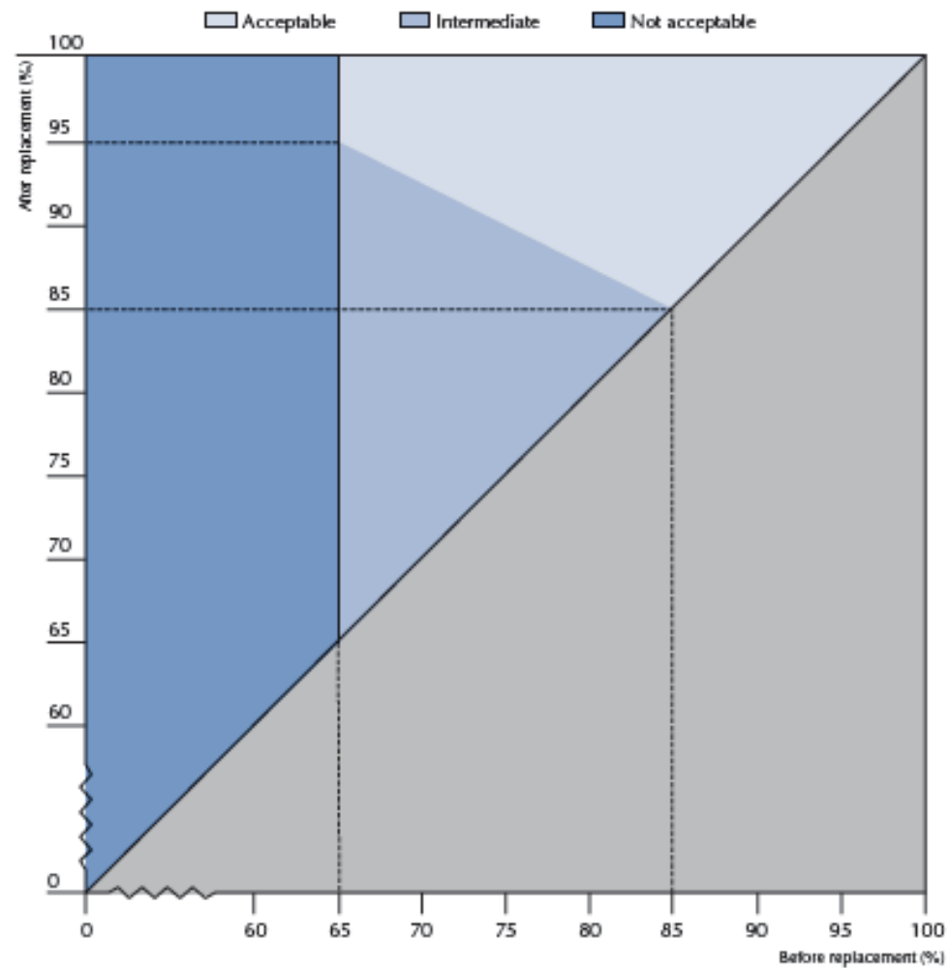
Response criteria in PISA (including replacement schools)
Rules when including replacement schools:
65% of initially sampled schools must take part (rather than 85%).
Replacement schools can then be included. But the ‘after replacement’ response rate becomes higher.
Example
65% of initially sampled schools recruited, then after replacement response required = 95%.
80% of initially sampled schools recruited, then after replacement response required ≈ 87%.
Country may still be included in international report even if they do not meet this revised criteria
‘Intermediate zone’ = Country has to provide analysis of non-response to be judged by PISA referee (criteria unknown).
Example = USA and England / Wales / NI in PISA 2009.
Notes:
See page 71 of http://www.oecd.org/pisa/pisaproducts/PISA%202012%20Technical%20Report_Chapter%204.pdf

Slide 15
What do countries in the ‘intermediate’ zone provide?
Example: US in 2009
Compared participating and non-participating schools in observable characteristics
Only those available on the sampling frame:
- School type; region; school size; ethnic composition; Free School Meals (FSM)
‘Bias’ based upon chi-square / t-test of difference between participants / non-participants
Found difference based upon FSM – but still included in the international report
Limitations of the bias analysis provided
Considers bias at school level only (not pupil level)
Small school level sample size (not enough power to detect important differences)
Very few characteristics considered
Notes:
See page 47 of http://nces.ed.gov/pubs2011/2011004.pdf

Slide 16
TALIS 2013 after replacement schools included
Source: TALIS 2013
School response rate required = 75%.
Only the USA did not meet this criteria (and hence excluded)
Notes:
See page 71 of http://www.oecd.org/pisa/pisaproducts/PISA%202012%20Technical%20Report_Chapter%204.pdf

Slide 17
Implications of missing response target
Kicked out of the international report (PISA/TALIS)
  England/Wales/NI in PISA 2003
  Netherlands TALIS 2008
  United States TALIS 2013
Figures reported at bottom of table instead(TIMSS/PIRLS)
  England in TIMSS 8th grade 2003
Exclusion from PISA 2003 national report described by Simon Briscoe, Economics Editor at The Financial Times, as among the ‘Top 20’ recent threats to public confidence in official statistics in the UK.
Being excluded still causing problems in UK politicians almost a decade later……

Slide 18
Response rates in England/Wales/NI over time…
Since being kicked out of PISA 2003, response rates in England/Wales/NI have improved……
….and not only in PISA.
However, this then has important implications for comparisons in test scores over time……

Slide 19
Respondent weights

Slide 20
Why are weights needed?
Complex design of the survey
- Over / under sampling of certain school / pupil types
- (e.g. over-sampling of indigenous children in Australia)
Non-response
- Despite use of replacement schools, certain ‘types’ of schools may be under- represented.
- Certain ‘types’ of pupils may be under-represented.
The PISA survey weights thus serve two purposes:
- Scale estimates from the sample to the national population
- Attempt to adjust for non-random non-response

Slide 21
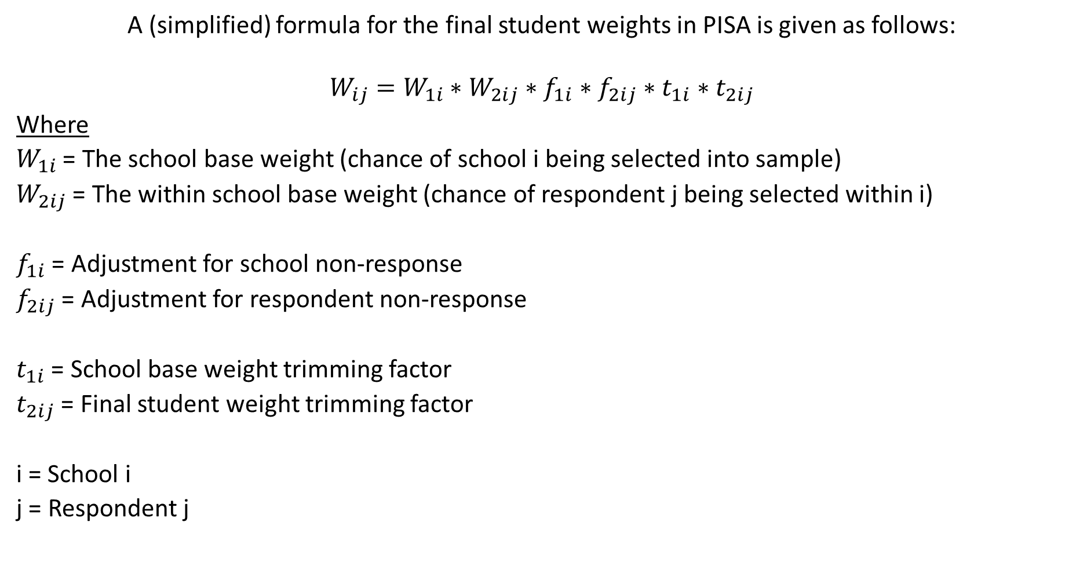
How are the final student weights defined?
A (simplified) formula for the final student weights in PISA is given as follows:
$$W_{ij}=W_{1i}∗W_{2ij}∗f_{1i}∗f_{2ij}∗t_{1i}∗t_{2ij}$$
Where
$W_{1i}$ = The school base weight (chance of school i being selected into sample)
$W_{2ij}$ = The within school base weight (chance of respondent j being selected within i)
$f_{1i}$ = Adjustment for school non-response
$f_{2ij}$ = Adjustment for respondent non-response
$t_{1i}$ = School base weight trimming factor
$t_{2ij}$ = Final student weight trimming factor
i = School i
j = Respondent j
Notes:
See PDF page 3 of http://www.oecd.org/pisa/pisaproducts/PISA%202012%20Technical%20Report_Chapter%208.pdf
Note I am ignoring fA1ij (the adjustment for countries only including pupils within the modal grade).

Slide 22
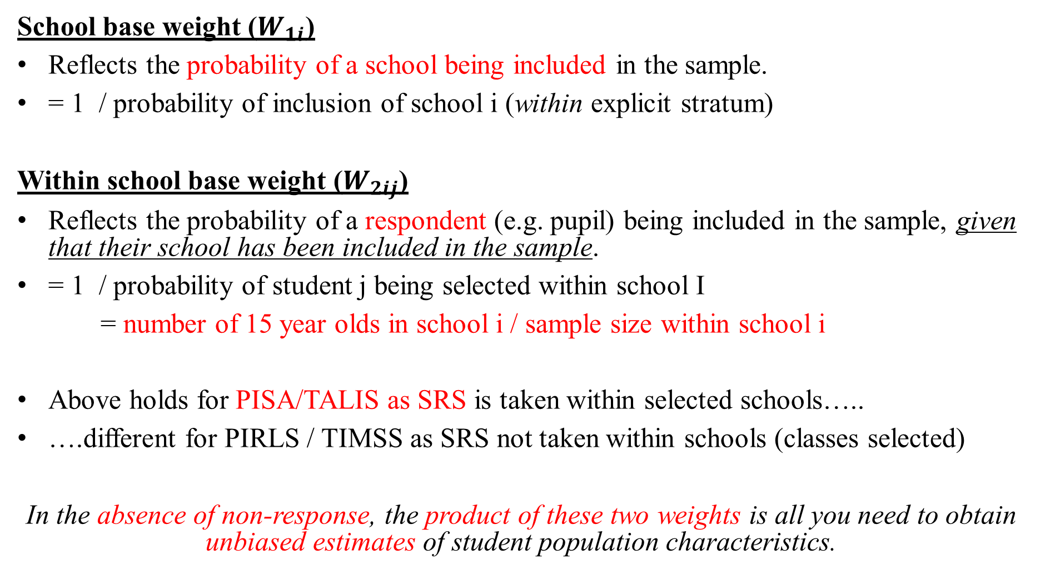
The base (design) weights (W)
School base weight ($W_{1i}$)
Reflects the probability of a school being included in the sample.
= 1 / probability of inclusion of school i (within explicit stratum)
Within school base weight ($W_{2ij}$)
Reflects the probability of a respondent (e.g. pupil) being included in the sample, given that their school has been included in the sample.
= 1 / probability of student j being selected within school I
= number of 15 year olds in school i / sample size within school i
Above holds for PISA/TALIS as SRS is taken within selected schools…..
….different for PIRLS / TIMSS as SRS not taken within schools (classes selected)
In the absence of non-response, the product of these two weights is all you need to obtain unbiased estimates of student population characteristics.
Notes:
See PDF page 3 of http://www.oecd.org/pisa/pisaproducts/PISA%202012%20Technical%20Report_Chapter%208.pdf
See oage 134-135 of Rutkowski, von Davier and Rutkowski (2013).
Note I am ignoring fA1ij (the adjustment for countries only including pupils within the modal grade).

Slide 23
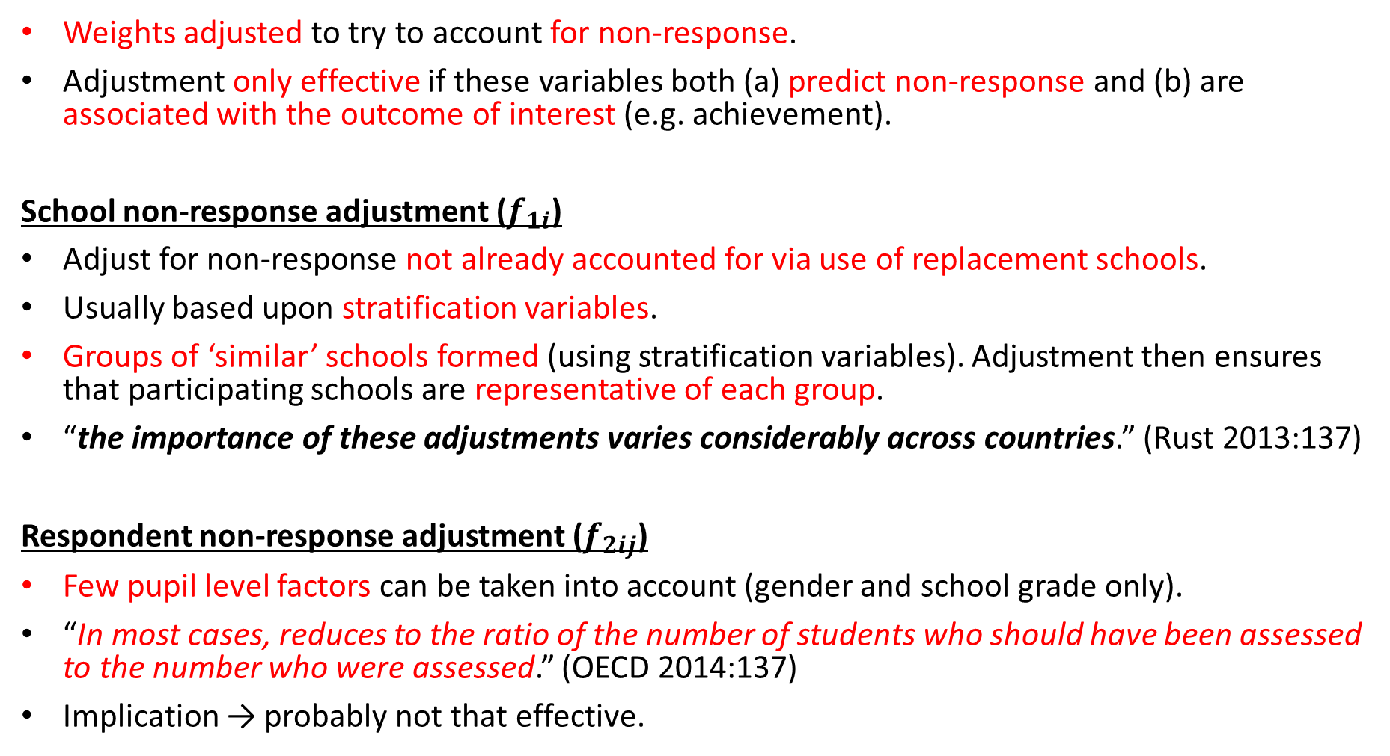
Non-response adjustments (f)
Weights adjusted to try to account for non-response.
Adjustment only effective if these variables both (a) predict non-response and (b) are associated with the outcome of interest (e.g. achievement).
School non-response adjustment ($f_{1i}$)
Adjust for non-response not already accounted for via use of replacement schools.
Usually based upon stratification variables.
Groups of ‘similar’ schools formed (using stratification variables). Adjustment then ensures that participating schools are representative of each group.
“the importance of these adjustments varies considerably across countries.” (Rust 2013:137)
Respondent non-response adjustment ($f_{2ij}$)
Few pupil level factors can be taken into account (gender and school grade only).
“In most cases, reduces to the ratio of the number of students who should have been assessed to the number who were assessed.” (OECD 2014:137)
Implication → probably not that effective.
Notes:
See page 137 of PISA 2012 technical report
Note I am ignoring fA1ij (the adjustment for countries only including pupils within the modal grade).

Slide 24
Trimming of the weights (t)
Motivation
→ Prevents a small number of schools / pupils having undue influence upon estimates due to being assigned a very large weight.
→ Very large weights for small number of pupils risks large standard errors and inappropriate representations of national estimates.
Strengths and limitations of trimming
  -ive = Can introduce small bias into estimates
  +ive = Greatly reduces standard errors
School trimming: Only applied where schools were much larger than anticipated from the sampling frame (3 times bigger)
Student weight trimming: Final student weight trimmed to four times the median weight within each explicit stratum.
PISA (2012): For most schools / pupils trimming factor = 1.0. Very little trimming needed.
Notes:
See PDF page 3 of http://www.oecd.org/pisa/pisaproducts/PISA%202012%20Technical%20Report_Chapter%208.pdf
Note I am ignoring fA1ij (the adjustment for countries only including pupils within the modal grade).

Slide 25
Implication…..
The student response weights should be applied throughout your analysis…..
…Only by applying these weights will you obtain valid population estimates that
- Account for differences in probability of selection
- Adjust (to a limited extent) for non-response
Stata
Use of the survey ‘svy’.
Specifying [pweight = <final respondent weight>] when conducting your analysis.
Remember
Also need to apply these weights when manipulating the data in certain ways…..
…. E.g. creating quartiles of a continuous variable when using ‘xtile’ command.
Notes:
See PDF page 3 of http://www.oecd.org/pisa/pisaproducts/PISA%202012%20Technical%20Report_Chapter%208.pdf
Note I am ignoring fA1ij (the adjustment for countries only including pupils within the modal grade).

Slide 26
Does applying the weight actually make a difference??
Example
PISA 2009 in UK
Applying weights
England drives UK figures
Wales little influence
Without weights
Wales (low performing outlier) has more influence on the UK figure…..
…disproportionate to what it should do (relative to its population size)
 | With weights |  |  | Without weights
 | Population size | % of total | Mean | Sample size | % of total | Mean
England | 570,080 | 83 | 493.0 | 4,081 | 34 | 495.0
Scotland | 54,884 | 8 | 499.0 | 2,631 | 22 | 499.0
Northern Ireland | 23,151 | 3 | 492.2 | 2,197 | 18 | 494.0
Wales | 35,264 | 5 | 472.4 | 3,270 | 27 | 473.0
Total (Whole UK) | 683,379 | 100 | 492.4 | 12,179 | 100 | 489.8

Slide 27
Example application: how many high achieving children are there in the UK?
Can also use the weights contained in PISA / TALIS etc in other interesting ways…
Sutton Trust → asked me to estimate the absolute number of high achieving children from non-high SES backgrounds there are in the UK (and how many of these are in low achieving schools).
PISA weights scale from sample up to population estimates. Can therefore use the PISA ‘total’ command to answer this question (along with standard error).
→‘High achieving’ = PISA level 5 in either maths or reading
→ Not high social class = Neither parent professional job
→ Not high parental education = Neither parent holds a degree
→ School performance = school average PISA maths quintile
Notes:
See PDF page 3 of http://www.oecd.org/pisa/pisaproducts/PISA%202012%20Technical%20Report_Chapter%208.pdf
Note I am ignoring fA1ij (the adjustment for countries only including pupils within the modal grade).

Slide 28
How many high achievers are there in the UK?
High achievers
N =90,460
Parents not Professionals
N = 29,800
Parents Professionals
N = 60,300
Missing data
N = 360
Parents’ with degree
N =8,350
Parents’ without degree
N = 20,870
Missing data
N = 570
School top quintile
N = 8,300
School Q2
N = 5,000
School Q3
N = 3,260
School Q4
N =2,525
School bottom quintile
N = 1,790
Notes:
See PDF page 3 of http://www.oecd.org/pisa/pisaproducts/PISA%202012%20Technical%20Report_Chapter%208.pdf
Note I am ignoring fA1ij (the adjustment for countries only including pupils within the modal grade).

Slide 29
Replication weights

Slide 30
Motivation
Large-scale international survey have a complex survey design.
Schools selected as the primary sampling unit. (I.E. Children ‘clustered’ within schools)
Violates assumption of independence of observations required to analyse the data as if collected under a simple random sample.
Standard errors will be underestimated unless this clustering is taken into account.
Stratification → Also influence SE’s. Need to be taken into account.
Notes:
See PDF page 3 of http://www.oecd.org/pisa/pisaproducts/PISA%202012%20Technical%20Report_Chapter%208.pdf
Note I am ignoring fA1ij (the adjustment for countries only including pupils within the modal grade).

Slide 31
Common methods for handling complex survey designs
Huber-White adjustments (Taylor linearization)
‘Adjust’ the standard errors to take into account clustering (and stratification) by making an appropriate adjustment to standard errors.
Implemented by using Stata ‘svy’ command:
    svyset SCHOOLID [pw = Weight] , strata(STRATUM)
    svy: regress PV1MATH GENDER
    Accounts for clustering, stratification and weighting.
2. Estimate a multi-level model
Pupil / teacher (fixed) characteristics at level 1. School random effect at level 2.
Standard errors account for clustering of children within schools
Stratification → How to also take this into account?
Weights → Appropriate application not straightforward
Notes:
See PDF page 3 of http://www.oecd.org/pisa/pisaproducts/PISA%202012%20Technical%20Report_Chapter%208.pdf
Note I am ignoring fA1ij (the adjustment for countries only including pupils within the modal grade).

Slide 32
Limitation of common approaches
Both methods require that a cluster variable (e.g. school ID) and a stratification variable is provided in the public use dataset.
Big issue for some countries. Concerns regarding confidentiality. Some schools / pupils become potentially identifiable.
Likely to be biggest issue in countries with very tight data security (e.g. Canada) or with small populations (e.g. Iceland) where essentially all schools sampled.
Major +ive of replication methods:
- Cluster and / or strata identifier does not have to be included
- All the information needed is provided via a set of weights instead…..
Notes:
See PDF page 3 of http://www.oecd.org/pisa/pisaproducts/PISA%202012%20Technical%20Report_Chapter%208.pdf
Note I am ignoring fA1ij (the adjustment for countries only including pupils within the modal grade).

Slide 33
The intuition behind replication methods
Example: Bootstrapping
Perhaps the most well-known (and widely applied) replication method
Use information from the empirical distribution of the data to make inferences about the population (e.g. to calculate standard errors)
NOTE: The international education datasets do not use bootstrapping, but other (similar) methods that are based upon a similar logic……
…..However, I am going to discuss bootstrapping in the next few slides to get across the broad intuition of the argument and how replicate weights work
Notes:
See PDF page 3 of http://www.oecd.org/pisa/pisaproducts/PISA%202012%20Technical%20Report_Chapter%208.pdf
Note I am ignoring fA1ij (the adjustment for countries only including pupils within the modal grade).

Slide 34
What is bootstrapping?
Say you have a sample of n = 5,000 observations that accurately represent the population of interest.
You calculate the statistic of interest (e.g. mean) from this sample.
From within your sample of 5,000 observations:
- Draw another sample of 5,000 (with replacement)
- Calculate statistic of interest (e.g. mean)
Repeat the above process ‘many’ times (m ‘bootstrap replications’)
NB: Sample with replacement → so BS sample not same as the original sample…..

Slide 35
What is bootstrapping?
Now have:
i. the mean from our sample
ii. a distribution of possible alternative means (based upon the BS re-samples).
Using (ii) we could draw a histogram of how much our estimate of the mean is likely to vary across alternative samples…..
….And we can also calculate the standard deviation
BS Standard Error
→ The standard deviation of the m bootstrap estimates.
→ Provides a remarkably good approximation to analytic SE
Notes:
See page 12 of http://www.stata.com/bookstore/updates/qreg12.pdf

Slide 36
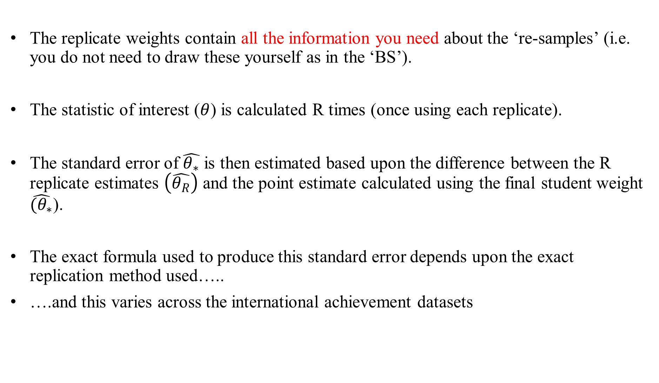
The replication weights provided in PISA etc work in a very similar way…..
The replicate weights contain all the information you need about the ‘re-samples’ (i.e. you do not need to draw these yourself as in the ‘BS’).
The statistic of interest ($θ$) is calculated R times (once using each replicate).
The standard error of $\hat{θ_{∗}}$ is then estimated based upon the difference between the R replicate estimates $\left(\hat{θ_{R}}\right)$ and the point estimate calculated using the final student weight $\hat{(θ_{∗}}$).
The exact formula used to produce this standard error depends upon the exact replication method used…..
….and this varies across the international achievement datasets
Notes:
See PDF page 3 of http://www.oecd.org/pisa/pisaproducts/PISA%202012%20Technical%20Report_Chapter%208.pdf
Note I am ignoring fA1ij (the adjustment for countries only including pupils within the modal grade).

Slide 37
Which replication method does each survey use?
Survey | Method | Number of replicate weights provided
PISA | BRR | 80
TALIS | BRR | 100
PIAAC | JK1 (5 countries) or JK2 (20 countries) | 80
TIMSS | JK | 75
PIRLS | JK | 75
Result: Each survey contains a set of R replicate weights.
Implications
These weights, along with the final respondent weight, are all you need to accurately estimate standard errors / p-values.
It is only possible to replicate the official OECD / IEA figures by using these weights.
Notes:
See PDF page 3 of http://www.oecd.org/pisa/pisaproducts/PISA%202012%20Technical%20Report_Chapter%208.pdf
Note I am ignoring fA1ij (the adjustment for countries only including pupils within the modal grade).

Slide 38
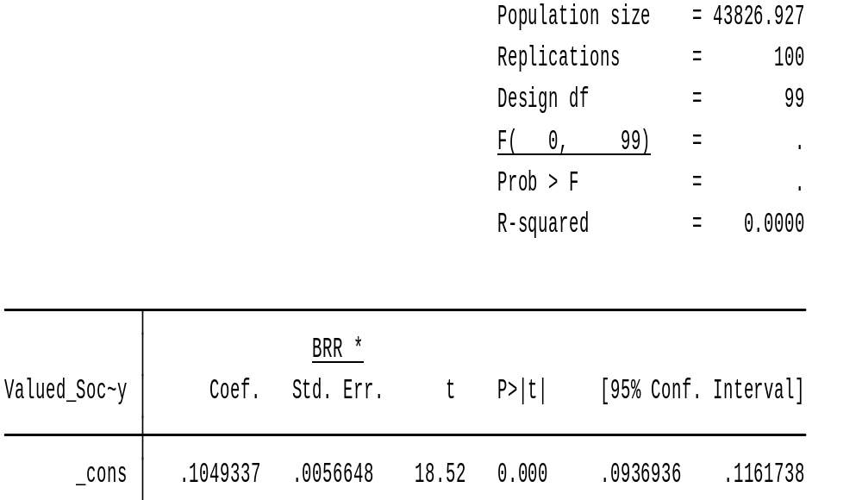
A brief note about degrees of freedom and critical values….
Number of degrees of freedom = Number of replicate weights – 1.
Impacts the critical value used in significance tests and CI’s.
Critical t-stat is 1.9842, rather than 1.96, when testing statistical significance at the five percent level.
Makes only a small difference – only important when right on the margins…….
Notes:
See PDF page 3 of http://www.oecd.org/pisa/pisaproducts/PISA%202012%20Technical%20Report_Chapter%208.pdf
Note I am ignoring fA1ij (the adjustment for countries only including pupils within the modal grade).

Slide 39
How do you use these replicate weights?
See computer workshop providing examples using TALIS 2013 data!
Notes:
See PDF page 3 of http://www.oecd.org/pisa/pisaproducts/PISA%202012%20Technical%20Report_Chapter%208.pdf
Note I am ignoring fA1ij (the adjustment for countries only including pupils within the modal grade).

Slide 40
Does this all matter? A comparison of results
Use TALIS 2013 dataset
Estimate the average age of teachers in a selection of participating countries
Produce estimates the following four ways:
1. No adjustment for complex survey design
2. Application of survey weights only
3. Application of survey weights + Huber-White adjustment to standard errors
4. Application of survey weights + BRR replicate weights
Compare the four sets of results to the figures given in the official OECD TALIS 2013 report.
Is there much difference between each of the above? (In this particular basic analysis)
Notes:
See PDF page 3 of http://www.oecd.org/pisa/pisaproducts/PISA%202012%20Technical%20Report_Chapter%208.pdf
Note I am ignoring fA1ij (the adjustment for countries only including pupils within the modal grade).

Slide 41
Does this all matter? A comparison of results
Country | SRS |  | Survey weights only |  | Survey weights + clustered SE |  | Survey + BRR weights |  | OECD official figures
 | Mean age | SE | Mean age | SE | Mean age | SE | Mean age | SE | Mean age | SE
Singapore | 36.039 | 0.182 | 36.013 | 0.186 | 36.013 | 0.215 | 36.013 | 0.177 | 36.013 | 0.177
England | 39.011 | 0.208 | 39.180 | 0.235 | 39.180 | 0.281 | 39.180 | 0.255 | 39.180 | 0.255
Chile | 41.225 | 0.292 | 41.336 | 0.310 | 41.336 | 0.449 | 41.336 | 0.453 | 41.336 | 0.453
Norway | 44.070 | 0.213 | 44.244 | 0.315 | 44.244 | 0.430 | 44.244 | 0.439 | 44.244 | 0.439
Spain | 45.515 | 0.148 | 45.566 | 0.166 | 45.566 | 0.268 | 45.566 | 0.236 | 45.566 | 0.236
Little impact upon the mean age estimate……
… but the standard error changes quite a bit (even between linearization and BRR estimates)
Notes:
See PDF page 3 of http://www.oecd.org/pisa/pisaproducts/PISA%202012%20Technical%20Report_Chapter%208.pdf
Note I am ignoring fA1ij (the adjustment for countries only including pupils within the modal grade).

Slide 42
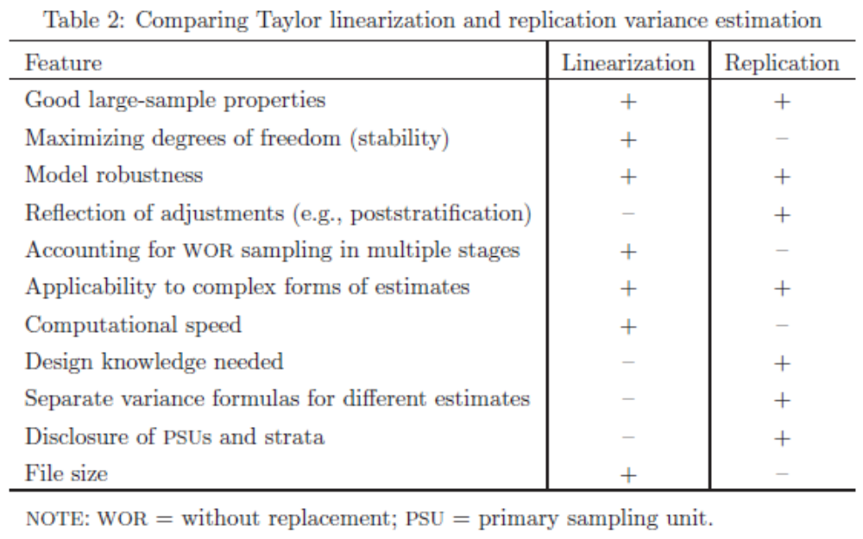
Strengths and weaknesses of variance estimation approaches
Notes:
See PDF page 3 of http://www.oecd.org/pisa/pisaproducts/PISA%202012%20Technical%20Report_Chapter%208.pdf
Note I am ignoring fA1ij (the adjustment for countries only including pupils within the modal grade).

Slide 43
Conclusions
All of the international datasets use a complex survey design.
‘Strict’ criteria for response rates – though there is also some flexibility……
…..But OECD will chuck your country out if response rate really is too low
Survey weights incorporate complex design, non-response adjustment and (very limited) trimming.
Only by applying these weights will your point estimates be ‘correct’ (i.e. consistent estimates of population values)
Replication methods are used to estimate standard errors (and associated significance tests and confidence intervals)….
….Only by using these weights will you be able to replicate the OECD / IEA figures
Notes:
See PDF page 3 of http://www.oecd.org/pisa/pisaproducts/PISA%202012%20Technical%20Report_Chapter%208.pdf
Note I am ignoring fA1ij (the adjustment for countries only including pupils within the modal grade).

